Slide 1
Detection and Noise in Spectroscopic Systems
Principles & Measurement

Slide 2
Photodiode Detectors
The most common photodiode detectors for the near-IR are silicon for the wavelength range of 0.2–1.1μm or InGaAs for 0.5–2.6μm.
Several parameters are commonly used to describe detector performance:
The responsivity, R, in units of AW⁻¹ defines the photodiode output current per watt of optical power falling on the detector.
The noise-equivalent-power (NEP) per unit bandwidth, in units of WHz^{−1/2}, defines the signal level for a signal-to-noise ratio of unity and is typically of the order of 10⁻¹² WHz^{−1/2}.
The detectivity, D, is the inverse of the NEP.
D* is defined by: where A_{d} is the detector area and is in units of cmHz^{1/2}W⁻¹.

Slide 3
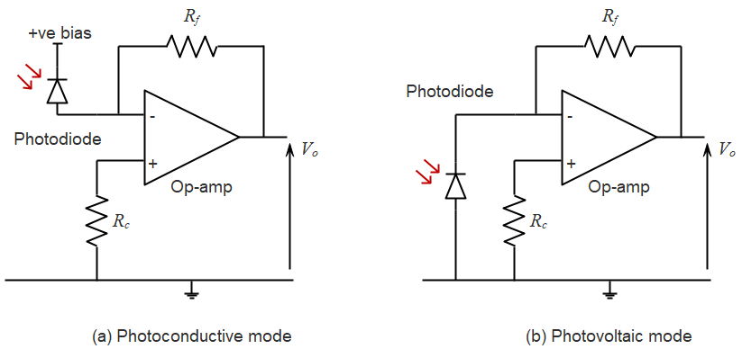
Transimpedance Photodiode Receivers
Zero bias photovoltaic mode has better noise characteristics due to the almost complete suppression of surface leakage currents. It also has a linear response due to the low load resistance on the photodiode from the virtual earth at the inverting input.
Biasing the photodiode in the photoconductive mode reduces the junction capacitance and hence improves the bandwidth.

Slide 4
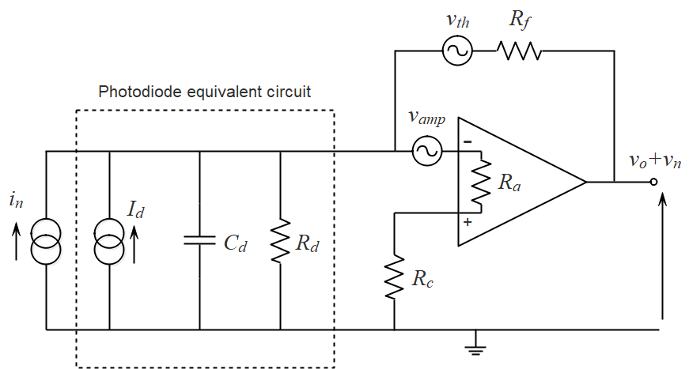
Equivalent Circuit Model of the Transimpedance Photodiode Receiver
Signal + noise
Signal
The noise sources in the transimpedance receiver consist of thermal noise, amplifier voltage and amplifier current noise, shot and dark current noise.

Slide 5
Noise in Transimpedance Receiver
Since each of the noise sources are mutually independent and uncorrelated, the total spectral density of the voltage noise on the output, v_{n}, is obtained by adding their mean square values:
Total noise on output
Thermal noise from R_{f}
Amplifier voltage noise on output
Amplifier current noise
Thermal noise of R_{p}
Shot and dark current noise
where:

Slide 6
Signal-to-Noise Ratio of the Transimpedance Receiver
If an optical power of P_{d} falls on the photodiode detector, the signal-to-noise ratio of the receiver over a frequency bandwidth B is:

Slide 7
Signal-to-Noise Ratio of 2nd Harmonic Measurements with WMS
The second harmonic signal is where a₂ is the Fourier coefficient of the second harmonic and A₀ is the line centre absorbance.
With a sufficiently large value of feedback resistor to reduce the thermal noise and with low amplifier and dark current noise (in the photovoltaic mode), the SNR is dominated by shot noise and is given by:
The Fourier coefficient of the second harmonic signal, a₂, has a maximum value of 0.343 at line centre for m=2.2. Hence with a typical value of 0.6A/W for the responsivity, the minimum detectable absorbance is ~2x10⁻⁹ W^{1/2}Hz^{−1/2} at a SNR of unity on the peak of the second harmonic, or a normalised noise-equivalent-absorption (NNEA) of ~2x10⁻⁹ cm⁻¹W^{1/2}Hz^{−1/2}

Slide 8
Lock-in Amplifier for Spectroscopic Measurements
The SNR can be greatly improved by reducing the bandwidth, B. This is usually done in WMS by feeding the receiver output to a lock-in amplifier (see next slide) with a reference at the modulation frequency to extract the desired harmonic. The lock-in may be in either analogue or in digital form.
The characteristics of the low-pass filter (time constant, filter order, roll-off, bandwidth and settling time) determine the noise bandwidth and set a limit in how fast the output can track changes in the input signal.
An appropriate time constant is selected by the user to take into account the trade-off between a long time constant for low noise and a short time constant for a fast response.
Typically, with WMS and line scanning at ~10Hz, a bandwidth of up to 1kHz (time constant of ~150μs) may be required to accurately reproduce the second harmonic signal shape for absorption line fitting.

Slide 9
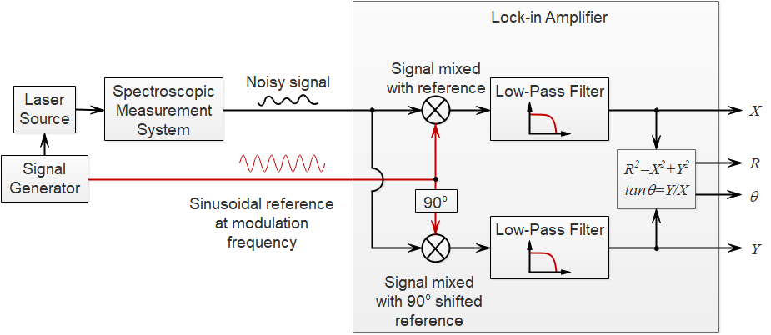
Schematic of a Lock-in Amplifier for Spectroscopic Measurements

Slide 10
Signal Averaging in Spectroscopic Measurements
Instead of improving the SNR by reducing the bandwidth, an alternative (and equivalent) method is that of signal averaging. Here, the data collected from repetitive scans over an absorption line is averaged over a specified time interval or number of scans, k.
Since the noise from each individual scan is uncorrelated, the noise signal adds according to: and the averaged noise over k scans with is:
Hence averaging reduces the noise by the factor which is equivalent to reducing the detection bandwidth by k for the non-averaged case.

Slide 11
The Allan Variance and Allan-Werle Plot for Spectroscopic Measurements
There is a limit in the sensitivity improvement that can be achieved through signal averaging since in addition to receiver (white) noise, there are a number of other noise sources (drift, jitter, etalon fringes, source noise or transmission fluctuations)
A useful way to identify the optimum averaging time is to determine, for a range of averaging (or integration) times,τ, the Allan Variance:
The Allan-Variance may then be plotted versus the integration time to give the characteristic Allan-Werle plot for a spectroscopic system, as illustrated in the next slide.

Slide 12
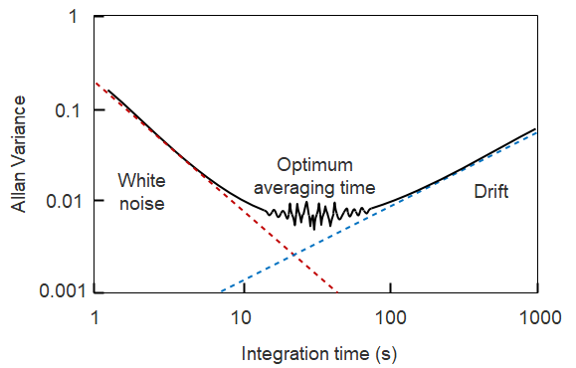
Allan-Werle Plot for a Spectroscopic Measurement System
The Allan-Werle plot illustrates how the sensitivity improves with integration time before reaching an optimum value after which system drift takes over

