Slide 1
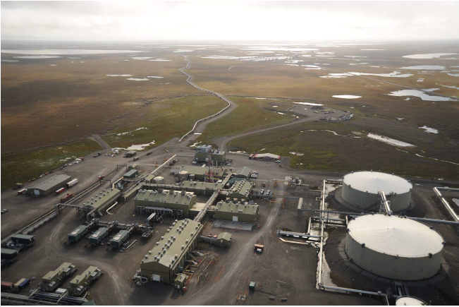
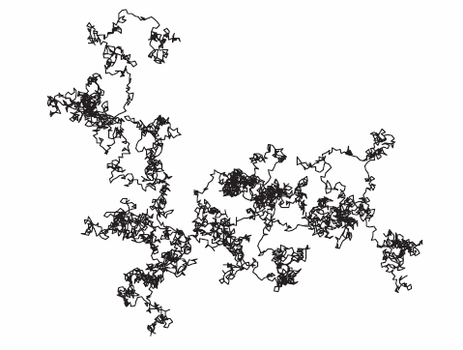
Figure 1.1 The Trans-Alaska Pipeline starts at Pump Station 1 in Prudhoe Bay. [Figure from www.clui.org/ludb/site/alaska-pipeline-
origin.]
Figure 2.1 Trajectory of a Brownian Particle.

Slide 2
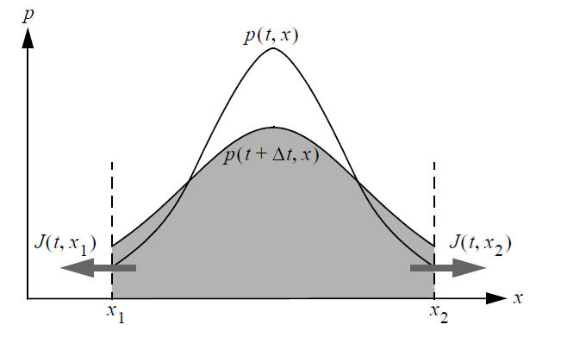
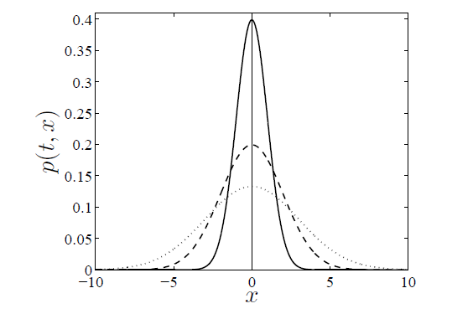

Slide 3
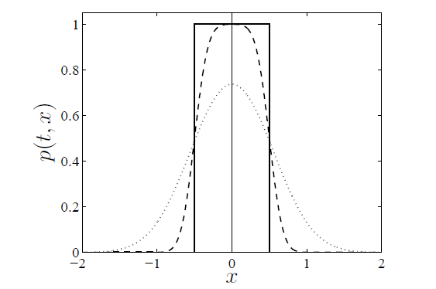
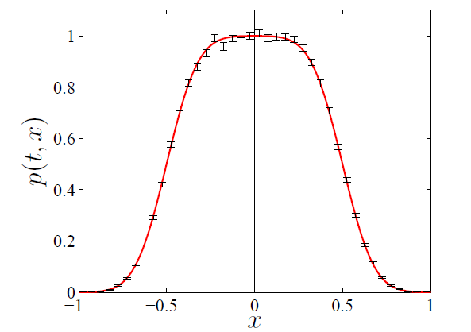

Slide 4
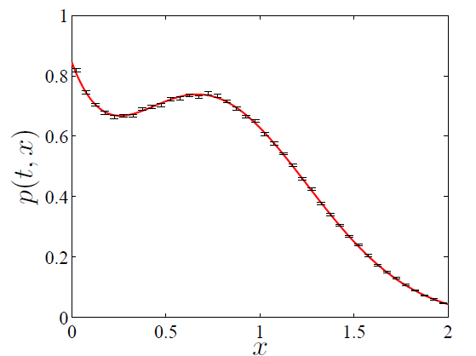
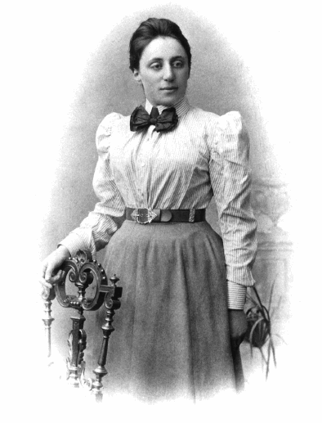
Figure 4.1 Emmy Noether, 1882-1935.

Slide 5
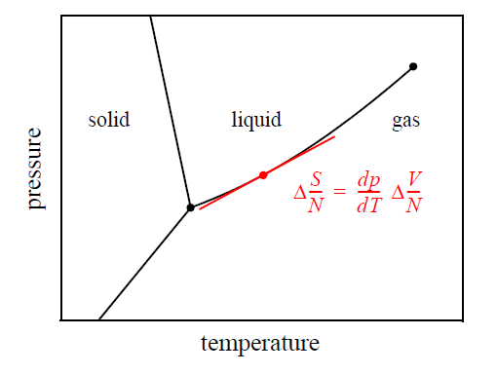
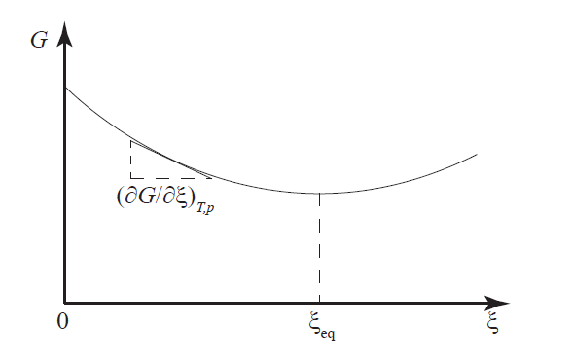
Figure 4.2 Illustration of the relevance of the Clapeyron equation.

Slide 6
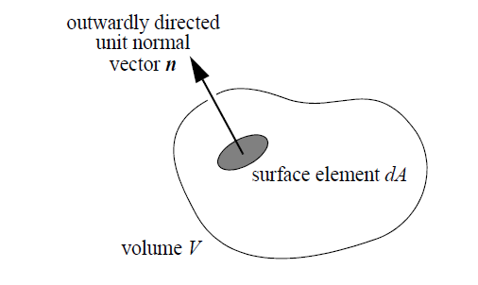
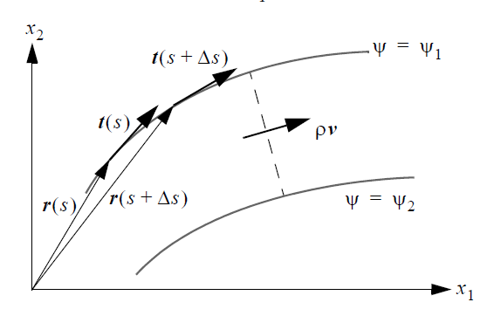
Figure 5.1 Arbitrary volume, fixed in space, over which mass, momentum, and energy balances are made.
Figure 5.2 Streamline for a two-dimensional flow in the 1-2 plane showing unit tangent vector t at position r. Also shown is a second streamline connected to the first one by a dashed line at arbitrary positions.

Slide 7
Figure 5.4 James Clerk Maxwell, 1831-1879.

Slide 8
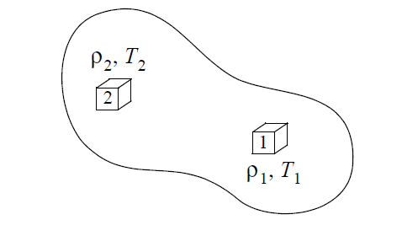
Figure 6.1 A global nonequilibrium system with local equilibrium subsystems 1 and 2.
Figure 6.2 Lars Onsager, 1903-1976.

Slide 9
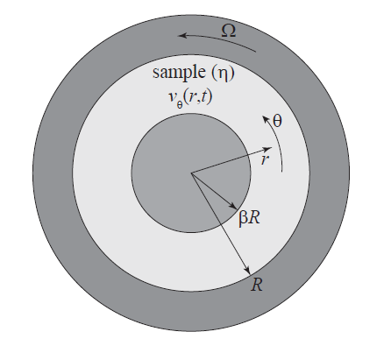
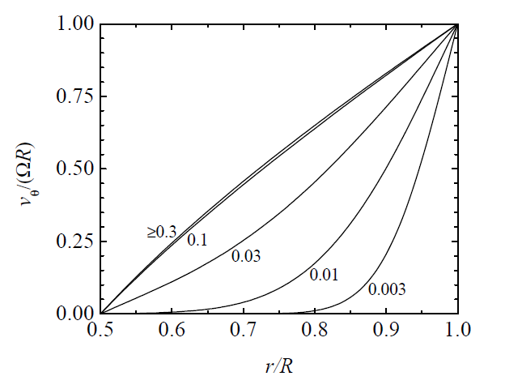

Slide 10
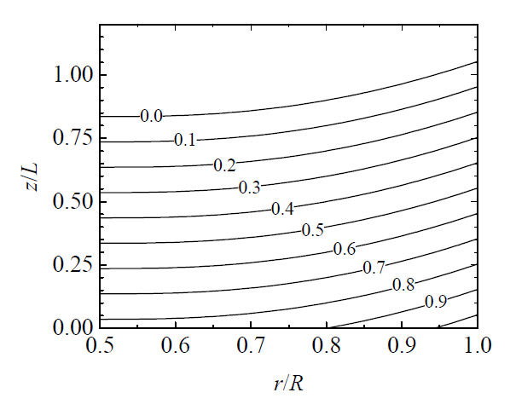
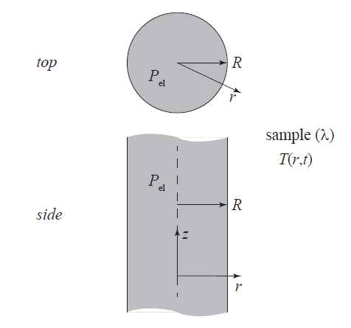

Slide 11
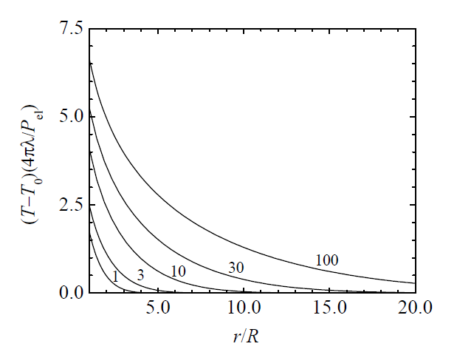
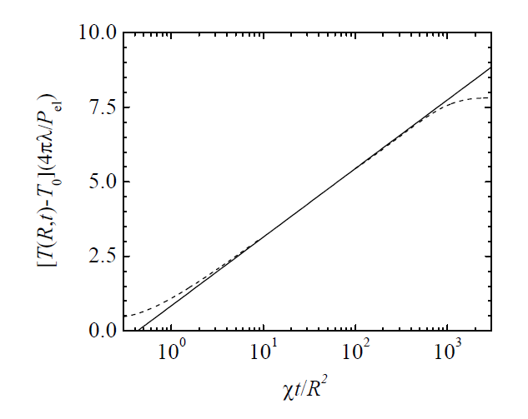
Figure 7.6 Temperature rise of wire in THW technique given by (7.25). Dashed curves at small and large times indicate non-idealities associated with finite heat capacity of the wire and the finite sample radius.

Slide 12
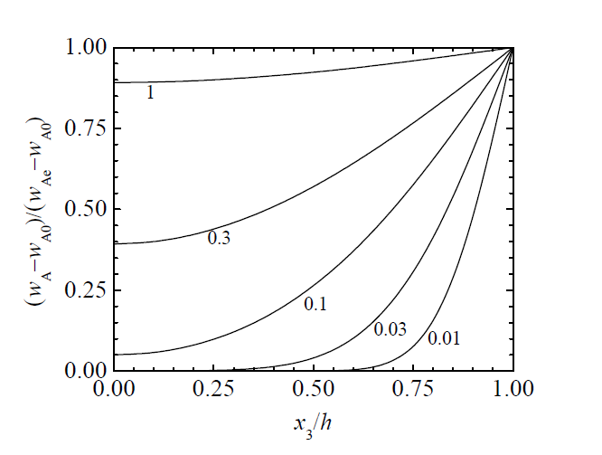
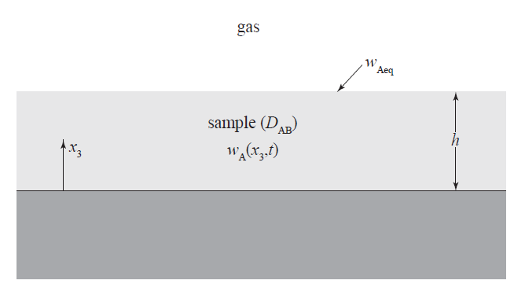

Slide 13
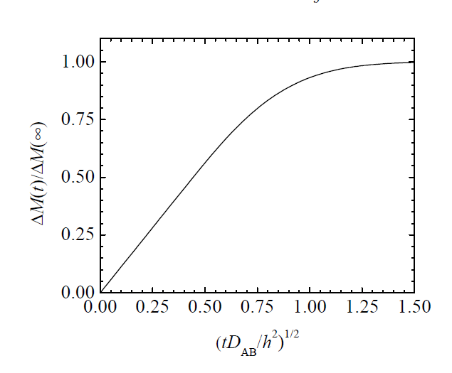
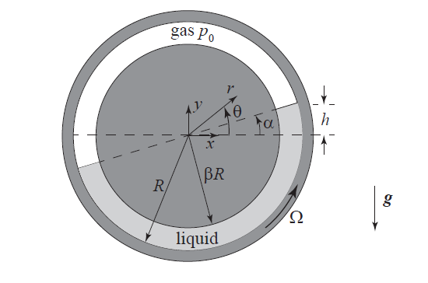
Figure 7.10 Schematic showing flow of a liquid (light shaded region) that
partially fills the annular region between horizontal concentric cylinders.

Slide 14
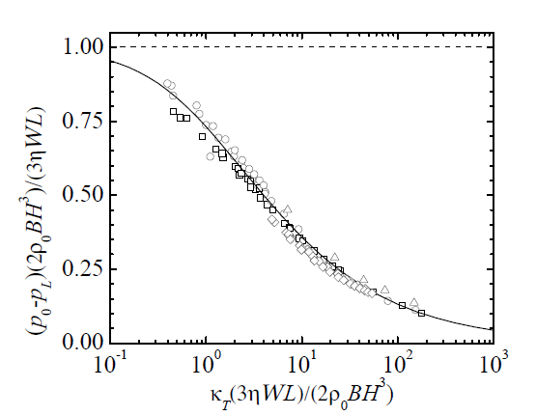
(Above) Figure 8.1 Flow in a tube showing cylindrical fluid element.

Slide 15
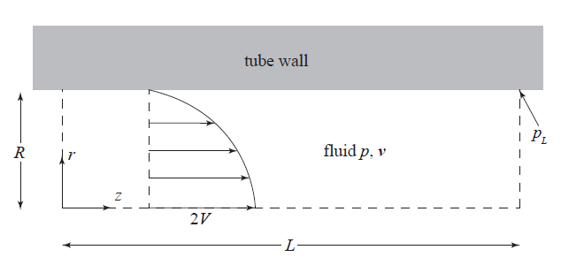
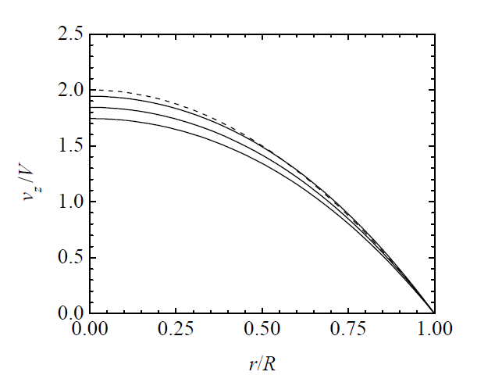
(Above) Figure 8.3 Schematic of flow in a tube of radius R and length L. Note that
2V is the maximum velocity only for incompressible flow.

Slide 16
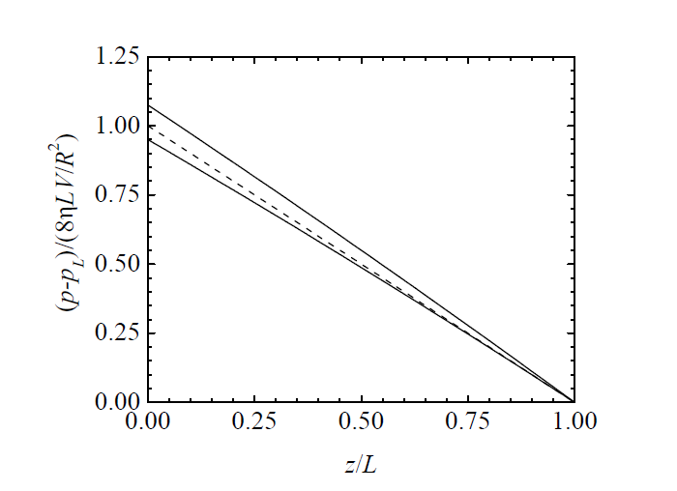
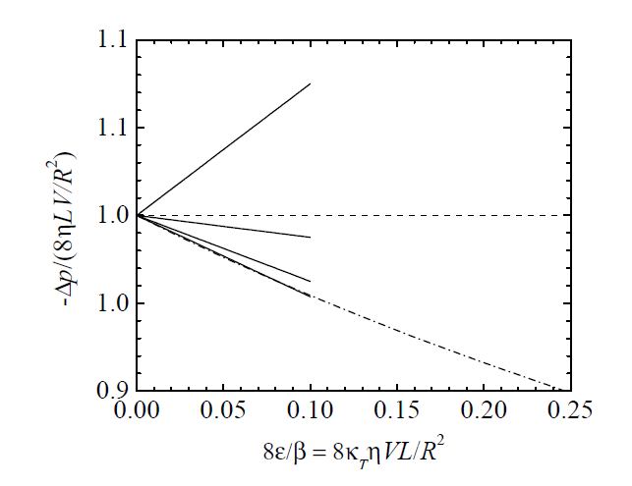
Figure 8.6 Normalized pressure drop for compressible flow in a tube from (8.30) for four values of 8 = 0:3, 1, 3, 10 (solid lines from bottom to top). The dash-dotted line is from the lubrication approximation (8.36). The dashed line is for the incompressible case, = 0.

Slide 17
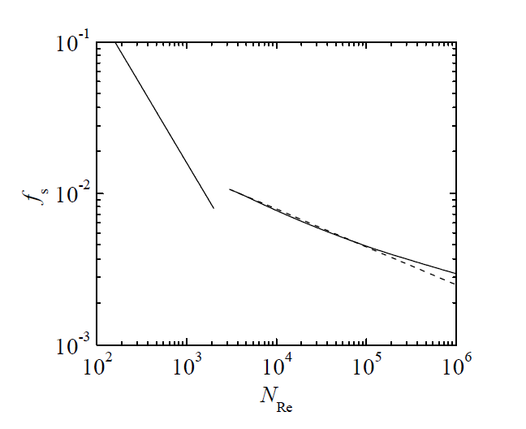
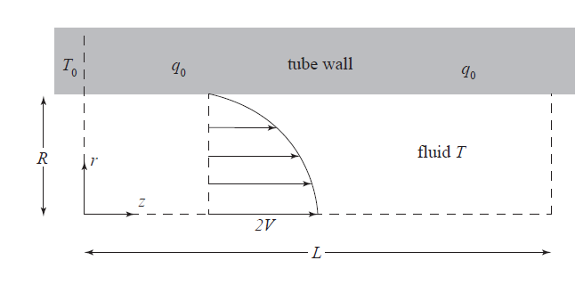
Figure 9.1 Schematic of forced convection in a heated tube.
Figure 8.7 Friction factor versus Reynolds number for incompressible flow in a smooth tube. The solid line for laminar flow is from (8.38). For turbulent flow , the solid line is from (8.42) and the dashed line is from (8.43).

Slide 18
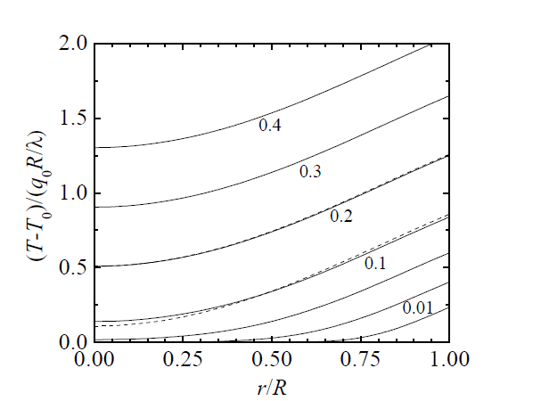
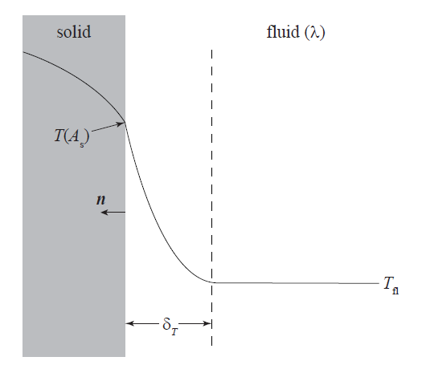
Figure 9.2 Temperature field for laminar flow in a heated tube for
= 0:005, 0:01, 0:05, 0:1, 0:2, 0:3, 0:4 (bottom to top). Also
shown for 0:1 (dashed lines) is the temperature from (9.10).
Figure 9.3 Schematic temperature profile across interface between solid and fluid phases showing thermal boundary layer with thickness .

Slide 19
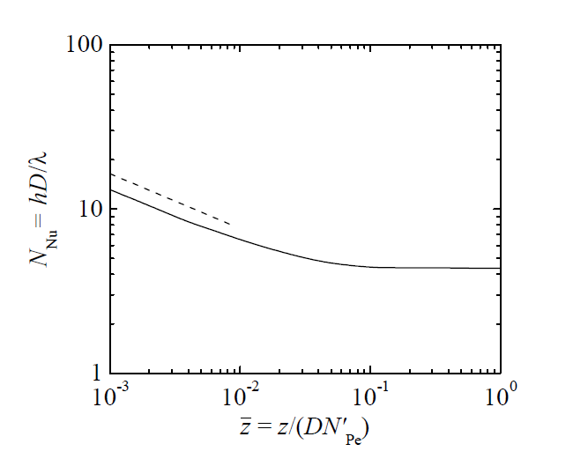
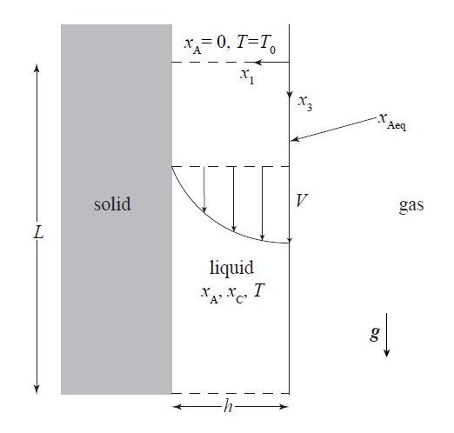
Figure 9.4 Nusselt number as a function of axial position for laminar flow in a heated tube from (9.30) The dashed line is from the asymptotic solution given in (9.31).
Figure 10.1 Schematic of gas absorption with homogeneous chemical reaction in a liquid film flowing along a vertical solid surface.

Slide 20
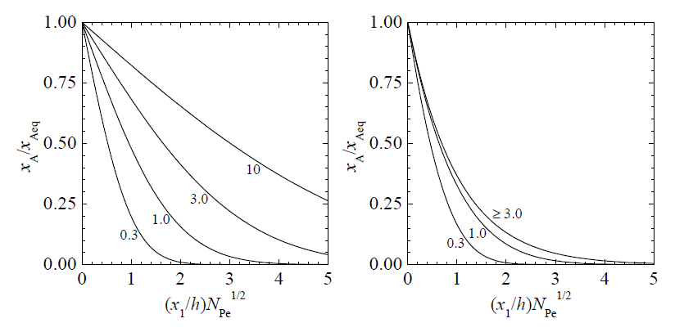
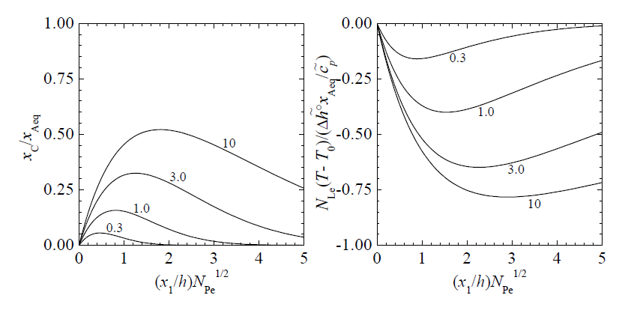
(Above) Figure 10.2 Species A concentration profile from (10.27) for gas absorption
without = 0 (left), and with = 1 (right), homogeneous chemical
reaction at several locations along film: = = 0:3; 1; 3; 10.
(Left) Figure 10.3 Species C concentration profile (left) from (10.30) and temperature
prole (right) from (10.33) with = 10 for gas absorption with
homogeneous chemical reaction with = 1 at several locations along
film: = 0:3, 1, 3, 10.

Slide 21
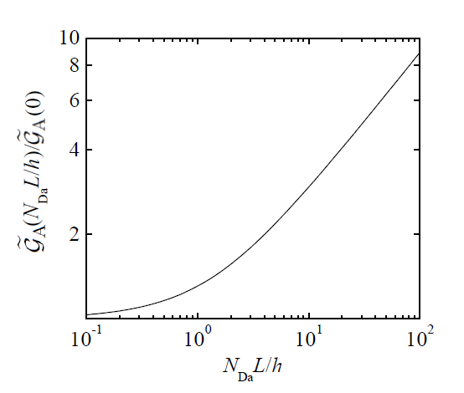
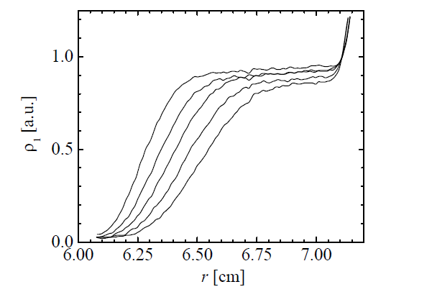
Figure 10.4 The dependence of molar rate of absorption on reaction rate and film length as given by (10.35).
Figure 11.1 Concentration of the enzyme RNase A as function of position
within sample cell for different times (increasing from left to right at 20 min
intervals) for an analytic ultracentrifuge experiment run at 20˚C, pH 6.5,
and rotation rate of 60,000 revolutions per min. [Adapted from Laue &
Staord, Annu. Rev. Biophys. Biomol. Struct. 28 (1999) 75.]

Slide 22
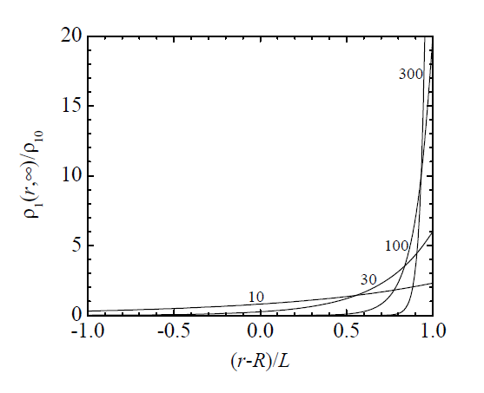
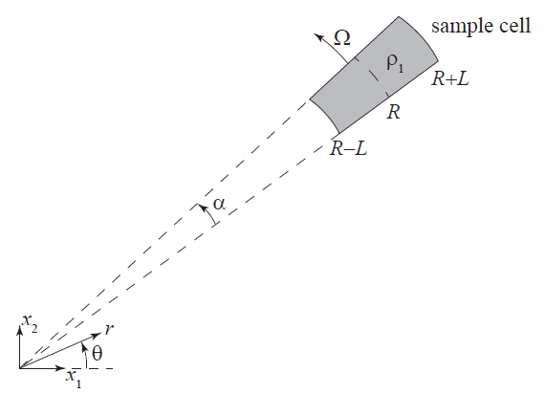
Figure 11.2 Schematic of centrifuge with sample cell rotating with angular
velocity . The sample occupies the region between and has solute concentration .
Figure 11.3 Steady state concentration field for an ultracentrifuge from
(11.30) with = 0:1 for = 10, 30, 100, 300.

Slide 23
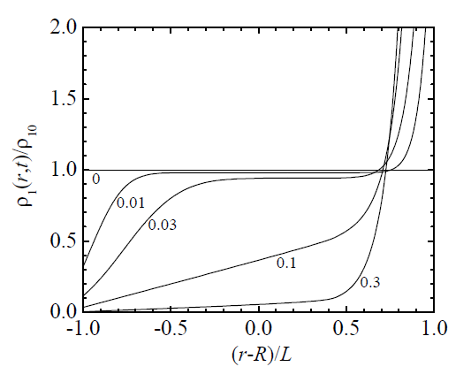
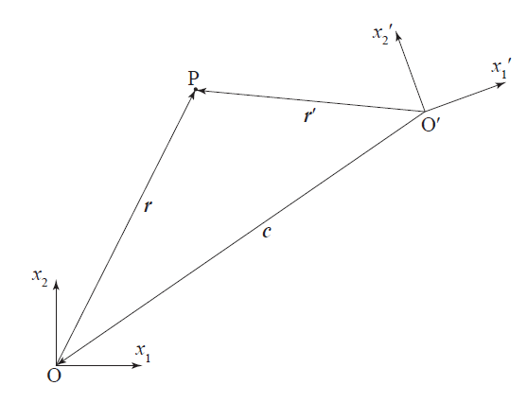
Figure 11.4 Time evolution of the solute concentration field for an ultracentrifuge obtained from numerical solution of (11.15)-(11.17) with = 0.1 and = 100 for different times = 0, 0.01, 0.03, 0.1, 0.3.
Figure 11.5 Two-dimensional representation of a non-inertial coordinate
system with origin O’ relative to an inertial coordinate system with origin O. Point P is an arbitrary point in space.

Slide 24
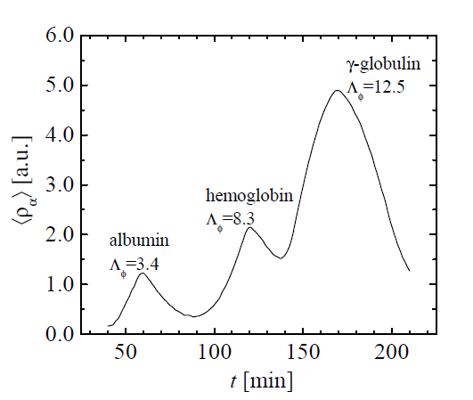
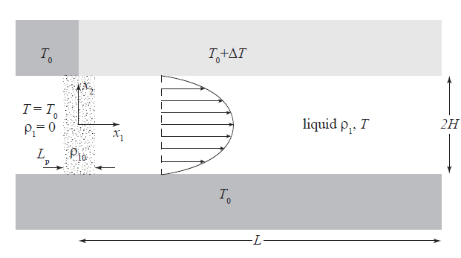
Figure 11.7 Schematic of thermal field-flow fractionation (F3) channel. For
t < 0, the liquid is pure solvent ( = 0) and has uniform temperature T0.
At t = 0, a liquid plug having concentration 10 and length Lp is injected
at the channel entrance (x1 = 0), and for t ≥ 0 a temperature difference
∆T is maintained between the channel walls.
Figure 11.6 Exiting average concentrations versus time for the separation of different blood proteins (species ) in an electric F3 experiment carried out at 25˚C, pH 4:5, and electric potential gradient of 2:95 V/cm. The parameter r (see Exercise 11.9) is proportional to the molecular weight of the protein. [Adapted from Krishnamurthy & Subramanian, Sep. Sci. 12 (1977) 347.]

Slide 25
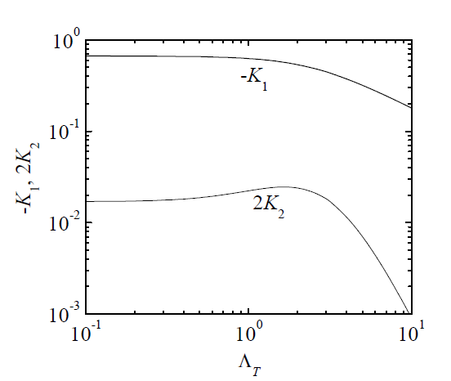
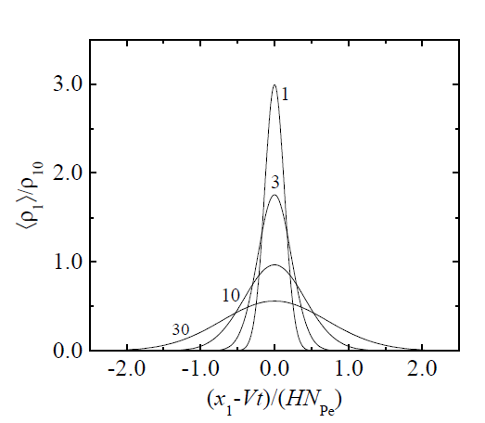
Figure 11.8 Dependence of the coefficients and with 1 on given by (11.47) and (11.48) from dispersion theory solution.
Figure 11.9 Time evolution of the radial-average solute concentration eld
for laminar ow in a channel without temperature gradient = 0 from
(11.46){(11.48) with 1 in a coordinate system that moves with the
average velocity of the fluid for different times = 1, 3, 10, 30.

Slide 26
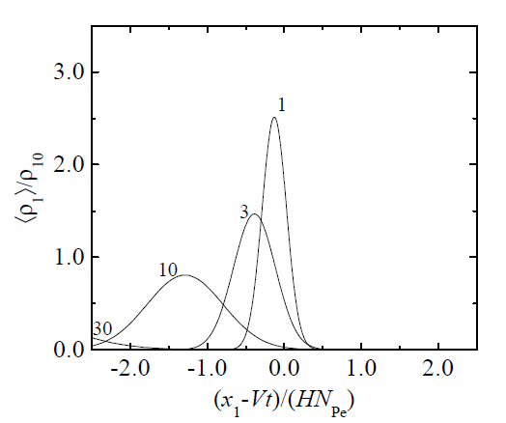
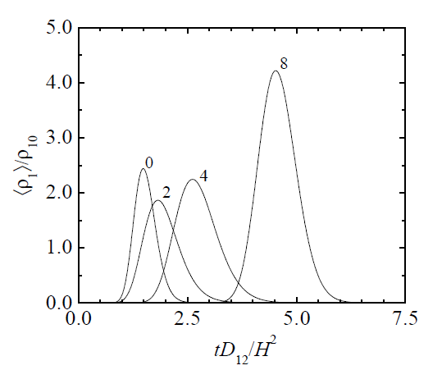
Figure 11.10 Time evolution of the radial-average solute concentration field for laminar flow in a channel with temperature gradient = 2 from (11.46)-(11.48) with 1 in a coordinate system that moves with the average velocity of the fluid for different times = 1, 3, 10, 30.
Figure 11.11 Elution curves at channel location = 1 in thermal
F3 method from (11.46)-(11.48) with 1 for = 0, 2, 4, 8.

Slide 27
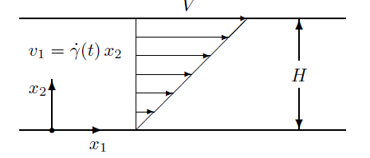
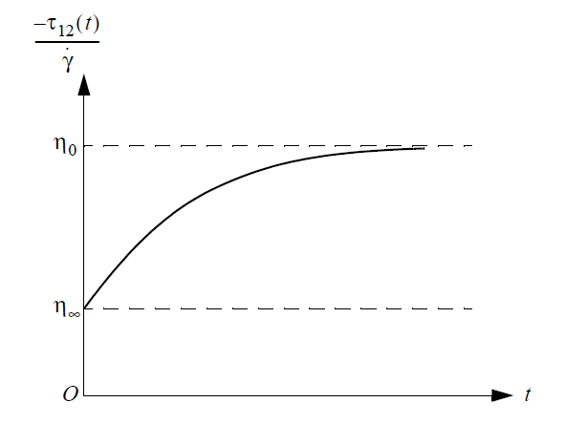
Figure 12.1 Time dependent shear flow between parallel plates with shear rate .
Figure 12.2 Stress growth in start-up of steady shear flow.

Slide 28
Figure 12.3 Shear storage G’ (squares) and loss G” (circles) moduli versus frequency for three polystyrene melts at 180˚C: = 100 kDa (open); = 200 kDa (dots); = 400 kDa (crosses), from experiments performed by Teresita Kashyap at IIT, Chicago.
Figure 12.4 Pipkin diagram showing dependence of material response on
Deborah and Weissenberg numbers.

Slide 29
Figure 12.5 Steady state viscosity and first normal-stress difference N1 versus shear rate for a polystyrene melt at 180˚C ( =200 kDa), from Schweizer et al., Rheol. Acta 47 (2008) 943. The solid curve is the t of the expression given in (12.39).
Figure 12.6 Occurrence of normal-stress differences in shear flow of viscoelastic liquids.

Slide 30
Figure 12.7 Translation and deformation of a vector by convection.
Figure 12.8 The velocity profile (12.68) for t = 1 (dashed line) and
t = 2 (continuous line).

Slide 31
Figure 13.1 Calcium transport across a cell membrane.
Figure 13.2 Two-way coupling between bulk phases and interfaces.

Slide 32
Figure 13.3 True continuous density profile (continuous line) and an idealized
profile for two bulk phases touching at a dividing interface (dashed line).
Figure 13.4 Relationship between change of normal vector and radius of
curvature.

Slide 33
Figure 13.5 Contact angle for two fluid phases I and II in equilibrium with a rigid substrate.
Figure 13.6 Meniscus formed by liquid in contact with a planar solid with
local height h and contact angle .

Slide 34
Figure 14.2 Instead of mapping equivalent points of a continuously deforming interface at two times t1 and t2 (thick lines), we can alternatively look at the trajectories associated with equivalent points (thin arrows) and their time derivatives providing the translational velocity field .
Figure 14.1 Density profile of a conserved quantity. As a consequence of a net accumulation of that quantity in the interfacial region, the dividing interface for as = 0 (dashed line) moves to the right.

Slide 35
Figure 14.4 Liquid (II) cylinder with unperturbed radius R0 surrounded by gas (I).
Figure 14.3 Falling liquid (II) jet surrounded by gas (I).

Slide 36
Figure 16.2 Schematic of flow through a circular die.
Figure 16.1 Schematic of process for the production of polymer fibers.

Slide 37
Figure 16.3 Velocity prole for flow through a circular die given by (16.6) for different values of the power law index n = 1.0, 0.5, 0.33 bottom to top.
Figure 16.4 Schematic of wire coating flow through a circular die.

Slide 38
(Above) Figure 16.5 Schematics of extruder with screw rotating with angular velocity inside stationary barrel (left) and unwound channel formed between screw and barrel (right).
(Left) Figure 16.6 Representative streamline showing recirculating nature of transverse flow within extruder channel. Solid lines indicate flow described by (16.11).

Slide 39
Figure 16.7 Velocity distributions is single-screw extrusion. Left plot
shows transverse velocity v1 given by (16.11), right plot shows velocity
along channel v3 given by (16.12) for several values of the quantity
.
Figure 16.8 Mass flow rate versus pressure difference for single-screw extrusion ( =10) of a Newtonian fluid. Line marked `die' is from (8.5) with = 0:5, and line marked `extruder' is from (16.13). The intersection of the two lines gives the operating point of the extruder.

Slide 40
Figure 16.9 Schematic of fiber spinning process showing lament of length L and local radius R. Note that in practice R << L.
Figure 16.10 Axial velocity along lament for fiber spinning of an upperconvected
Maxwell fluid for = 0, 0.01, 0.02, 0.03, 0.04, 0.05 (bottom to top) obtained by solution of (16.36) for DR = 20. The Newtonian case ( = 0) given by (16.39).

Slide 41
Figure 17.1 Sphere of radius R with its center at the origin of rectangular and spherical coordinate systems surrounded by an infinite medium.
Figure 16.11 Dependence of FL on NDe for the fiber spinning of an upperconvected Maxwell fluid for DR = 20. Note that the maximum possible Deborah number is given by = (DR -1) -1

Slide 42
Figure 17.2 Normalized temperature isotherms in the
x2-x3 plane around a sphere imbedded in an infinite medium predicted by
(17.10) and (17.11) with = 0 and = 4 (left) and 1=4 (right).
Figure 17.3 Schematic of heterogeneous system composed of multiple
spheres with thermal conductivity imbedded in a medium with thermal conductivity , and its representation as an effectively continuous medium with effective thermal conductivity eff.

Slide 43
Figure 17.4 Dependence of normalized effective thermal conductivity as a function of thermal conductivity ratio predicted by (17.16) for = 0.1
with = 0 (solid line) and = 0.1 (dashed line).
Figure 17.5 Normalized stream function in the x2-x3 plane for creeping flow around a sphere predicted by (17.29) with = 0 (left) and (right).

Slide 44
Figure 17.6 Normalized pressure contours in the x2-x3 plane
for creeping ow around a sphere from (17.32) with = 0 (left) and (right).
Figure 17.7 Albert Einstein (1879-1955) in 1904.

Slide 45
Figure 18.1 Schematic of gas bubble with radius R surrounded by infinite liquid.
Figure 18.2 Representative concentration field w1 in liquid (r > R) versus
radial position r for bubble growth (R > R0) and collapse (R < R0).

Slide 46
Figure 18.3 Representative solute chemical potentials for the gas phase ,
interface and liquid near the gas-liquid interface for bubble growth
showing nonequilibrium (left) and equilibrium (right) cases.
Figure 18.4 Bubble radius and pressure versus time during bubble growth
for the following parameter values: Nw = 1 and = 0.001. Solid lines are
for diffusion-induced case where Nn = 0.1, N∆p = 0.5 and = 0.25.
Dashed line is diusion-controlled case Nn = = 0; dotted line is for
(18.30) with = 1.34.

Slide 47
Figure 19.1 Image of the Intel 4004 microprocessor circa 1970 with overall dimensions of 10mm x 10 mm. This device contains 2300 transistors and has device features of 10 m in size. Current microprocessors have device features with sizes 25nm and over 500 million transistors.
Figure 18.5 Bubble radius and pressure versus time during bubble collapse for the following parameter values: and = 0.001. Solid lines are for diffusion-induced case where Nn = 0.1, N∆p = 2 and = 0.5. Dashed line is diffusion-controlled case N = N = 0.

Slide 48
Figure 19.2 Schematic of selected semi-conductor processing steps: a) Si wafer with SiO2 layer; b) surface coated with positive photoresist film; c) exposure of photoresist through mask; d) photoresist after selective removal; e) selective removal of SiO2 layer by etching; f) SiO2 feature left after photoresist removal.
Figure 19.3 Schematic of Czochralski crystal growth process.

Slide 49
Figure 19.4 Normalized temperature ( T - Tg)/(Ts - Tg) isotherms in Czochralski crystal growth process given by (19.8) with = 1.0 for three crystal lengths L/R = 1, 2.5, 5 (left to right).
Figure 19.5 Schematic of Si oxidation process showing SiO2 layer having thickness h.

Slide 50
Figure 19.6 Oxide lm thickness h in m versus time t in hours given by (19.28) with and , and the following parameter values: Different curves correspond to different values of D/ks = 0.0, 0.01, 0.03 m (top to bottom).
Figure 19.7 Schematic of spin coating process. Note that film thickness h is exaggerated for clarity.

Slide 51
Figure 19.8 Normalized stream function for velocity within a uniform film given by (19.43) and (19.44) in terms of the stream function given in (19.49) as found in Exercise 19.8. Contours are for constant values of .
Figure 19.9 Evolution of film prole predicted by (19.48) with an initially Gaussian profile
Different proles are for different values of time t = 0, 0.3, 1.0, 3.0 (top to bottom).

Slide 52
Figure 20.1 Two equivalent particle configurations for a gas of spherical
particles.
Figure 20.2 Peaked distribution of a macroscopic variable such as the internal
energy U’ in a canonical ensemble.

Slide 53
Figure 20.3 Two subsystems brought in contact to identify the statistical expression for the entropy.
Figure 20.4 Open subsystem with fluctuating internal energy and particle number within a large equilibrium bath.

Slide 54
Figure 21.1 Gas particles with a positive velocity component toward the right wall of a cubic container (particles with a negative velocity component
are not shown). [Reprinted with permission from Öttinger, Beyond Equilibrium Thermodynamics (Wiley, 2005). Copyright by John Wiley & Sons.]
Figure 21.2 A particle has a collision a distance ∆z above the plane and transports property a to another particle a distance ∆z below the plane. [Reprinted with permission from $Ö$ttinger, Beyond Equilibrium Thermodynamics (Wiley, 2005). Copyright by John Wiley & Sons.]

Slide 55
Figure 22.1 Under ow conditions, such as the indicated shear ow, polymer
molecules become stretched and oriented. To develop a simple kinetic
theory, we model the polymer conformations by a dumbbell.
Figure 22.2 The volume that must be occupied by bead 1 when the connector vector Q intersects the shaded rectangle with unit normal vector n.

Slide 56
Figure 23.1 Schematic of porous medium with magnified view of averaging
volume Veff at position r.
Figure 22.3 Temporary network conformation.

Slide 57
Figure 23.2 Schematic of spatially periodic unit cells (left) and a single unit consisting of a spherical solid surrounded by a spherical fluid (right).
Figure 23.3 Comparison of experimental effective diffusivities in porous
media comprised of spheres (circles) and sand (squares) and model predictions
from (23.32){(23.34) for a periodic array of spheres (solid curve)
and for (23.37) (dashed curve): . [Adapted from
Whitaker, The Method of Volume Averaging (Kluwer, 1999)].

Slide 58
Figure 23.4 Schematic of a spherical porous catalyst particle with radius R surrounded by a gas that maintains concentration cAg at particle surface.
Figure 23.5 Reactant concentration prole within catalyst particle from (23.40) for = 3 at different times = 0.01, 0.03, 0.1, 0.3, 1 (left); steady state reactant concentration prole from (23.41) for different values of = 0.3, 1, 3, 10 (right).

Slide 59
Figure 23.6 Effectiveness factor n for catalyst particles with spherical (23.43) and thin disk (23.52) shapes as a function of modified Thiele modulus
Figure 23.7 Schematic of tubular packed bed reactor having length Lb and radius Rb containing spherical catalyst particles with magnified view of
averaging volume .

Slide 60
Figure 23.8 Schematic of liquid lm between porous and impermeable
disks.
Figure 24.1 A sarcomere as the basic unit of a muscle. The ends of the
myosin laments are actually attached to the Z-disc by means of highly
elastic molecules which, for simplicity, are not shown in the figure. [For
a more realistic sketch see, for example, Kim et al., Trends Cell Biol. 18
(2008) 264.]

Slide 61
Figure 24.2 Transition rates for the two-state model of translational motors.
Figure 24.3 Dwell time distribution (24.18) for (continuous
line); for comparison, the single exponential decay is also shown (dashed line).

Slide 62
Figure 24.4 Normalized forward drift velocity as a function of the backward pulling force f divided by the stall force f0; the continuous and the dashed lines correspond to the rate parameters (24.2) and (24.3), respectively, where the coefficients are chosen as c+ = 1, c_= 0:2, and f0 = 20.
Figure 24.5 Randomness as a function of the backward pulling force f
divided by the stall force f0; the continuous and the dashed lines correspond to the rate parameters (24.2) and (24.3), respectively, where the coefficients are chosen as c+ = 1, c_ = 1, and f0 = 20.

Slide 63
Figure 24.6 Experimental data for the dwell time histogram for the myosin V motor protein. [Redrawn from Purcell et al., Proc. Natl. Acad. Sci. U.S.A. 102 (2005) 13873.]
Figure 24.7 Experimental data for (a) the molecular motor velocity and
(b) the randomness parameter for kinesin moving along microtubules at
high ATP concentration. [Redrawn from Visscher et al., Nature 400 (1999)
184.]

Slide 64
Figure 24.8 Schematic of phospholipid bilayer membrane with Ca-ATPase protein for active transport of Ca2+ (left); idealization of membrane as an interface with molar flux from interface into phase I and (right).
Figure 24.9 Thermodynamic efficiency n of Ca2+ ion pump versus Z for
different values of the coupling coefficient q given by (24.29) and (24.30).

Slide 65
Figure 24.10 Qualitative behavior of the activation energy .
Figure 25.1 Schematic of Brownian motion of spherical particle (bead) with radius R showing particle position rb and displacement ∆rb vectors.

Slide 66
Figure 25.2 Mean-square displacement for microbead rheology experiment performed on a wormlike micellar solution measured using diffuse wave spectroscopy [see Willenbacher et al., Phys. Rev. Lett. 99 (2007) 068302].
Figure 25.3 Complex modulus for a wormlike micellar solution from the mean-square displacement data in Figure 25.2 and from mechanical rheology: G’ (squares); G” (circles) [see Willenbacher et al., Phys. Rev. Lett. 99 (2007) 068302]. The solid curves are obtained using (25.18) and the dashed curves using (25.19) [curves provided by Tsutomu Indei at IIT, Chicago].

Slide 67
Figure 26.2 Plot of the time dependence of a property A(t) fluctuating
about its average value <A>indicated by the dashed line.
Figure 26.1 Lord (John William Strutt) Rayleigh (1842-1919).

Slide 68
Figure 26.4 Schematic of dynamic light scattering (DLS) setup.
Figure 26.3 Schematic plot of time dependence of autocorrelation function
obtained from time dependence of A(t) in Figure 26.2.

Slide 69
Figure 26.5 Schematic of scattering from a single stationary particle located at the origin.
Figure 26.6 Schematic of scattering from two stationary particles located near the origin.

Slide 70
Figure 26.7 Normalized autocorrelation function of density fluctuation predicted by (26.51) with
=
Figure 26.8 Normalized dynamic structure factor (scaled by
) predicted by (26.52) with and
= 1:15. Inset shows magnfied view of the Rayleigh peak.

