Slide 1
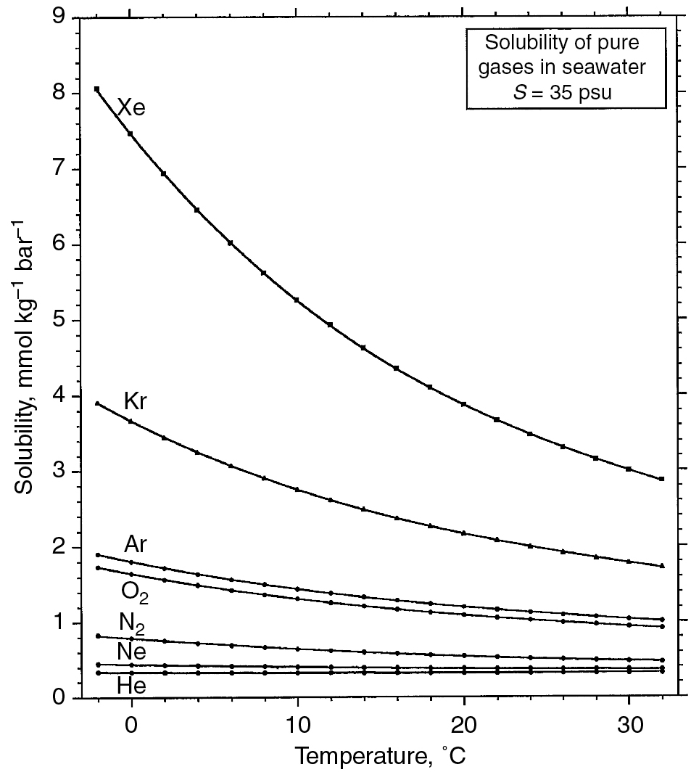
PILSON_Fig 05_01
© Cambridge University Press 2012

Slide 2
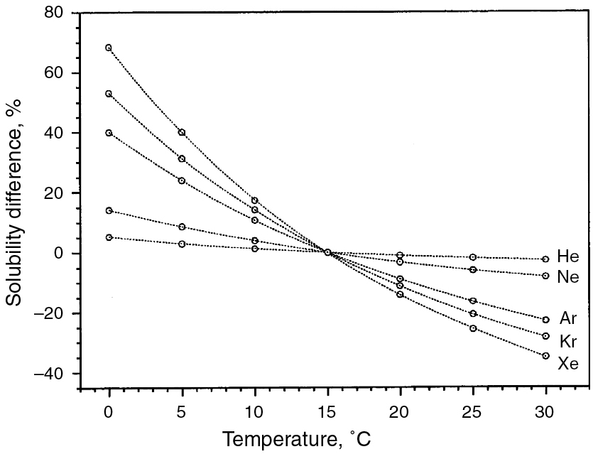
PILSON_Fig 05_02
© Cambridge University Press 2012

Slide 3
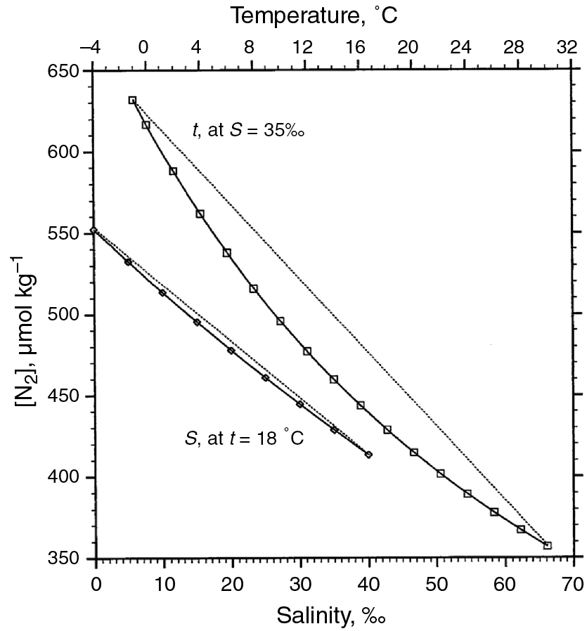
PILSON_Fig 05_03
© Cambridge University Press 2012

Slide 4
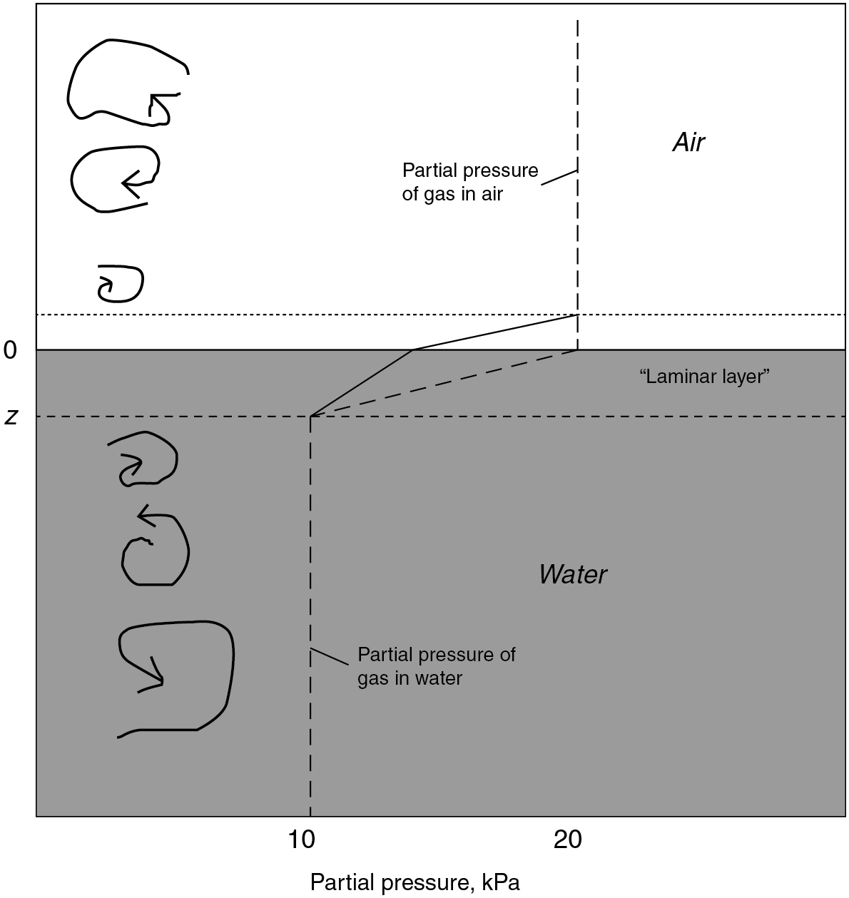
PILSON_Fig 05_04
© Cambridge University Press 2012

Slide 5
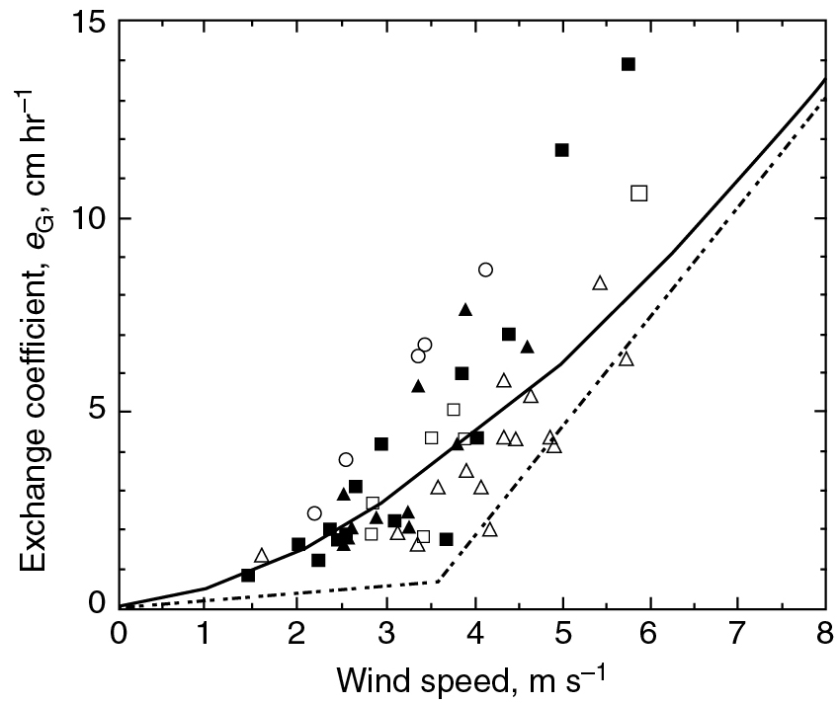
PILSON_Fig 05_05
© Cambridge University Press 2012

Slide 6
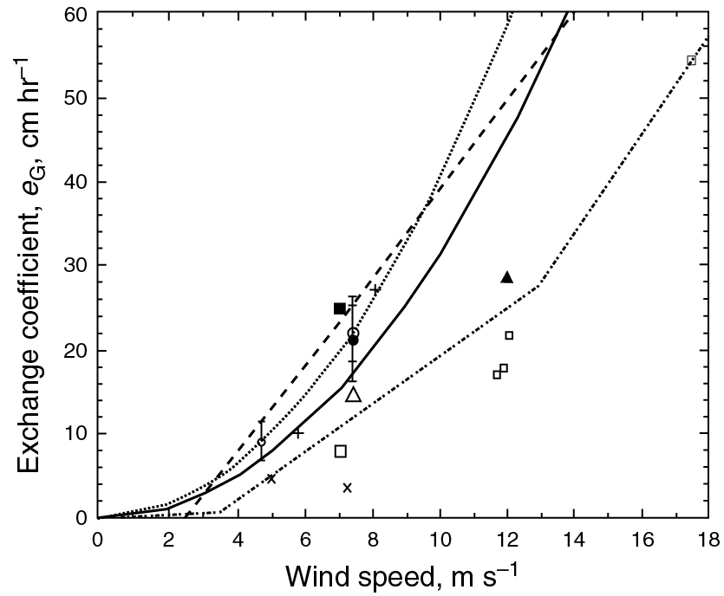
PILSON_Fig 05_06
© Cambridge University Press 2012

Slide 7
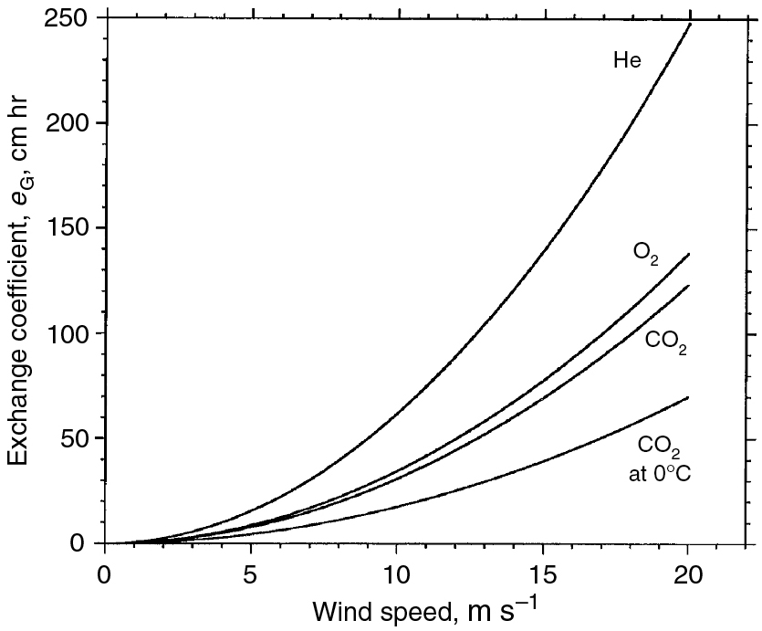
PILSON_Fig 05_07
© Cambridge University Press 2012

Slide 8
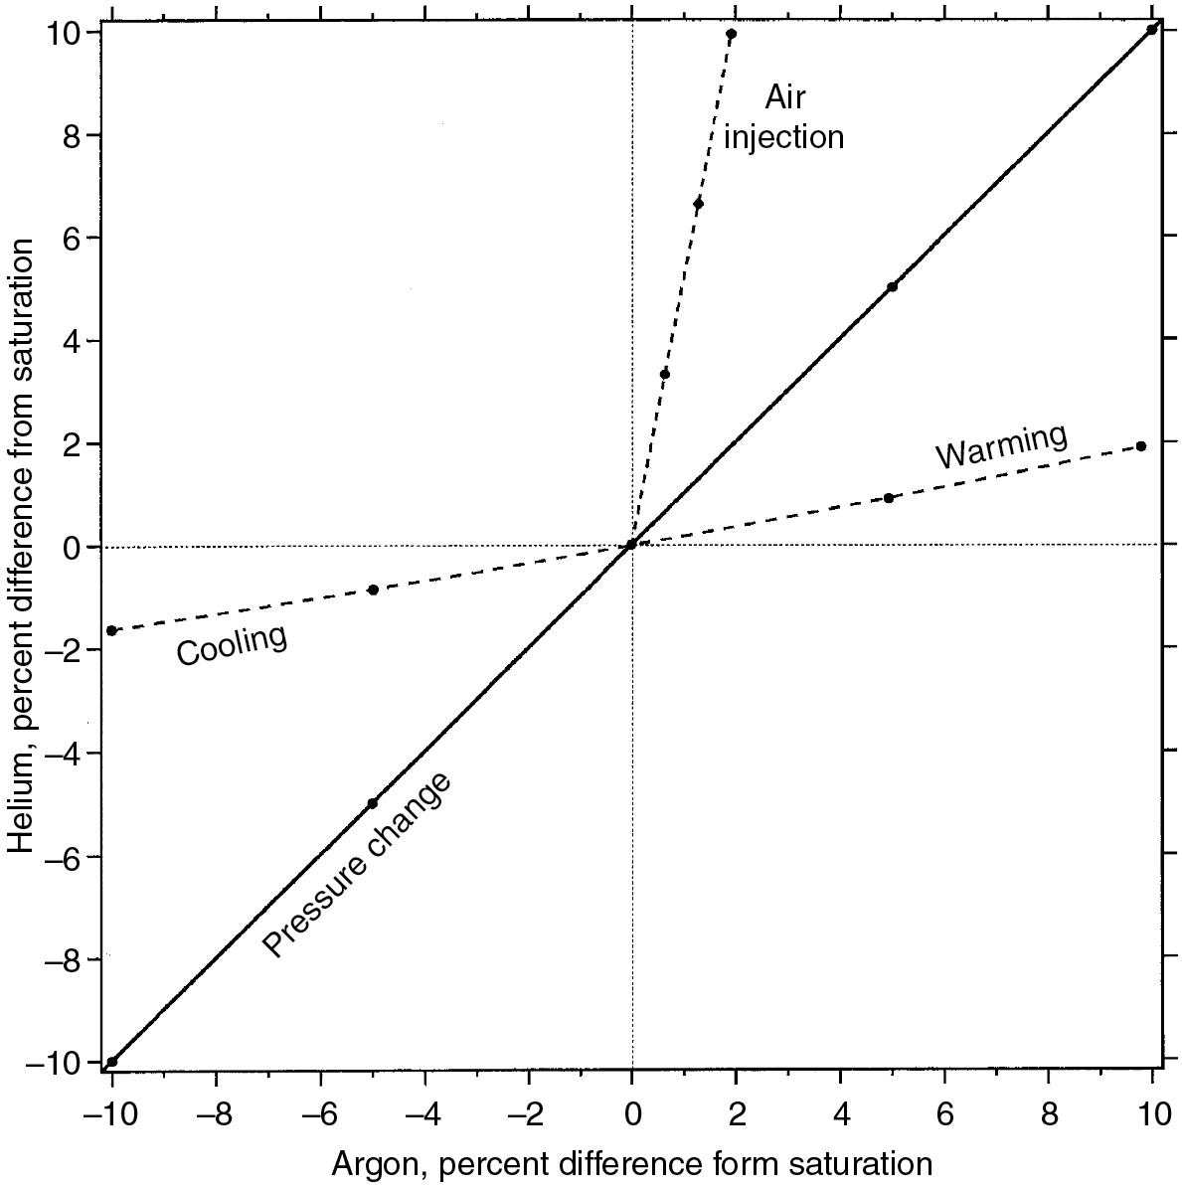
PILSON_Fig 05_08
© Cambridge University Press 2012

