Slide 1
IMPORTANT – PLEASE NOTE:
These resources are provided free of charge by Cambridge University Press with permission of the authors of the corresponding work, but are subject to copyright. You are permitted to view, print and download these resources for your own personal use or for educational purposes, provided any copyright lines on the resources are not removed or altered in any way. Any other use, including but not limited to distribution of the resources in modified form, or via electronic or other media, is strictly prohibited unless you have prior permission from the authors of the corresponding work and the owners of the images displayed herein, and provided you give appropriate acknowledgement of the source.

Slide 2
NOTE TO USERS:
The simplified information included in this presentation is intended to compliment the accompanying CUP book on Glaciovolcanism by Smellie & Edwards. Please refer to the book for further details and information on references cited, etc

Slide 3
Glaciovolcanism on Mars

Slide 4
TALK OUTLINE -
Global dichotomy & Mars’ geological evolution
Mars’ hydrological cycle
Geological evidence for surface water
Evidence for glaciovolcanism

Slide 5
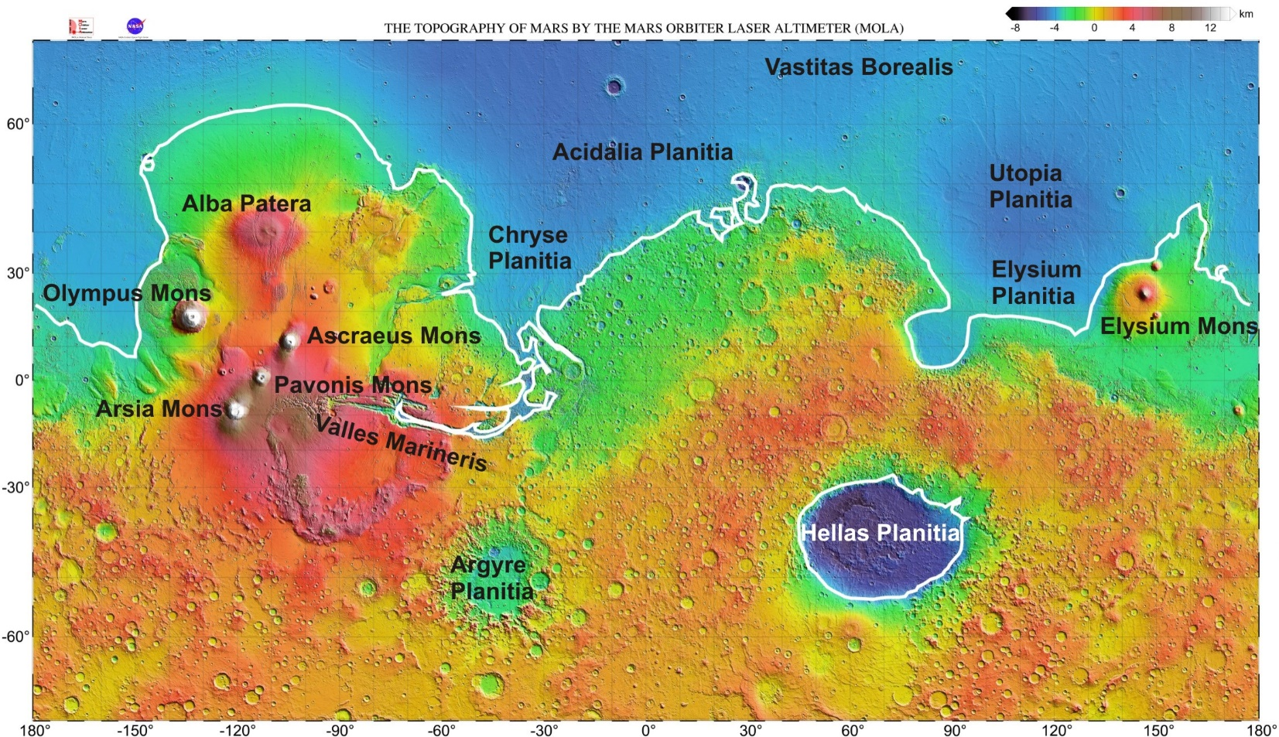
Mars Orbiter laser altimeter (MOLA) map of Mars, showing global dichotomy
Northern ocean?
Southern highlands
Putative shoreline (white) from Clifford & Parker (2001)

Slide 6
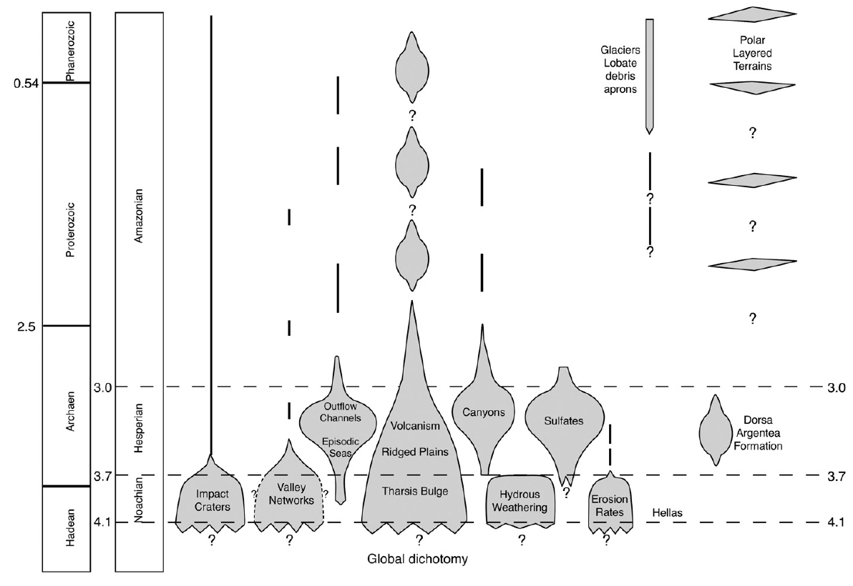
Summary of the geological evolution of Mars
Events with significant
water involvement
Carr & Head (2010)

Slide 7
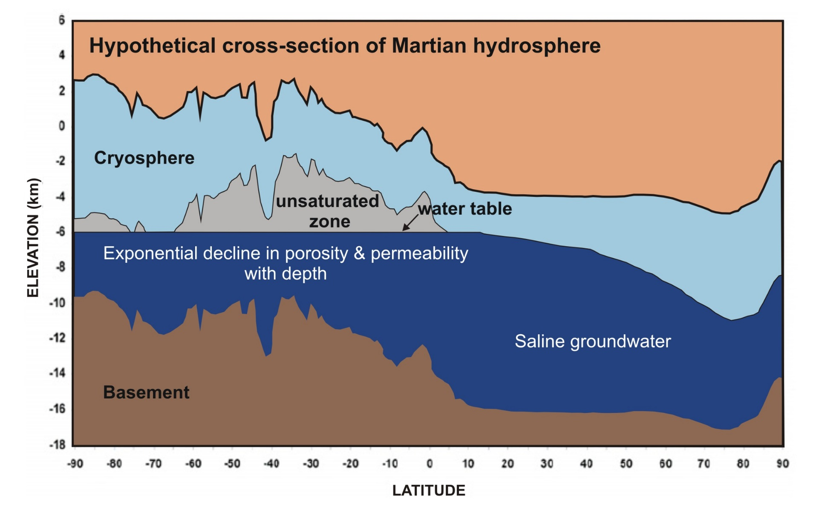
Hydrology of Mars
Water (or ice) potentially available at any latitude
[surface]
Clifford & Parker (2001)

Slide 8
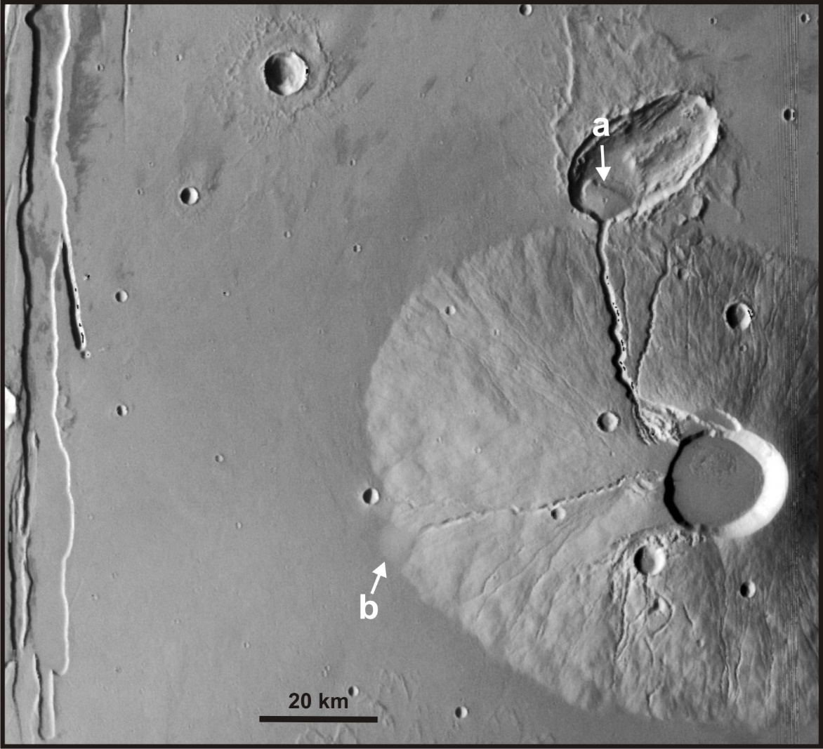
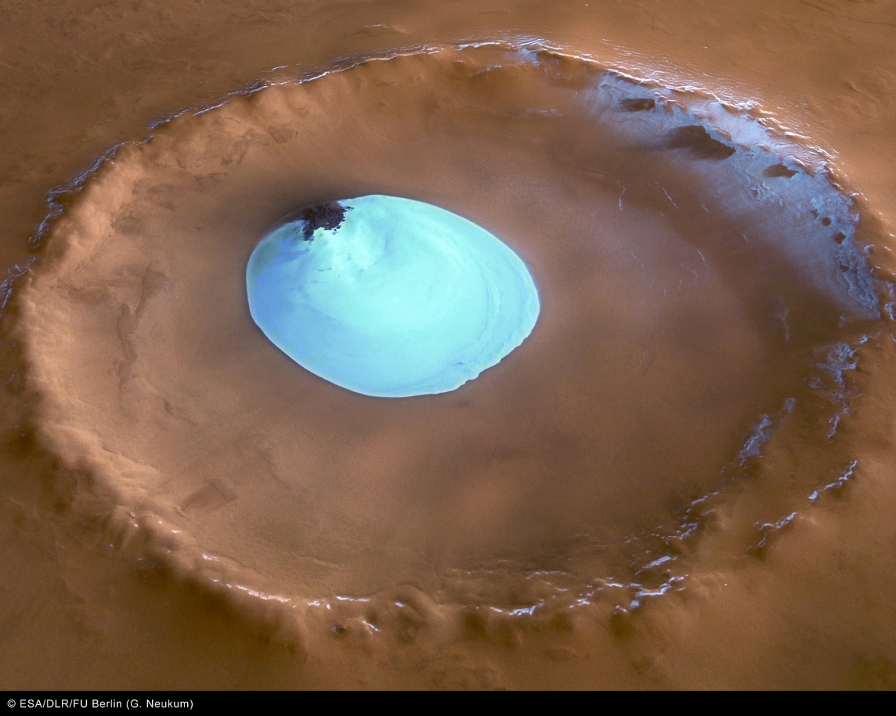
Evidence for surface water on Mars
Runoff channels on Ceraunius Tholus and associated
sediment fans (a,b)
Frozen lake in crater near Mars’ North Pole
Fassett & Head (2007)
Image: ESA/DLR/FU Berlin (G.Neukum)

Slide 9
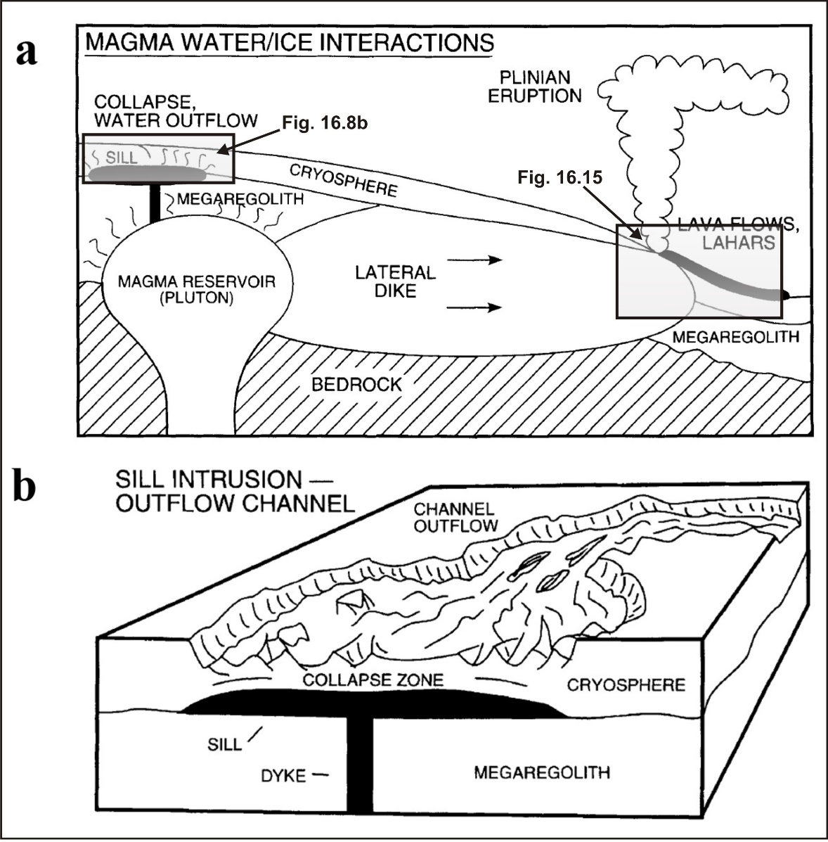
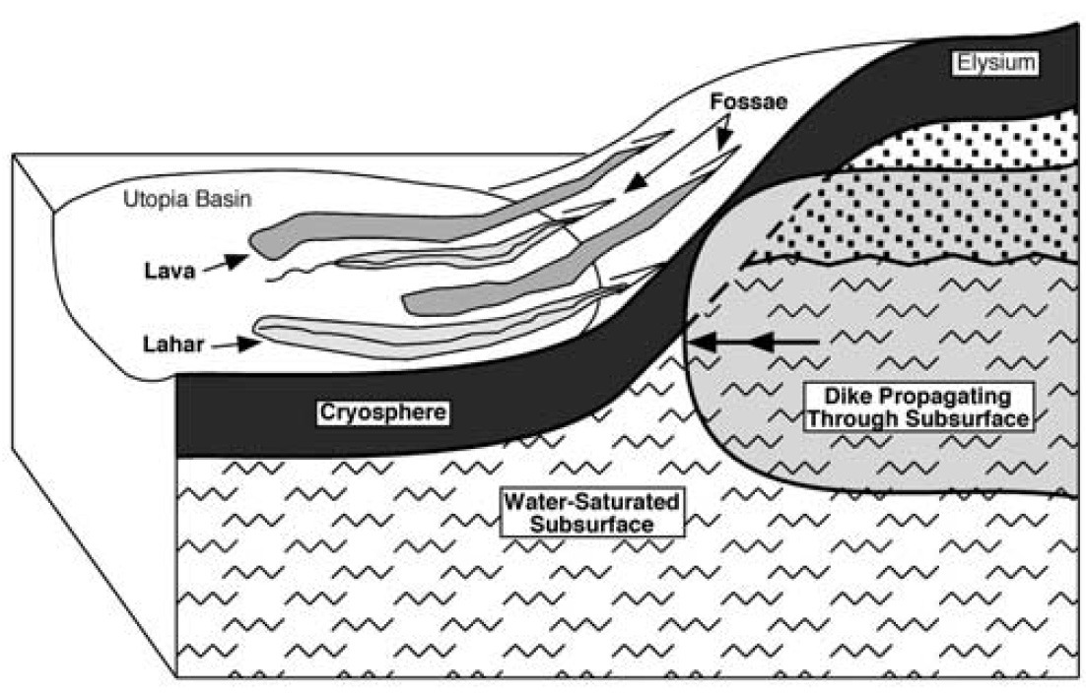
Glaciovolcanism on Mars – theoretical aspects
Squyres et al. (1987)
Head & Wilson (2002)
Russell & Head (2003)

Slide 10
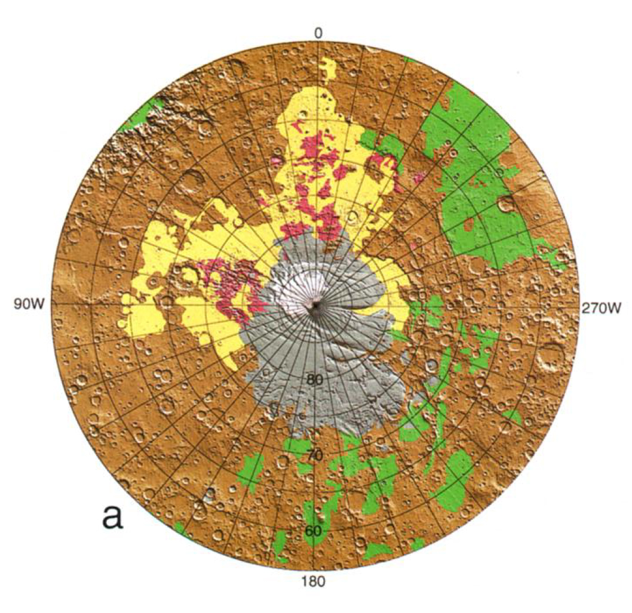
Geological evidence for surface water on Mars – extensive polar ice sheets
South Polar Region showing outcrop of glacial (incl.
glaciovolcanic) Dorsa Argentea Fmn (yellow)
Likely tuyas and glaciovolcanic tephra
mounds in South Polar Region
Ghatan & Head (2002)
Head & Pratt (2001)

Slide 11
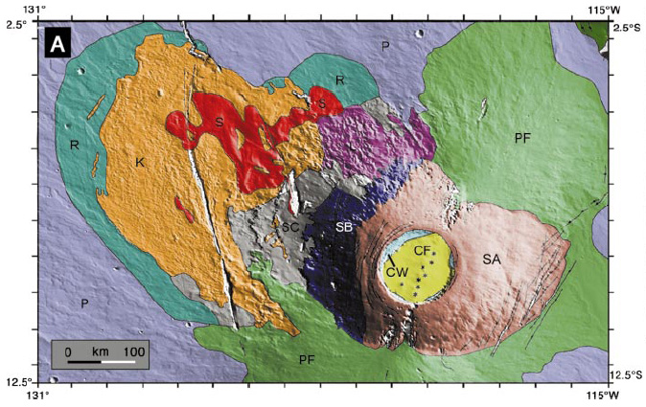
Geological evidence for surface water on Mars – tropical glaciers
Geological units at Arsia Mons interpreted as drop moraines (R),
sublimation till (K) & rock glacier deposits (S)
Head & Marchant (2003)

Slide 12
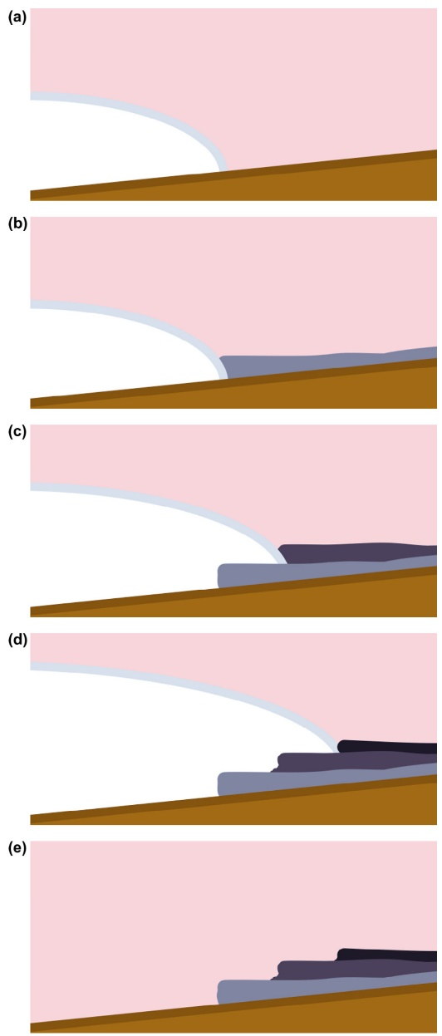
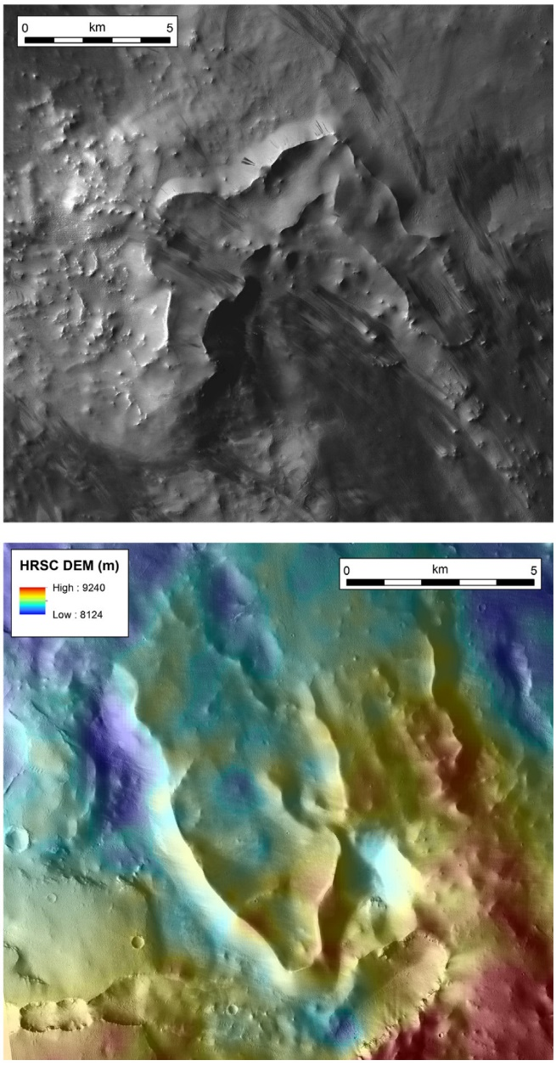
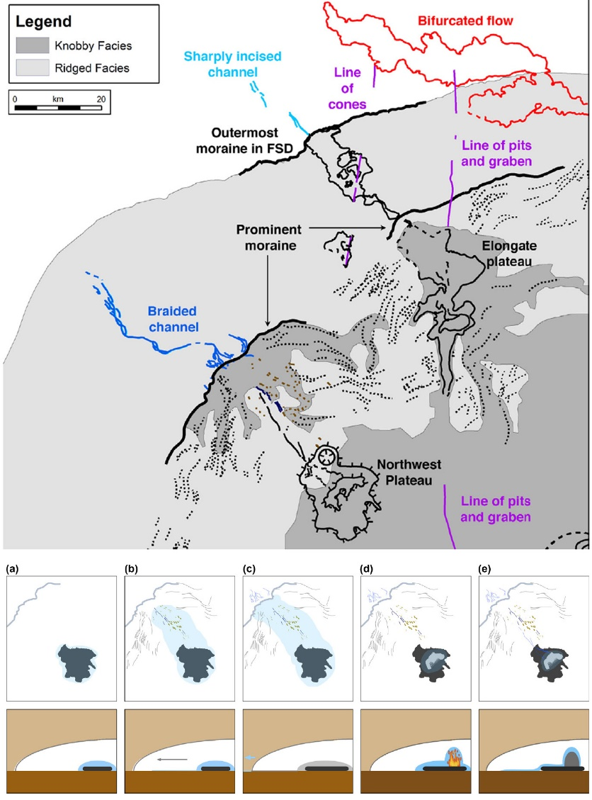
Geological evidence for glaciovolcanism on Mars
Geological features near Arsia Mons
interpreted as glaciovolcanic, including
subglacial pillow sheet and related meltwater
features
Possible subglacially emplaced
lavas
Ice-impounded lavas
Scanlon et al. (2014)
Scanlon et al. (2014)
Scanlon et al. (2014)

Slide 13
SUMMARY
Mars’ geological history indicates a major role for water,
including potential magma:water interaction.
2. Abundant observational evidence for water (ice) presently
on Mars’ surface and subsurface.
Increasing evidence, including glaciovolcanism, indicates
much more extensive ice cover in the geological past,
including in tropical regions.
4. Major consequences for assessing Mars’ water inventory,
prospects for human habitation and the ongoing search
for exobiology.

