Slide 1
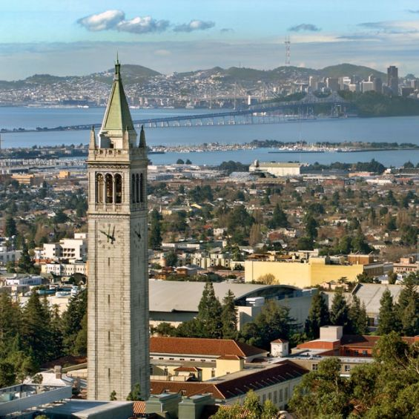
University of California, Berkeley
X-rays and Extreme Ultraviolet Radiation
AST210/EECS213
Fall 2019

Slide 2
Laser High Harmonic Generation
David Attwood
University of California, Berkeley

Slide 3
Courtesy of Chang-Hee Nam, KAIST

Slide 4
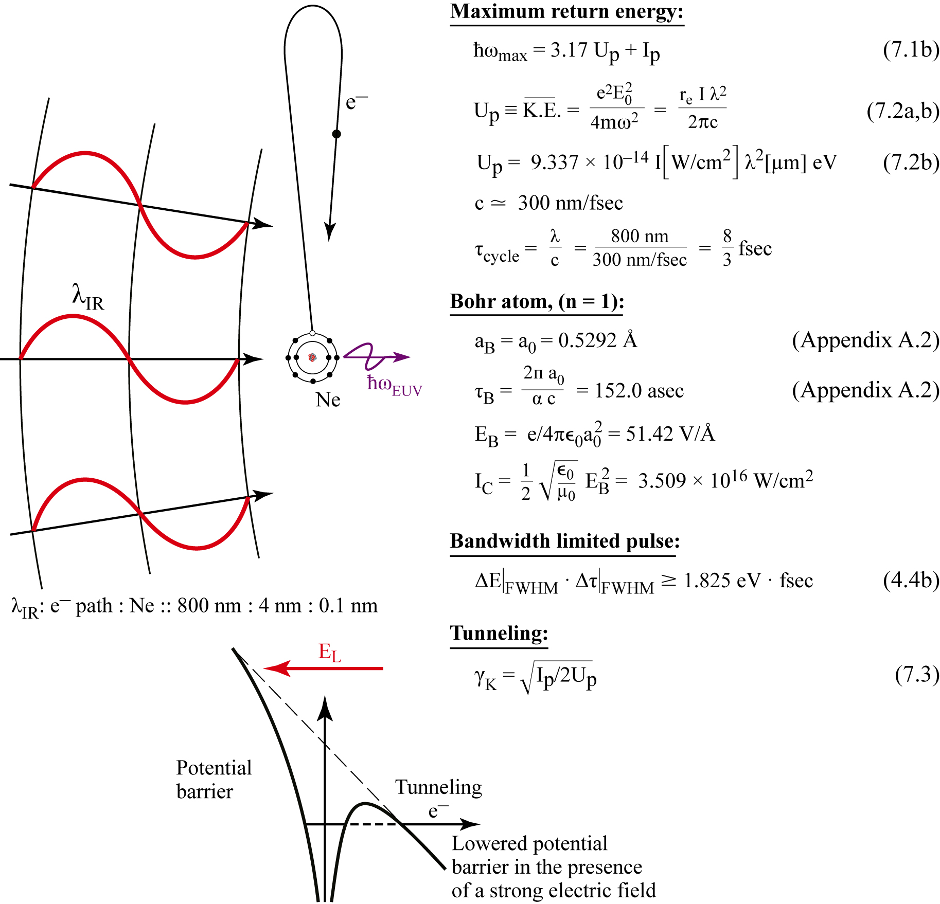
High Harmonic Generation (HHG)

Slide 5
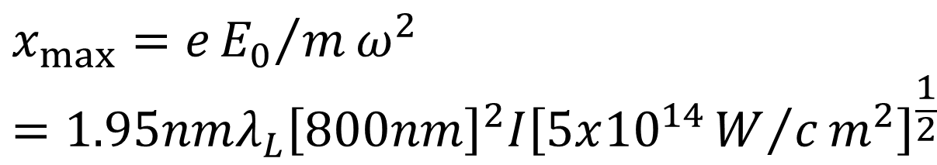
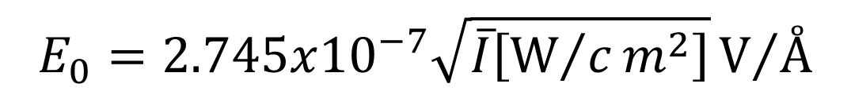
Relationships among electric field and intensity for a plane wave in vacuum
$$E_{0}=2.745x{10}^{−7}\sqrt{\overline{I}\left[W/cm^{2}\right]}V/Å$$
$$x_{max}=e{E_{0}}/mω^{2}=1.95nmλ_{L}{\left[800nm\right]}^{2}I{\left[5x{10}^{14}W/cm^{2}\right]}^{\frac{1}{2}}$$

Slide 6
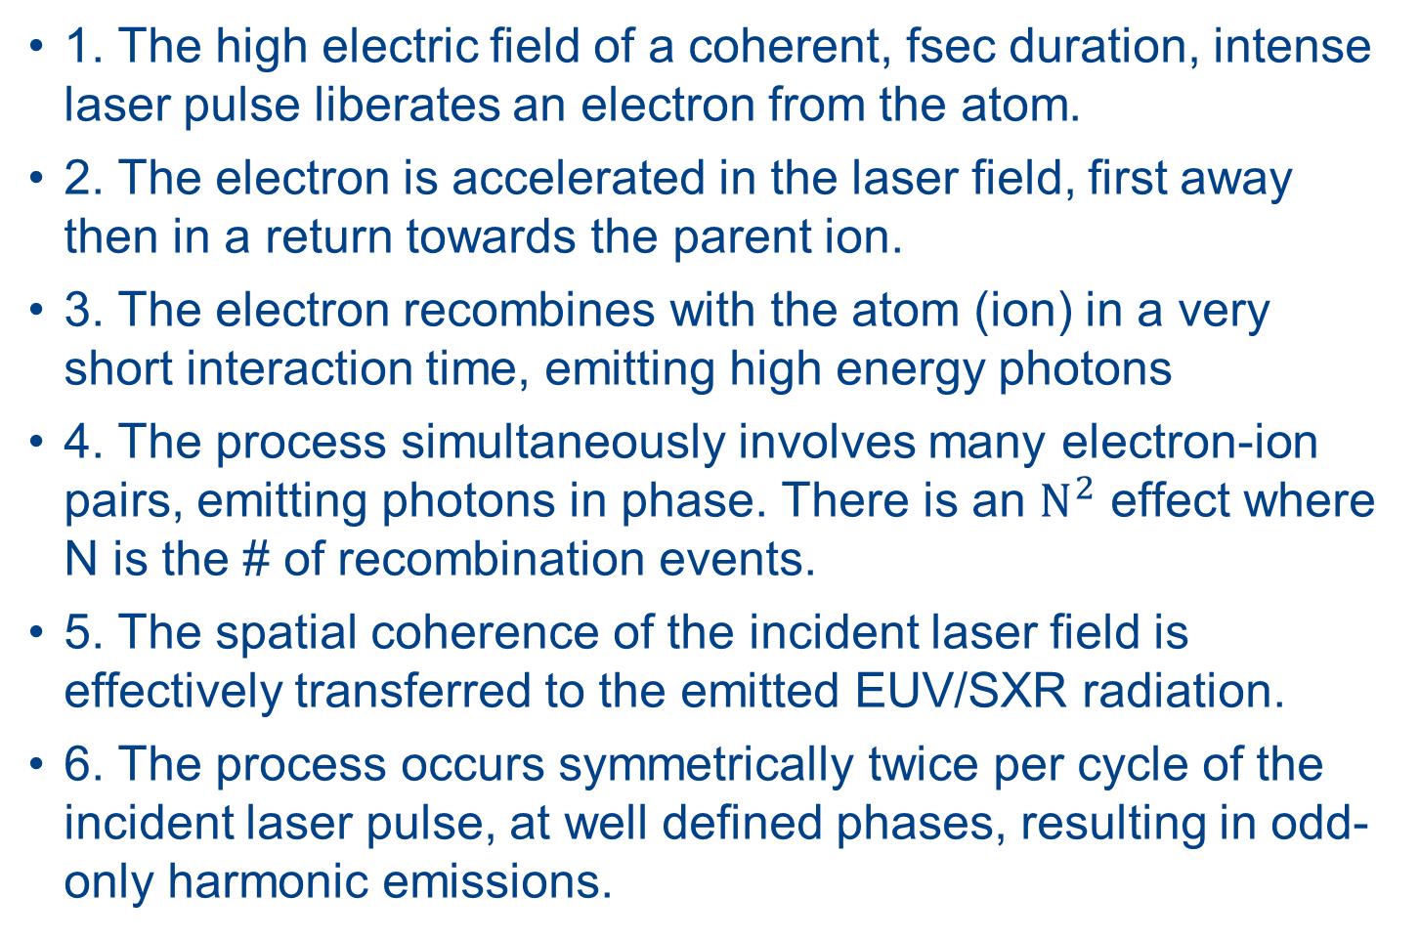
HHG process
1. The high electric field of a coherent, fsec duration, intense laser pulse liberates an electron from the atom.
2. The electron is accelerated in the laser field, first away then in a return towards the parent ion.
3. The electron recombines with the atom (ion) in a very short interaction time, emitting high energy photons
4. The process simultaneously involves many electron-ion pairs, emitting photons in phase. There is an $N^{2}$ effect where N is the # of recombination events.
5. The spatial coherence of the incident laser field is effectively transferred to the emitted EUV/SXR radiation.
6. The process occurs symmetrically twice per cycle of the incident laser pulse, at well defined phases, resulting in odd-only harmonic emissions.

Slide 7
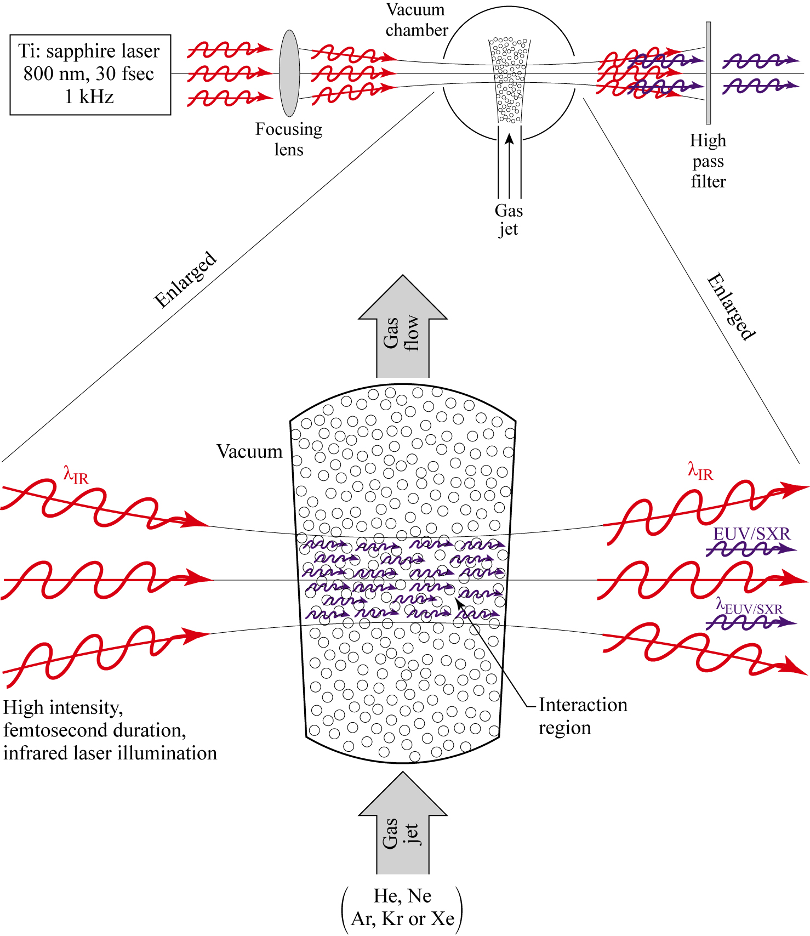
Laser High Harmonic Generation (HHG)

Slide 8
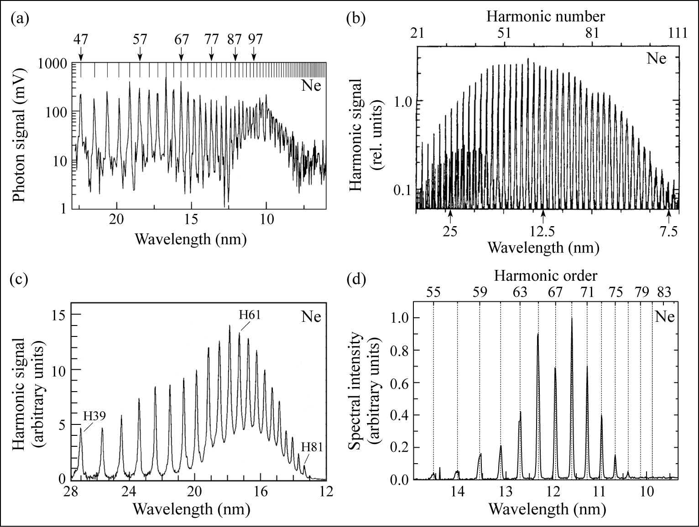
Early HHG Experiments
L’Huillier and Balcou (1993); (b) Macklin, Kmetec and Gordon (1993);
(c) Schulze et al. (1998); (d) Pfeiffer (2004).

Slide 9
HHG spectra in pursuit of non-linear EUV processes
Ti:sapphire, 780 nm/45 nm bandwidth, 20mJ, 27 fsec, 1 KHz, 2Torr Ar, 6m focus to a 6 cm gas cell. Energy/pulse ~3 nJ in the 29th harmonic at 26.9 nm.
Relative spectral resolution ~ 1/2hN ~ 1/145, thus Δλ ~ 0.2 nm (~Instr. ltd.)
Courtesy of E. Champenois, UC Berkeley, AS&T.

Slide 10


Step 1: Tunneling of a bound electron in an intense laser field
The tunneling probability is exponential in nature, involving the atoms ionization potential, Ip, and the laser electric field strength, E₀. The governing non-dimensional parameter, known as the Keldysh parameter, $γ_{K}$, is given by
where Ip is the binding potential due the electric field of the
nucleus as felt by the bound electron (shielded by other electrons) and Up =
In the parameter range of interest to HHG « 1, the
laser electric field is comparable but smaller than the nuclear
binding field, and tunneling is the primary mechanism by which
an electron is removed from the atom. Tunneling time experiments are discussed by Camus et al., Phys. Rev. Lett. 119, 023201 (14July 2017).
e²E₀²/4mω² is the ponderomotive potential. .
$$γ_{K}$$

Slide 11
Three Step HHG Model
Tunneling of a valence electron through the atom’s potential barrier in the presence of an intense laser field
Acceleration of the electron in the intense laser field, and return to the parent ion upon laser field reversal
Radiative recombination with the emission of a photon having an energy equal to the binding energy plus return kinetic energy

Slide 12
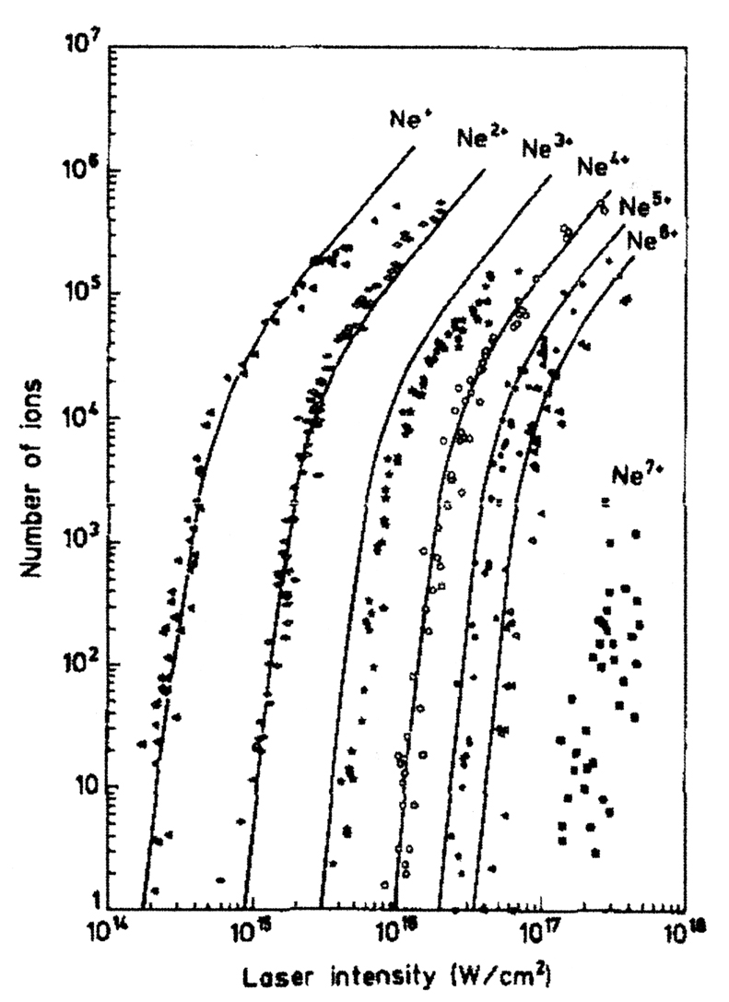
Measured ionization of neon as a function of intensity
Nd:glass
1053nm
1 psec
T. Auguste, P. Monot, L. A. Lompre, G. Mainfray and C. Manus, J. Phys. B: At. Mol. Opt. Phys. 25, 4181 (1992).

Slide 13
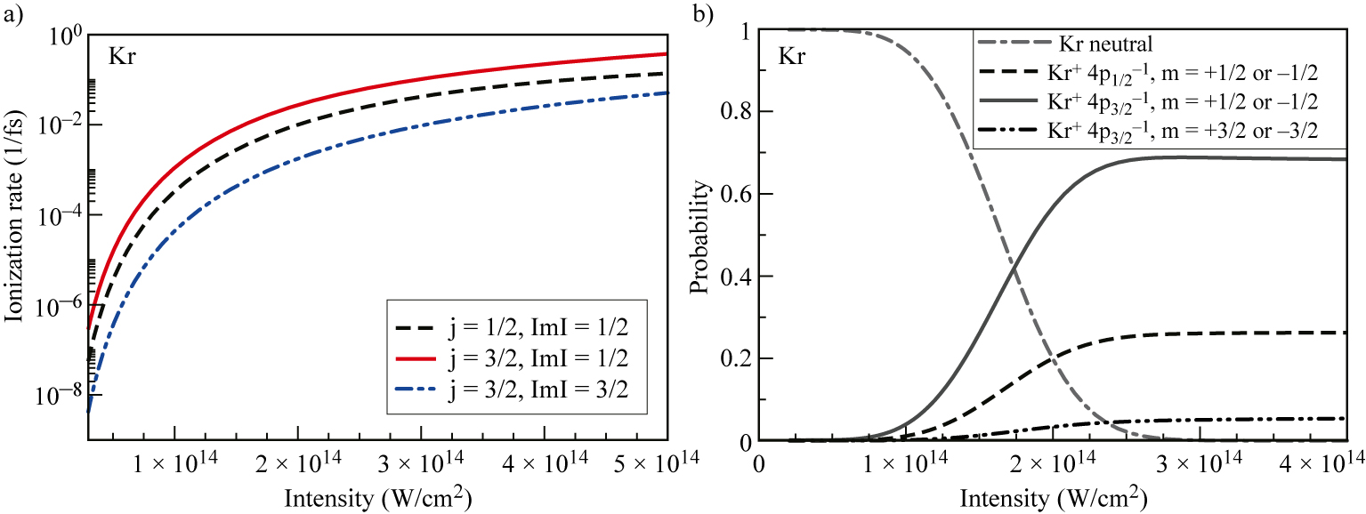
Calculated ionization rates for 4p orbitals of Kr
Calculated ionization rates of Kr,
λ= 800 nm, 40 fsec FWHM
Probability of neutral Kr atoms surviving by the end of the pulse
Courtesy of R Santra (CFEL/DESY), R. Dunford and L. Young (Argonne).

Slide 14
Electron motion in an intense laser field (continued)
This equation can be solved numerically for the return time, or phase φ_{r}, as a function of the time of the electron’s emergence from the tunneling process (“birth”) at phase φ₀. If the electron is born at the peak of the laser pulse, φ₀ = 0, the electron undergoes a simple oscillation away from, and then back to the ion, with relatively high cycle-averaged kinetic energy, but unfortunately returning with zero kinetic energy and thus not contributing to HHG emission. High return kinetic energies occur for electrons released just after the peak of the pulse, with a maximum return energy at φ₀ ≅ π/10, or 18°. For initial phases π/2 ≤ φ₀ ≤ π there are no real solutions for φ_{r}; the electron never returns to the parent ion and thus cannot generate HHG photons.
.

Slide 15
Electron motion in an intense laser field (continued)
The process repeats every half cycle, with identical excursion amplitudes and return kinetic energies, but travelling in the opposite direction due to the reversed direction of the laser electric field. A second maximum return energy occurs at an initial phase of 198°; 18° beyond the peak electric field at φ = π.
.

Slide 16
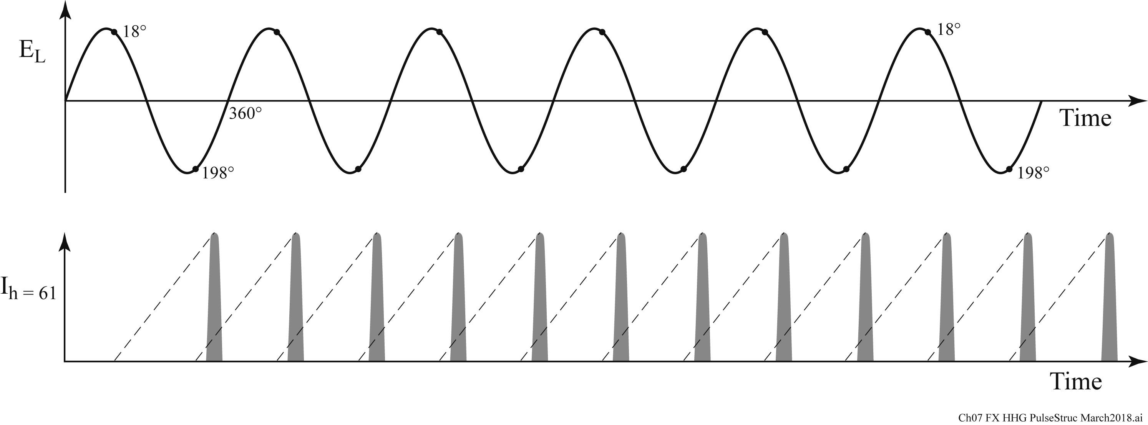
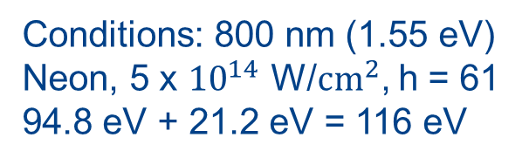
High harmonics are generated twice per IR cycle
Electron return and EUV/SXR emission
delayed ≈ 2.4 fsec
Conditions: 800 nm (1.55 eV)
Neon, 5 x ${10}^{14}$ W/${cm}^{2}$, h = 61
94.8 eV + 21.2 eV = 116 eV
Following Yanwei Liu (UCB/AS&T now at SLAC). Also see T. Pfeifer et al. Optics Lett. 31, 975 1 April 2006).

Slide 17
University of California, Berkeley
X-rays and Extreme Ultraviolet Radiation
AST210/EECS213
Fall 2019

Slide 18
High Harmonic Generation (HHG)

Slide 19
HHG spectra in pursuit of non-linear EUV processes
Ti:sapphire, 780 nm/45 nm bandwidth, 20mJ, 27 fsec, 1 KHz, 2Torr Ar, 6m focus to a 6 cm gas cell. Energy/pulse ~3 nJ in the 29th harmonic at 26.9 nm.
Relative spectral resolution ~ 1/2hN ~ 1/145, thus Δλ ~ 0.2 nm (~Instr. ltd.)
Courtesy of E. Champenois, UC Berkeley, AS&T.

Slide 20
Three Step HHG Model
Tunneling of a valence electron through the atom’s potential barrier in the presence of an intense laser field
Acceleration of the electron in the intense laser field, and return to the parent ion upon laser field reversal
Radiative recombination with the emission of a photon having an energy equal to the binding energy plus return kinetic energy

Slide 21
Tunneling ionization at moderately high laser intensity
Modest laser intensity provides single electrons for the HHG process without excessive ionization. Excessive plasma electrons would increase the IR wave phase velocity and thus affect phase matching across the interaction region. The plasma electron density profile would also cause refractive divergence of the IR laser pulse.
Augst, Strickland et al., PRL 63, 2212 (13Nov1989)

Slide 22
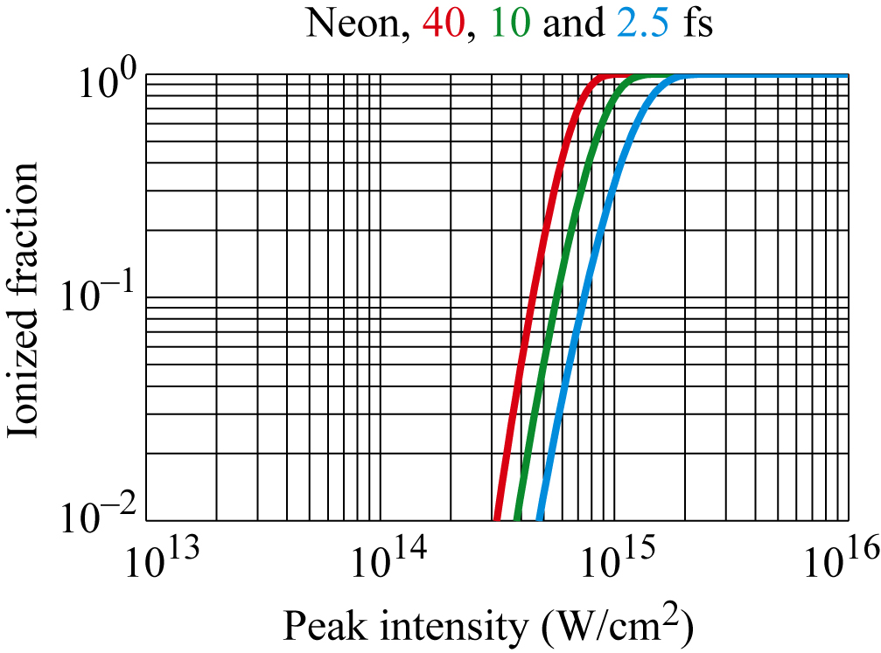
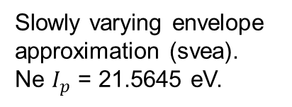
Calculated ionization probabilities for a neon atom as a function of laser intensity
Slowly varying envelope
approximation (svea).
Ne $I_{p}$ = 21.5645 eV.
Courtesy of C. Ott, MP/INF, Heidelberg

Slide 23
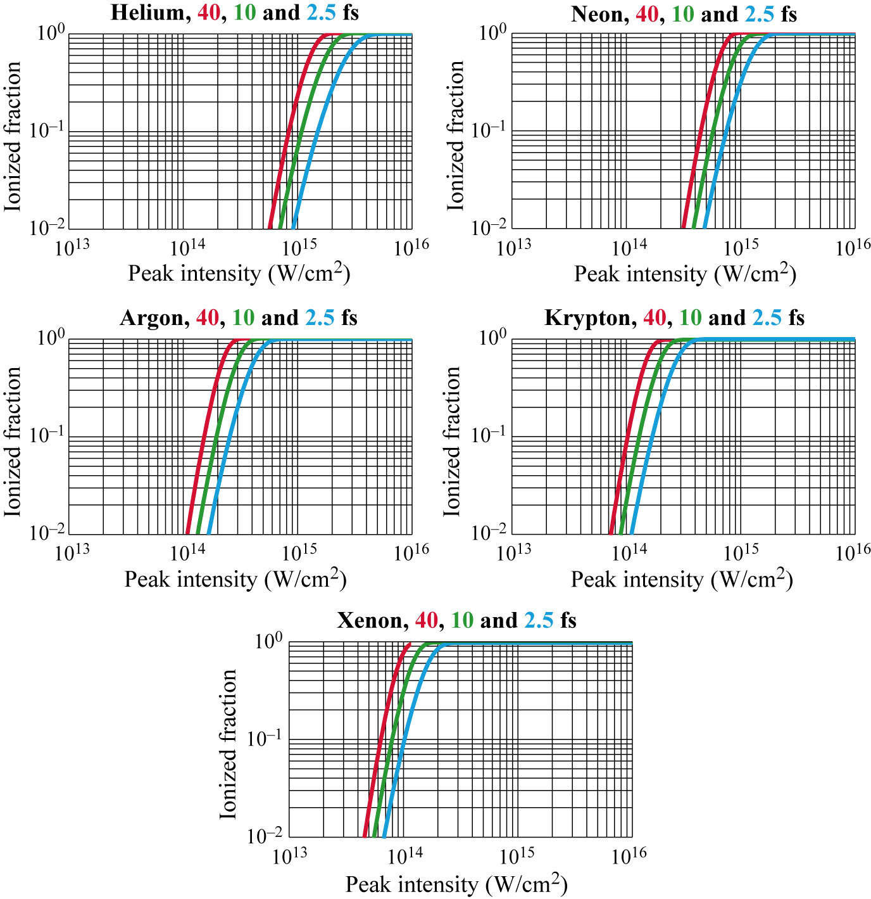
Calculated ionization probabilities for He, Ne, Ar, Kr and Xe atoms as a function of laser intensity
Slowly varying envelope
approximation (svea).
Courtesy of C. Ott, MP/INF, Heidelberg

Slide 24
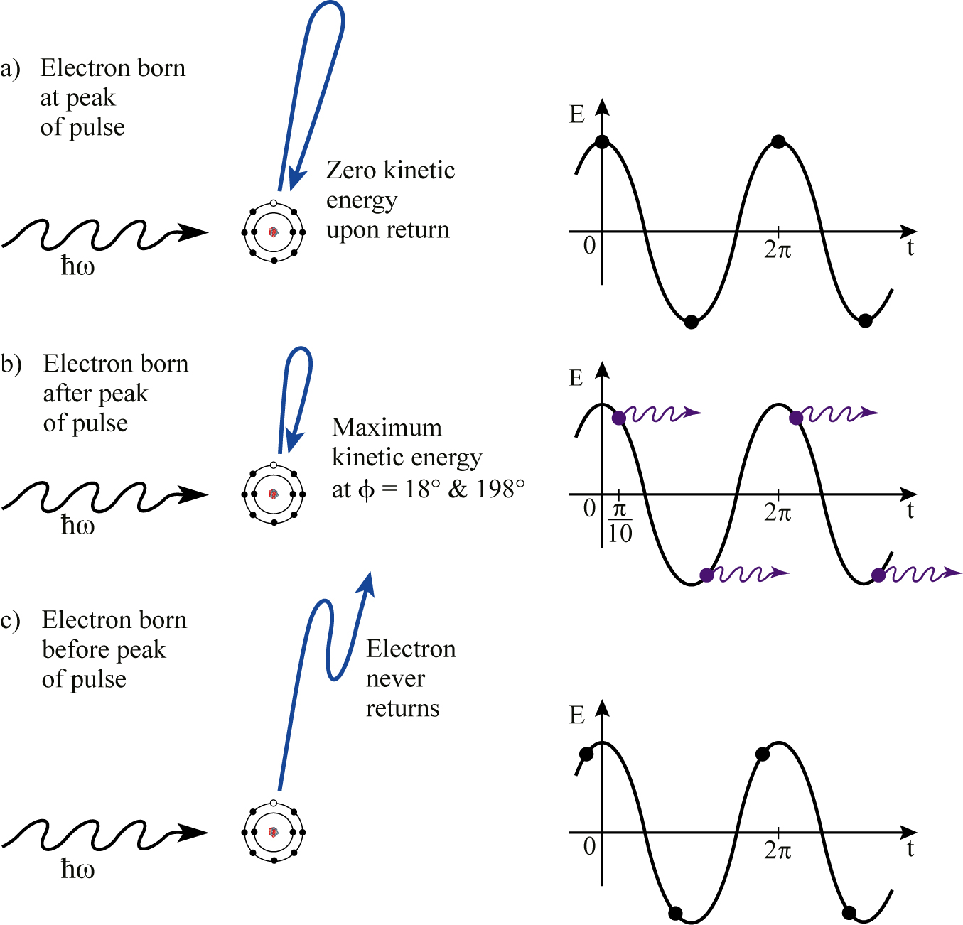
Step 2: Electron acceleration in the laser field. Time of birth affects return energy

Slide 25
Electron motion in an intense laser field
The equation of motion for a bound electron just released in a laser field of E = E₀cosωt
a(t) = d²x/dt² = -[eE₀ /m] cosωt
Integrating twice
v(t) = -[eE₀/mω] sinωt + v₀
x(t) = [eE₀/mω²] cosωt + v_{o}t + x₀
where the constants of integration are set by the initial conditions v(t₀) = 0 and x(t₀) = 0 at the electron’s time of birth, ωt₀ =φ₀, within the phase φ=ωt of the laser electric field
ma = -e[E + v x B]

Slide 26
Electron motion in an intense laser field: applying boundary conditions at t = 0
With the initial conditions v(t₀) = 0 and x(t₀) = 0
v₀= [eE₀/mω] sinφ₀
and x₀ = - [eE₀/mω²](cosφ₀ + φ₀sinφ₀)
The time dependent velocity of the electron is then
v(t) = -[eE₀/mω](sinφ – sinφ₀) (correct Eq.7.6a in book)
and the time dependent amplitude of the electron (away from the parent atom ion) is
x(t) = [eE₀/mω²][(cosφ – cosφ₀) + (φ-φ₀)sinφ₀] (Eq.7.6b)
At return to the parent ion x(t_{r}) = 0, thus the bracket on the rhs must be zero
φ_{r}sinφ₀ + cosφ_{r} = φ₀sinφ₀ + cosφ₀
where the return phase is φ_{r} = ωt_{r}.

Slide 27
An HHG example
For atoms irradiated at 5 x 10¹⁴ W/cm², with a wavelength of 800 nm, the peak electric field, E₀, is 6.14 x 10⁸ V/cm. From the equations in a previous slide, one has
x(t) = (1.947 nm)[(cosφ – cosφ₀) + (φ – φ₀)sinφ₀)]
The electron return energies are
E_{e} (t_{r}) = ½ mv²(t_{r}) = [e²E₀²/2mω²] (sinφ_{r} – sinφ₀)²
E_{e} (t_{r}) = (59.76 eV) (sinφ_{r} – sinφ₀)²
The trajectory for φ₀ = 0° (birth at the peak of the laser electric field) corresponds to a simple electron oscillation with excursion distances of nearly 4 nm from the parent ion, gaining a maximum kinetic energy of near 60 eV, but returning to the ion with zero kinetic energy. For neon atoms the ionization energy is 21.6 eV.

Slide 28
An HHG example (continued)
Of particular interest is φ₀ ≅ π/10 = 18°, just beyond the peak of the pulse. This corresponds to the maximum return energy, in this example 94.8 eV at φ₀ = 18° and φ_{r} = 252°. Note that the cycle averaged kinetic energy is 29.9 eV, demonstrating the 3.17 factor. The highest photon energy emitted equals the return kinetic energy, 94.8 eV, plus the neon ionization energy, 21.6 eV, for a total of 116 eV.

Slide 29
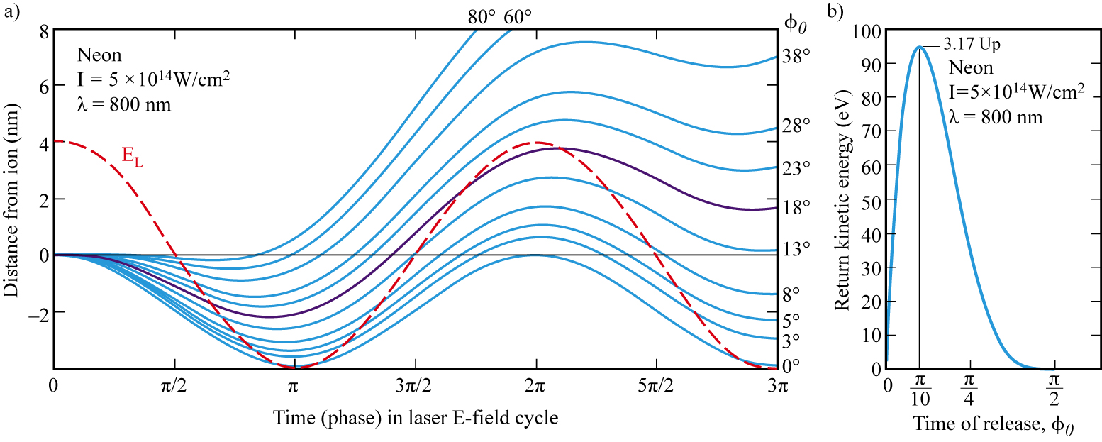
Electron trajectories for a variety of emission times within the phase of the incident electric field
For an initial phase φ = o, the electron gains significant kinetic energy but returns
with none, simply oscillating with a 4 nm excursion amplitude.
For initial phases of φ = π/10, or 18˚, maximum return kinetic energy is achieved,
94.8 eV in this case. The same is true for 198˚, but travel is in the opposite direction.
Electrons emerging from the tunneling process at initial phases extending from π/2
to π, just before the peak of the pulse, never return to the parent ion.
Note that the same return electron kinetic energy occurs twice in (b). These correspond
to what is known as the short and long return paths.

Slide 30
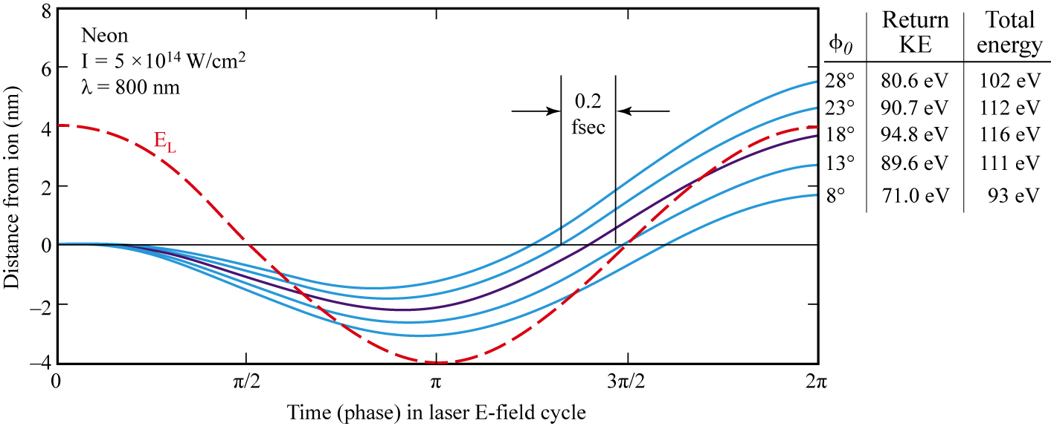
Selected trajectories with a limited bandpass
Note that for φ = 18˚ the return kinetic energy is maximum at 94.8 eV. Adding the ionization energy, the total available energy for photon emission is 116 eV, assuming there is a radiative recombination with the parent ion. A 5% spectral bandpas around that peak is emitted within 200 asec.

Slide 31
Step 3: Radiative recombination with the parent ion
The probability of electron recombination is relatively small due to several factors. Tunneling has an efficiency of order 10⁻¹ to 10⁻². Half the photoelectrons never return to their parent ion. The return probability is dominated by the long excursion path (several nm) away from the ion and the divergent nature of the emitted electron wave packet, known as "quantum diffusion". The photoemission process is properly described as diffraction of an electron wave packet as it emerges from the transversely confined, Ångstrom scale atom. Thus the electron moves away from the ion as a divergent electron wave packet, with a lateral divergence of order 5Å/fsec (Corkum and Krausz, Nature Physics, 2007). Thus a 2 fsec return time yields a 1 nm electron wavepacket spread across the 0.1 nm “wide” parent ion, further reducing the probability of recombination. Experimental values or overall HHG conversion efficiency are seen in the next slide.

Slide 32
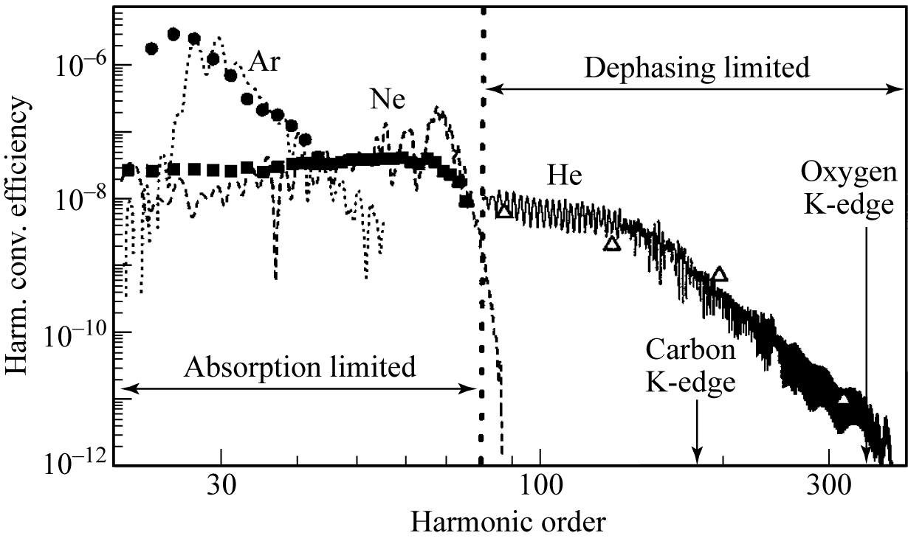
Conversion efficiency of high harmonic generation
Coutesy of M. Schnürer, Techn.Univ.Vienna, and F.Krausz, Max Planck Instit. for Quant. Optics and Ludwig Maxmillians Univ., Garching

Slide 33
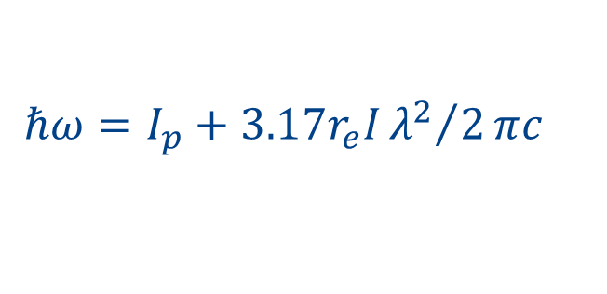
Scaling of efficiency, η, with laser wavelength
There is great interest in extending HHG into the soft x-ray region with photon energies of several hundred eV. The photon energies which can be achieve are given by Eqs.(7.1 & 7.2):
where λ is the driving laser wavelength. The choice of longer wavelengths correctly predicts higher achievable harmonic energies.
However, the HHG efficiency is also dependent on the driving laser wavelength, λ, through the liberated electron excursion distance and probability of radiative recombination. The excursion distance of the free electron is given by Eq.(7.6b): x(t) = [eE₀/mω²][(cosφ – cosφ₀) + (φ-φ₀)sinφ₀]
thus the excursion distance, x ~ λ² , and the round trip distance, 2x ~ 2λ².
The probability of recombination, an important multiplicative factor in the overall conversion efficiency,η, scales inversely with return area. Thus η includes a factor ~ 1/(2x)² ~ 1/4 λ⁴ . Quantum mechanical calculations of electron wavefront propagation indicate an efficiency more like λ⁻⁵ or λ⁻⁶, a high price to pay for increased harmonic generation into the soft x-ray region, indicating that one does not want to push longer wavelengths too far.
$$ℏω=I_{p}+3.17r_{e}I{λ^{2}}/2πc$$

Slide 34
The generation of high harmonics
IR pulse trains generate high harmonics through constructive and destructive interference
There are twice the number of EUV/SXR pulses as IR cycles
The IR pulses each generate a spectral continuum, which by constructive and destructive interference form harmonics.
Symmetric pulse structure (in time) implies only odd harmonics
Even harmonics appear only if the temporal symmetry is broken
Fourier analysis of the EUV wave train reveals high harmonics, limited in photon energy, and thus harmonic number, by Eq.(7.1)
To first order the harmonic pulses contain hN cycles and are of similar duration as the driving IR laser pulse
With a single IR pulse there is no interference, thus no harmonics form, leaving a broad EUV spectral content and thus permitting the formation of very short (asec) pulses

Slide 35
Spatial and Temporal Coherence of High harmonic Radiation
Spatial coherence is impressed by that of the driving laser field. The condition d_{FWHM} ∙ 2θ_{FWHM} ≅ λ/2 implies that the harmonics radiate into narrower angles than the incident IR.
The spatial coherence of HHG radiation is largely imprinted from that of the fully coherent IR laser wavefront. This is true despite the randomness of atoms in the gas. Every participating atom across a uniform IR wave front emits radiation in the forward direction with a fixed phase relative to the laser electric field, and thus to each other. As a consequence of this impressed spatial coherence, the electric fields for a given harmonic add constructively in the forward direction, generating very intense radiation, proportional to the square of the number of participating atoms in the interaction region. Random atomic positions do affect radiation emitted in other directions. Random phases in other directions generally cancel so that there is essentially no HHG at other angles.

Slide 36
Spectral bandwidth and duration of mid-spectral range HHG pulses
For mid-spectral range harmonics one expects a relative spectral bandwidth λ/Δλ ≈ hN, the product of the # of IR cycles, N, and the harmonic #, h. Relative spectral bandwidths can be of order 0.1%.

Slide 37
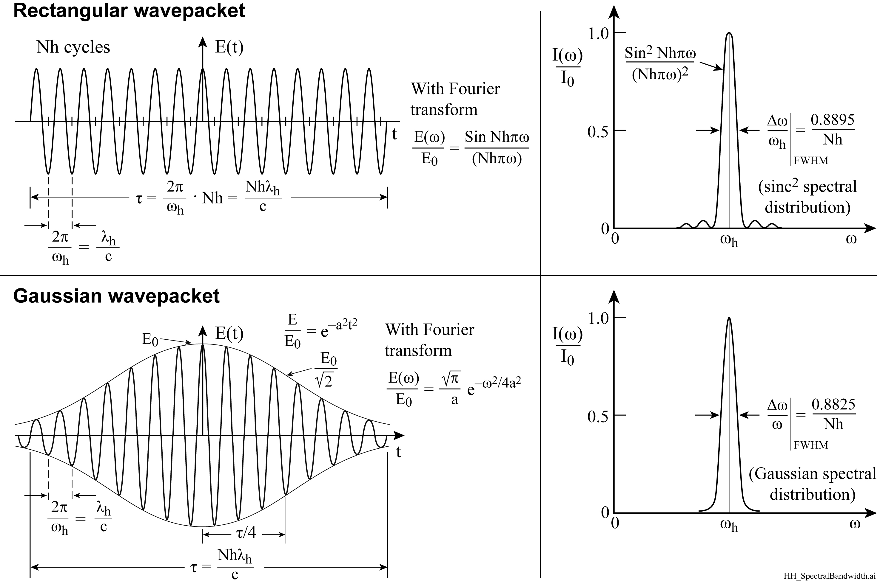
High harmonic spectral bandwidth
We consider two models of HHG spectral bandwidth, a rectangular wavepacket, and a Gaussian wavepacket having an intensity FWHM equal to half the duration of the rectangular wavepacket. In each case we take the Fourier transform of the electric field, E(t), to obtain E(ω), then square to obtain I(ω).
For experimental HHG spectra see, for example, M. Gaarde et al.,PRA 59,1367 (Feb1999),Fig.5; and P. Saliѐres et al. Science 292, 902 (4May2001).

Slide 38
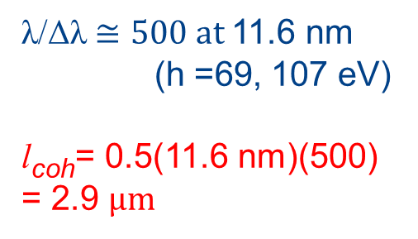
Spectrally narrow high harmonics
Courtesy of Thomas Pfeifer,
Max Planck Institute for Nuclear Physics, Heidelberg
λ/Δλ $≅500 at$11.6 nm
(h =69, 107 eV)
l_{coh}= 0.5(11.6 nm)(500) = 2.9 μm
HHG relative spectral bandwidths of order hN/2 are discussed in the literature, e.g., M.B. Gaare et al, Phys. Rev. A 59, 1367 (February 1999); P. Salieres et al., Science 292, 902 (4 May 2001).

Slide 39
Temporal coherence of HHG
Temporal coherence is set by the harmonic bandwidth l_{coh} = λ²/2Δλ
For mid-range harmonics one expects a relative spectral bandwidth λ/Δλ ≈ hN, the product of the # of IR cycles, N, and the harmonic #, h.
Relative spectral bandwidths can be of order 0.1%.
For attosecond duration pulses a broad spectral bandwidth is required
thus a 100 asec pulse requires an 18 eV bandwidth
ΔE_{FWHM} ∙Δτ_{FWHM} ≥ 1.825 eV∙fsec

Slide 40
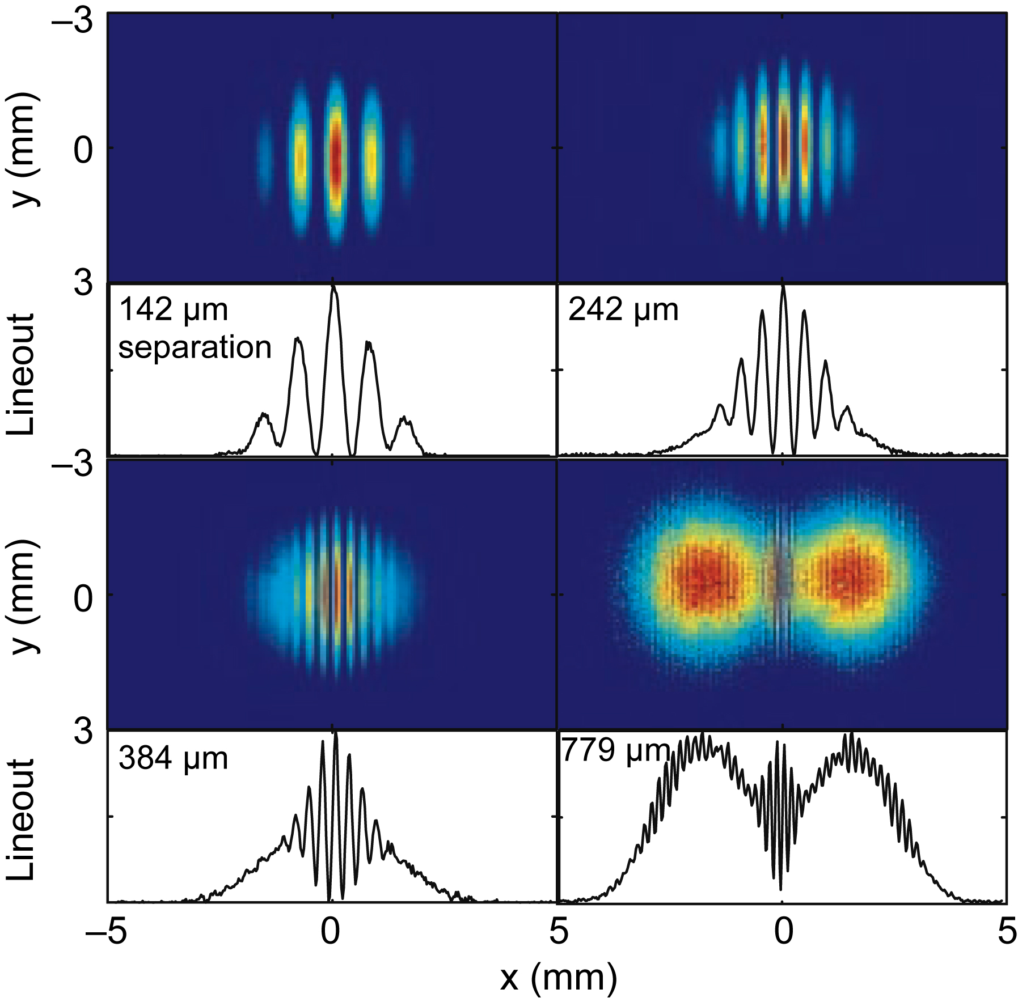
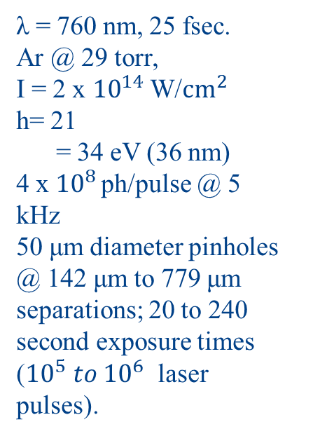

HHG approaches full spatial coherence
λ = 760 nm, 25 fsec.
Ar @ 29 torr,
I = 2 x ${10}^{14}$ W/${cm}^{2}$
h= 21
= 34 eV (36 nm)
4 x ${10}^{8 }$ph/pulse @ 5 kHz
50 μm diameter pinholes @ 142 μm to 779 μm separations; 20 to 240 second exposure times (${10}^{5} to {10}^{6 }$laser pulses).
$ℏω$
Courtesy R. Bartels, Univ. Colorado, Boulder, now at CSU, Fort Collins,
and Y. Liu, UC Berkeley, now at SLAC.

Slide 41
New topic: Generating asec HHG pulses

Slide 42
Generating asec HHG pulses
For attosecond duration pulses a broad spectral bandwidth is required; not a spectrally sharp harmonic. A 100 asec pulse requires an 18 eV bandwidth
ΔE_{FWHM} ∙Δτ_{FWHM} ≥ 1.825 eV∙fsec

Slide 43
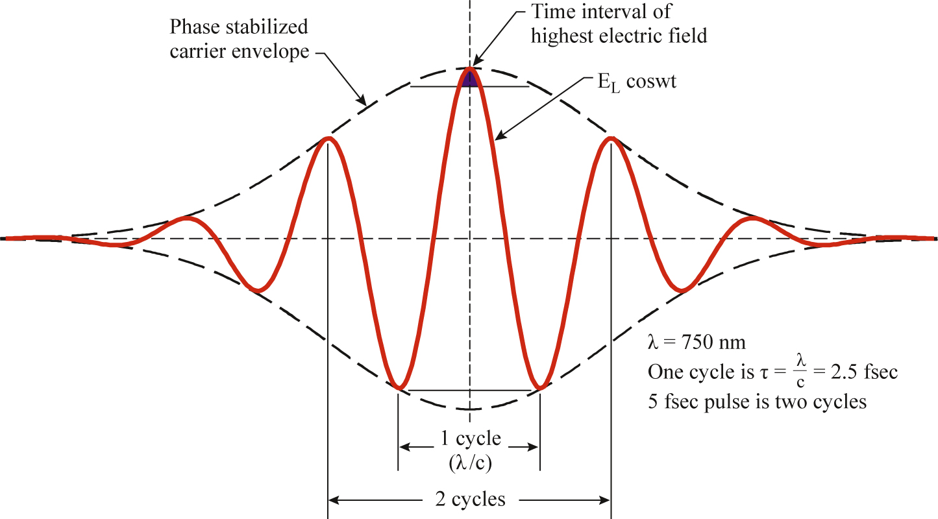
Generating attosecond duration pulses
… by stabilizing the carrier phase envelope (CPE) and spectrally accepting only the highest intensity
Following F. Krausz and M. Ivanov, “Attosecond Physics” Rev. Mod. Phys. 81, 163(Jan.– March 2009)

Slide 44
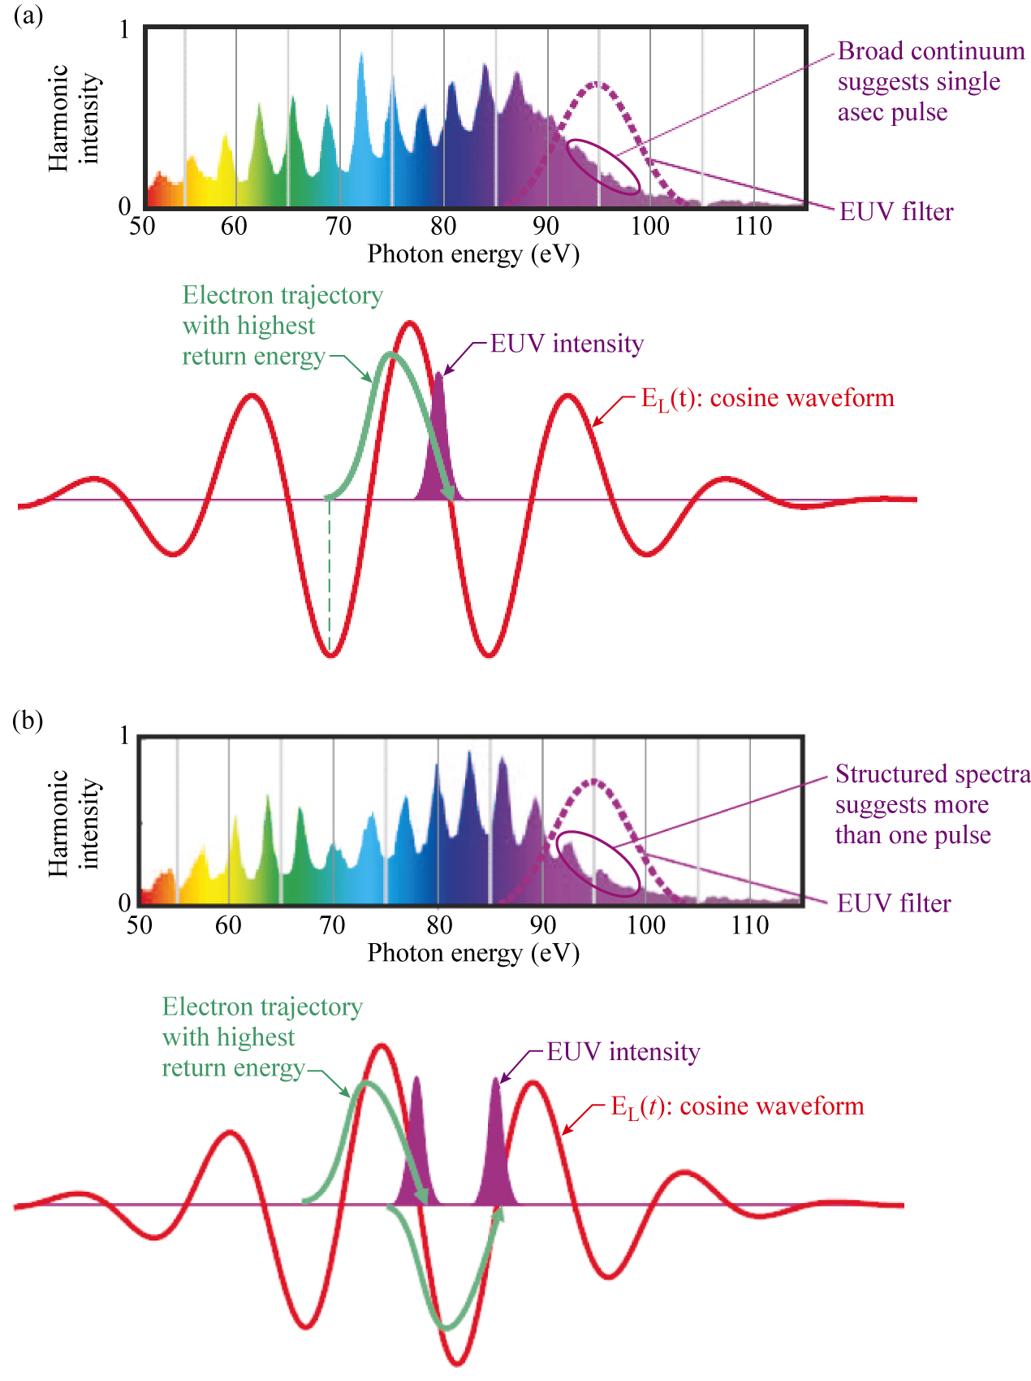
Spectral features reveal pulse structure
Courtesy of F. Krausz and M. Ivanov,
“Attosecond Physics”, Rev. Mod. Phys.
81, 163 (Jan-March 2009)

Slide 45
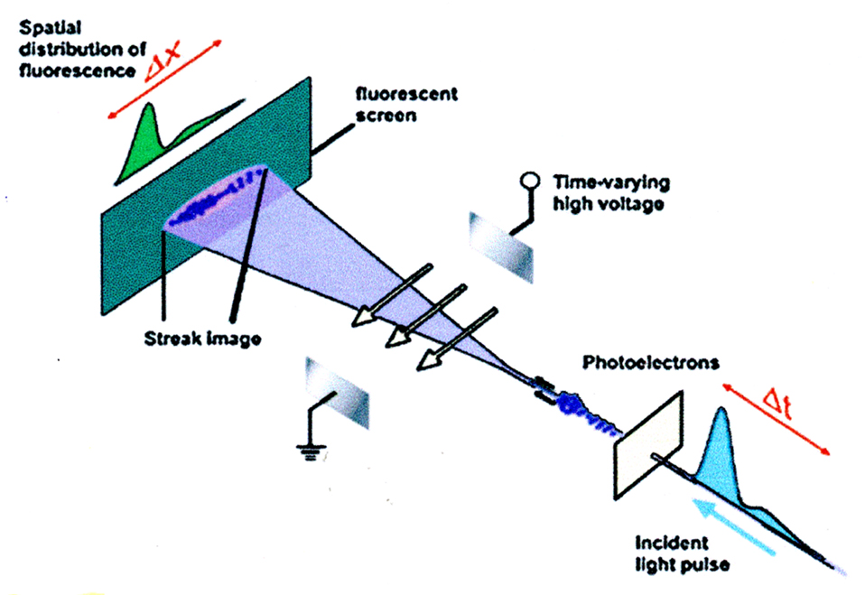
Conventional streak camera
R. Kienberger and F. Krausz,
“Attosecond Metrology Comes of Age”,
Physica Scripta, T110, 32 (2004)

Slide 46
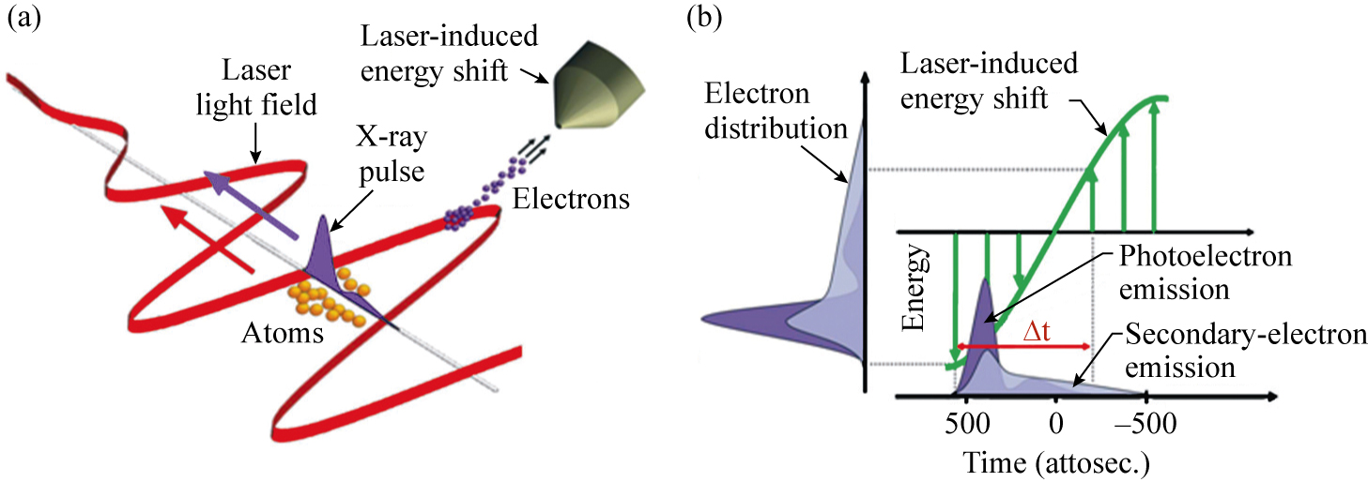
IR laser field/ photoelectron streak camera
Attosecond Streak Recorder (ATR):
R. Kienberger and F. Krausz,
“Attosecond Metrology Comes of Age”,
Physica Scripta, T110, 32 (2004)

Slide 47
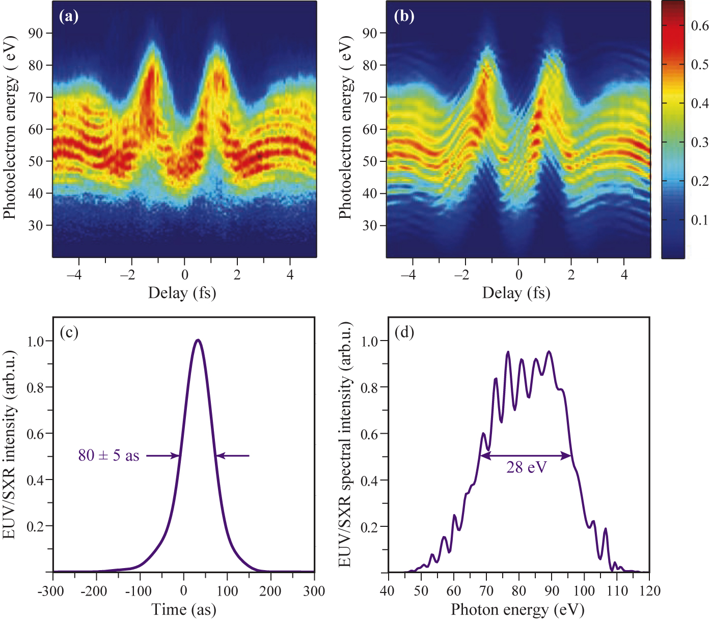
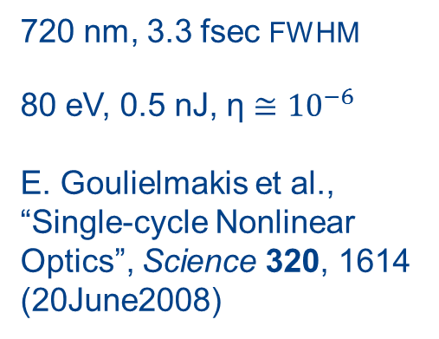
Generating single 80 asec EUV pulses
720 nm, 3.3 fsec FWHM
80 eV, 0.5 nJ, η $≅$ ${10}^{−6}$
E. Goulielmakis et al.,
“Single-cycle Nonlinear Optics”, Science 320, 1614 (20June2008)
Courtesy of E. Goulielmakis and F. Krausz, MPI Quantum Optics, Garching; A. Aquila, AST/UCB

Slide 48
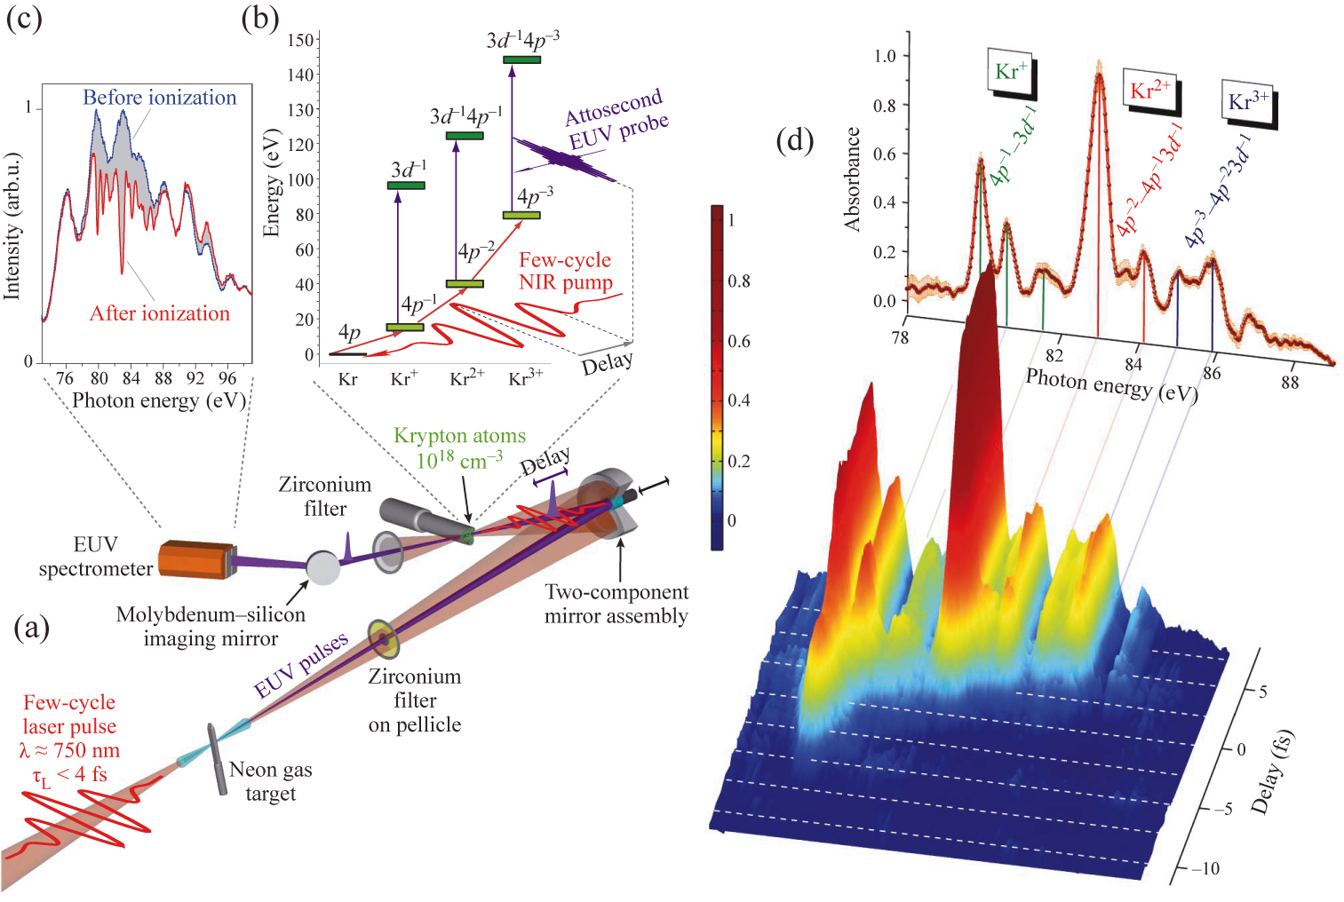
Attosecond transient absorption spectroscopy: A pump - probe study of electron dynamics in atomic Kr ions
E. Goulielmakis, Z.-H. Loh, A. Wirth, R. Santra, N. Rohringer, V. S. Yakovlev, S. Zherebtsov, T.Pfeifer, A. M. Azzeer, M. F. Kling, S. R. Leone and F. Krausz, “Real-Time Observation of Valence Electron Motion”, Nature 466, 739 (5 August 2010).

Slide 49
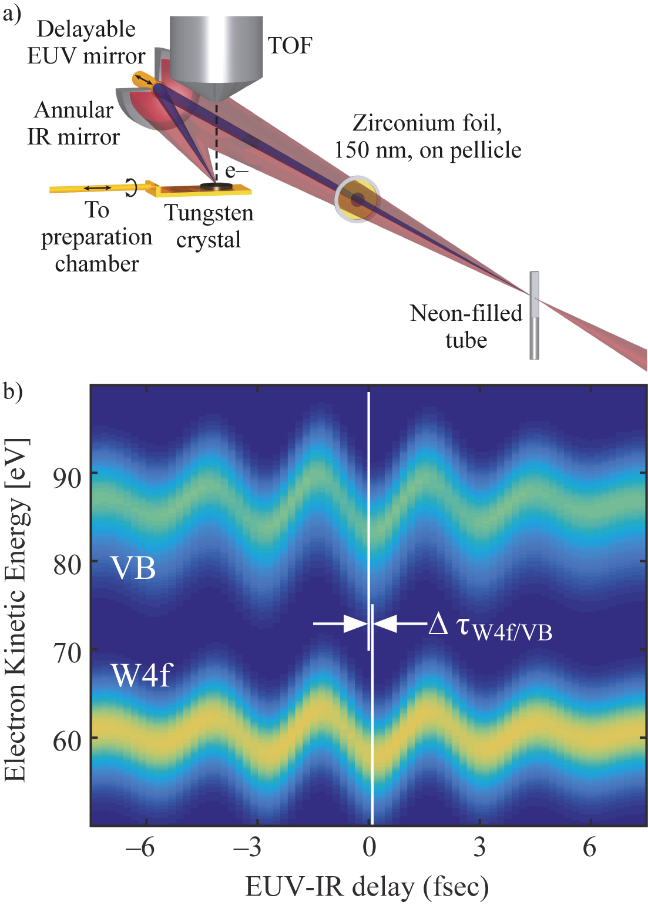
Attosecond streak spectrometry of delayed photoemission in solid state tungsten
Photoelectrons liberated from core states are observed to be delayed ~100 asec with respect to electrons from the conduction band in crystalline tungsten (W).
A. L. Cavalieri, N. Müller, Th. Uphues, V. S. Yakovlev, A. Baltuška, B. Horvath, B. Schmidt, L. Blümel, R. Holzwarth, S. Hendel, M. Drescher, U. Kleineberg, P. M. Echenique, R. Kienberger, F. Krausz and U. Heinzmann, “Attosecond Spectroscopy in Condensed Matter”, Nature 449, 1029 (25 October 2007).

Slide 50
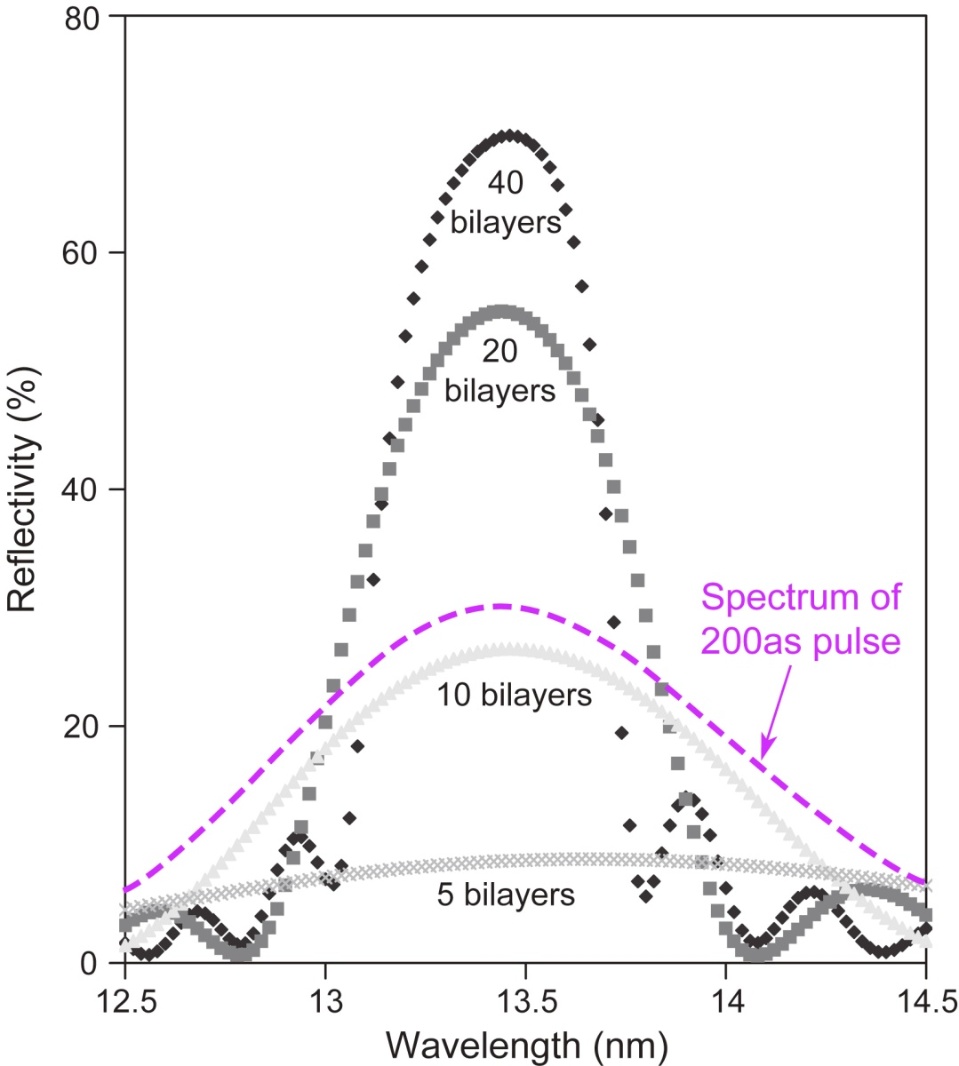
Broad bandwidth multilayer mirrors can support asec duration pulses
∆E(eV) ∙∆τ(fs) ≥ 1.8 fs∙eV (FWHM)
Multilayer mirrors depend on constructive interference from individual interfaces
Higher reflectivity needs more layers
Bandwidth gets narrower with more layers
Attosecond pulse requires a broad spectral bandwidth, thus a limited number of layers.
Multilayer mirror with N<10 layers required for a 200 as pulse (@13nm)
Courtesy of Yanwei Liu, UCB/AS&T, now SLAC

Slide 51
What limits IR to EUV harmonic conversion efficiency?
Return efficiency
Effective IR path in the gas

Slide 52
Laser High Harmonic Generation (HHG);
What limits the interaction lengh?

Slide 53
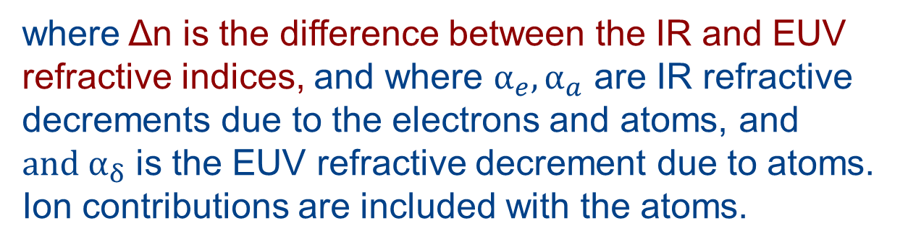

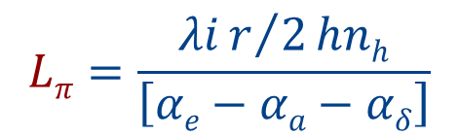
Differing EUV and IR phase velocities limit HHG generation
The dephasing distance is that where the downstream generated EUV is out of phase by π with the earlier upstream generated HHG. Propagation beyond that is counterproductive, limiting further increases to the harmonic pulse energy. The limiting dephasing distance is given by
(0.5λ/h)/Δn
$$Lπ=\frac{λir/2hnh}{\left[αe−αa−αδ\right]}$$
$$=$$
n_{hh} error in book, p.297
where Δn is the difference between the IR and EUV refractive indices, and where $α_{e}{,α}_{a}$ are IR refractive decrements due to the electrons and atoms, and ${and α}_{δ}$ is the EUV refractive decrement due to atoms. Ion contributions are included with the atoms.

Slide 54

The dephasing limit for effective HHG is due to differences in the IR and harmonic phase velocities
The distance travelled in the medium by the IR and high harmonic waves is (λ is in vacuum)
L_{ir} = Nλ_{ir} = Nλ/n_{ir}
L_{h} = (hN + ½)λ_{h} = (hN + ½)λ/hn_{h}
The dephasing distance is reached when $L_{ir}$ = $L_{h}$. Solving for N, the number of IR cycles for dephasing is
so that the dephasing distance can be written as

Slide 55
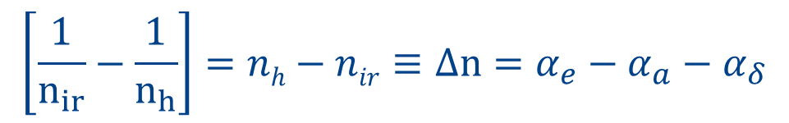
Refractive index decrements are small for these IR and high harmonic waves
For the driving IR wave, with contributions from low density neutral atoms (and ions) and from free electrons, the refractive index is n_{ir} = 1 + α_{a} – α_{e} , where α_{a} and α_{e} « 1 and positive.
For the higher photon energy harmonic wave, with contributions from the atoms (and ions), the refractive index is n_{h} = 1– α_{δ} ,where α_{δ} « 1 and positive.
Note that the free electron contribution to the harmonic wave is negligible as it scales as 1/ω².
The factor in the denominator of L_{π} is then
$$\left[\frac{1}{n_{ir}}−\frac{1}{n_{h}}\right]=nh−nir≡Δn=α_{e}−α_{a}−α_{δ}$$

Slide 56
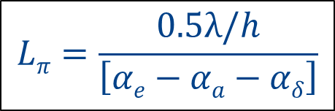
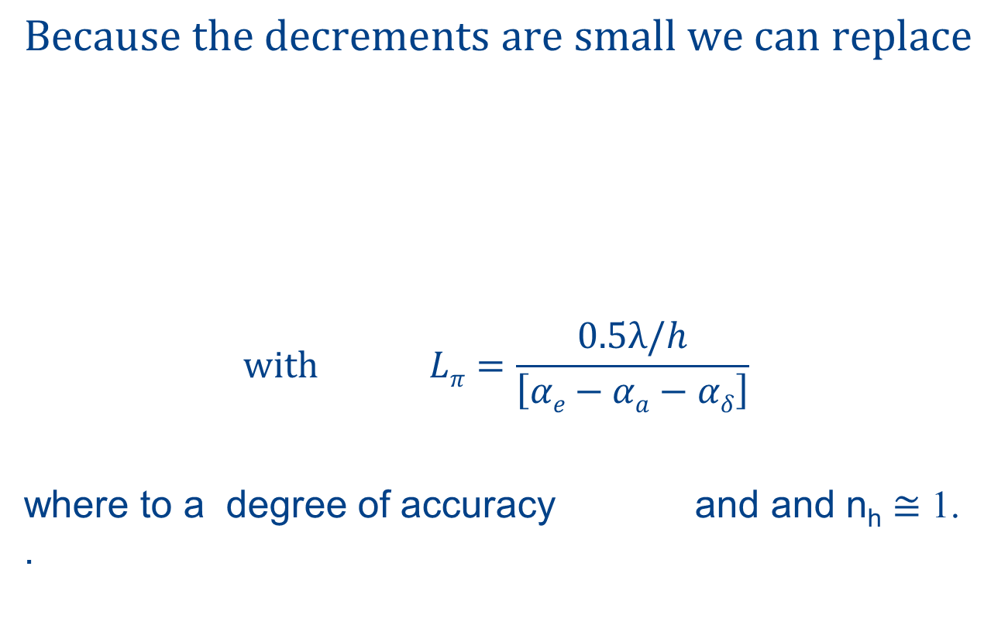

The dephasing distance for HHG
$$Because the decrements are small we can replace$$
$$with Lπ=\frac{0.5λ/h}{\left[αe−αa−αδ\right]}$$
where to a degree of accuracy and and n_{h} $≅$ 1. .
$$Lπ=\frac{0.5λ/h}{\left[αe−αa−αδ\right]}$$
Eq.(7.13)
$$λ≃λ_{ir}$$

Slide 57
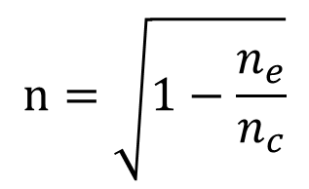
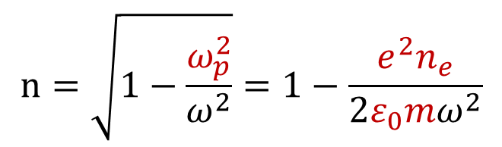
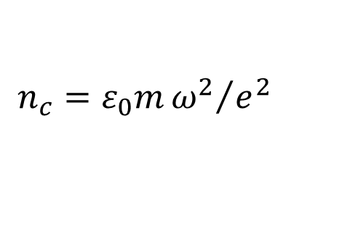
A note on the refractive index of an electromagnetic wave in a plasma
$$n=\sqrt{1−\frac{ω_{p}^{2}}{ω^{2}}}=1−\frac{e^{2}n_{e}}{2ε_{0}mω^{2}}$$
$$n=\sqrt{1−\frac{n_{e}}{n_{c}}}$$
where
$$n_{c}=ε_{0}m{ω^{2}}/{e^{2}}$$
For Ne at 300 Torr & 1.1% ionization, n_{e} = 1.17 x 10¹⁷ e/cc. For 800 nm light, n_{c}= 1.73 x 10²¹ e/cc.
Thus n_{e} / n_{c} << 1 for the IR pulse.The sq root approx. is good. The plasma electrons exert a strong refractive effect, speeding the IR wave and introducing a negative lensing.
Because of its 1/ω² dependence, the plasma contribution to the higher frequency EUV refractive index is negligible.

Slide 58
An example of dephasing distance
To determine the value of L_{π} various refractive index decrements are required. As an example we choose neon at a pressure of 300 Torr (~0.4 atm), illuminated by an 800 nm wavelength, 40 fsec pulse at an intensity of 3.2 x 10¹⁴ W/cm².
For the IR at 800 nm:
Free electrons. With1.1 x 10¹⁹ neon atoms/cm³ and 1.1% ionization, the free electron density is 1.2 x 10¹⁷e/cm³. With a critical electron density of 1.7 x 10²¹ e/cm³, the IR refractive index decrement due to free electrons, α_{e} = n_{e}/2n_{c}, is 3.4 x 10⁻⁵.
Atoms contribution to the IR refractive index. See the text.
α_{a} = (6.70 x 10⁻⁵)(300/760) =2.6 x 10⁻⁵ at 800 nm wavelength.

Slide 59
Dephasing example; high harmonic refractive index
High harmonic refractive indices. Neon at 3.2 x 10¹⁴ W/cm², highest harmonic is h= 53, 15.1 nm, 82.2 eV.
For the atoms at EUV wavelengths, Appendix C, Table C.1, f₁⁰ = 5.20 and f₂⁰ = 6.12,
α_{δ} = δ = n_{a}r_{e}λ²f₁⁰/2π = 5.6 x 10⁻⁶.
For the ions. Far from the K- and L-absorption edges the ions contribute essentially the same to refractive index as the atoms and thus are included with the atoms.
For the free electrons. Due to the 1/ω² dependence the free electron (plasma) contribution to EUV refractive index is negligible.

Slide 60
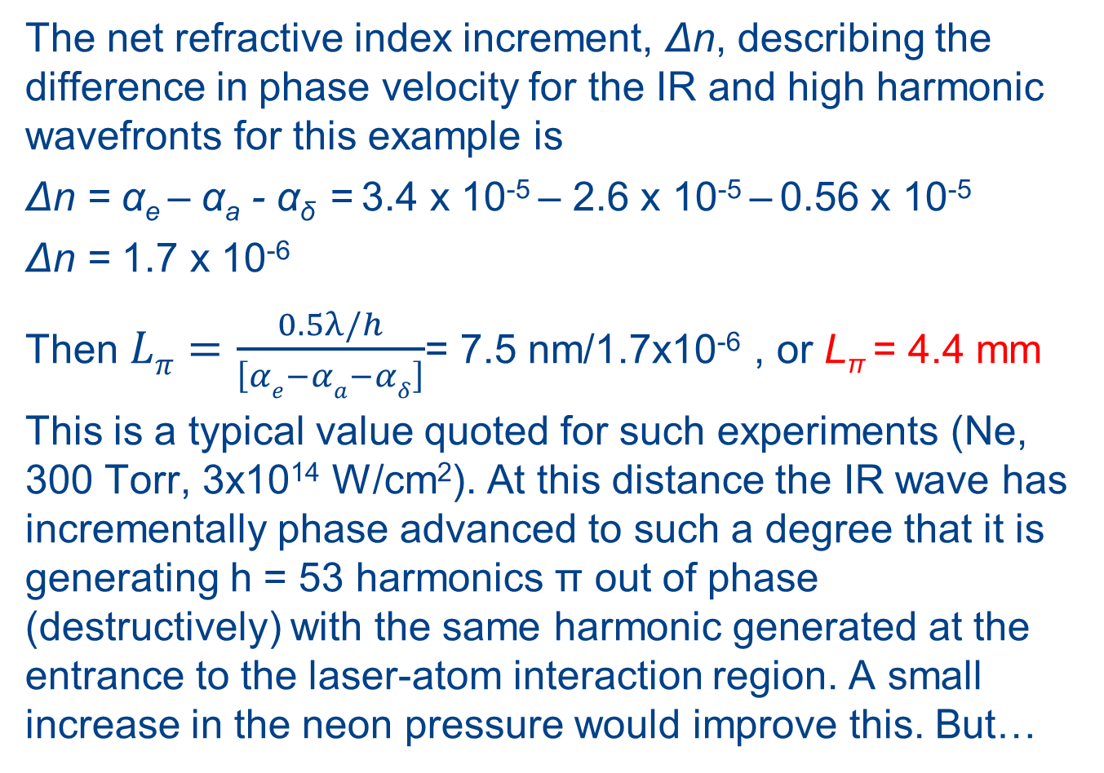
Dephasing distance, continued
The net refractive index increment, Δn, describing the difference in phase velocity for the IR and high harmonic wavefronts for this example is
Δn = α_{e} – α_{a} - α_{δ} = 3.4 x 10⁻⁵ – 2.6 x 10⁻⁵ – 0.56 x 10⁻⁵
Δn = 1.7 x 10⁻⁶
Then $Lπ=\frac{0.5λ/h}{\left[αe−αa−αδ\right]}$= 7.5 nm/1.7x10⁻⁶ , or L_{π} = 4.4 mm
This is a typical value quoted for such experiments (Ne, 300 Torr, 3x10¹⁴ W/cm²). At this distance the IR wave has incrementally phase advanced to such a degree that it is generating h = 53 harmonics π out of phase (destructively) with the same harmonic generated at the entrance to the laser-atom interaction region. A small increase in the neon pressure would improve this. But…

Slide 61
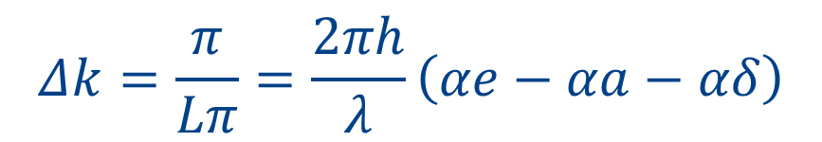
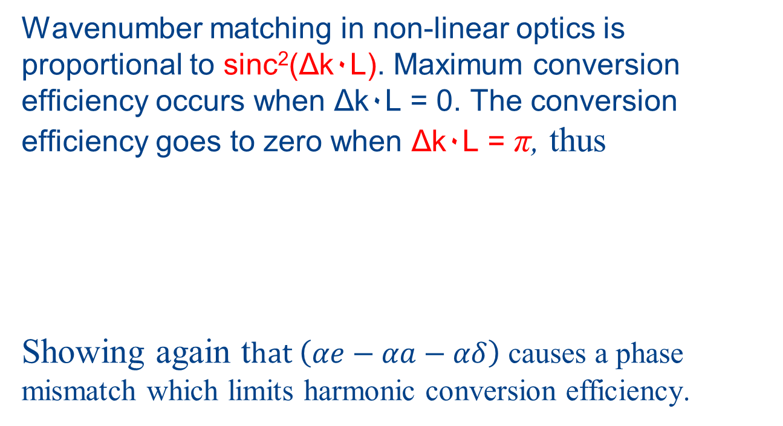
The common description of non-linear harmonic phase matching is in terms of wavenumber mismatch, Δk
Δk = k_{h} – hk = Δk_{e} + Δk_{a}
Wavenumber matching in non-linear optics is proportional to sinc²(Δk۰L). Maximum conversion efficiency occurs when Δk۰L = 0. The conversion efficiency goes to zero when Δk۰L = π, thus
Showing again t$hat \left(αe−αa−αδ\right)$ causes a phase mismatch which limits harmonic conversion efficiency.
$$Δk=\frac{π}{Lπ}=\frac{2πh}{λ}\left(αe−αa−αδ\right)$$

Slide 62
The effect of absorption
For neon at 800nm/53 = 15.1 nm, f₂⁰ = 6.12, which determines the imaginary component of the refractive index, which according to Eqs.(3.22 & 3.23) gives β = 6.63 x 10⁻⁶, and an absorption length l_{abs}= λ/4πβ = 0.18 mm.
Thus for this example the harmonic must propagate through several absorption lengths, greatly limiting the achievable conversion efficiency.
Unfortunately this photon energy, 82 eV, is near the peak absorption for neon, as seen in the f₂⁰ curve in Table C.1. Clearly tradeoffs need to be explored amongst gas, gas pressure, laser intensity and pulse duration when planning an HHG experiment.
Class project?

Slide 63
Absorption limited HHG conversion below 100 eV
Coutesy of M. Schnürer, Techn.Univ.Vienna, and F.Krausz, Max Planck Instit. for Quant. Optics and Ludwig Maxmillians Univ., Garching

Slide 64
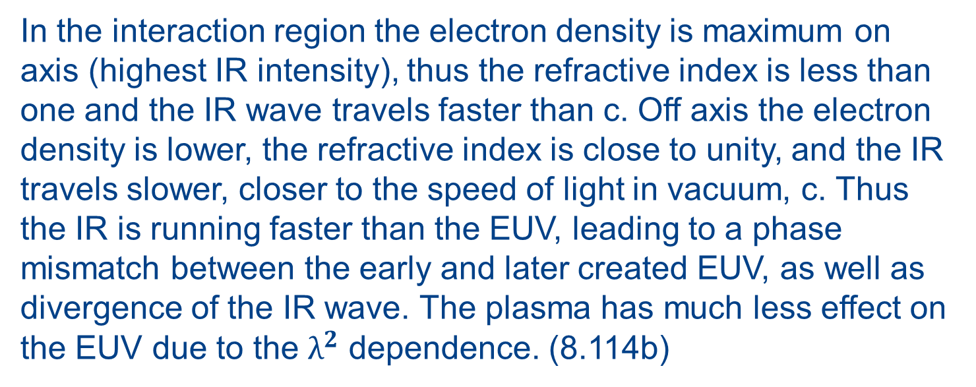
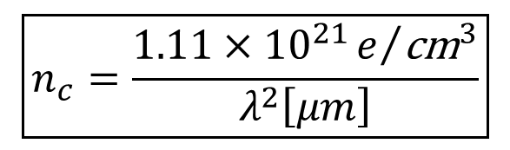
Further description of plasma refractive index
8.4.7 Transverse Electromagnetic Waves in a Uniform Plasma
(8.114b)
$$\boxed{n_{c}=\frac{1.11×{10}^{21}e/{{\text{cm}}^{3}}}{λ^{2}\left[μm\right]}}$$
(8.112b)
In the interaction region the electron density is maximum on axis (highest IR intensity), thus the refractive index is less than one and the IR wave travels faster than c. Off axis the electron density is lower, the refractive index is close to unity, and the IR travels slower, closer to the speed of light in vacuum, c. Thus the IR is running faster than the EUV, leading to a phase mismatch between the early and later created EUV, as well as divergence of the IR wave. The plasma has much less effect on the EUV due to the $λ^{2}$ dependence. (8.114b)

Slide 65
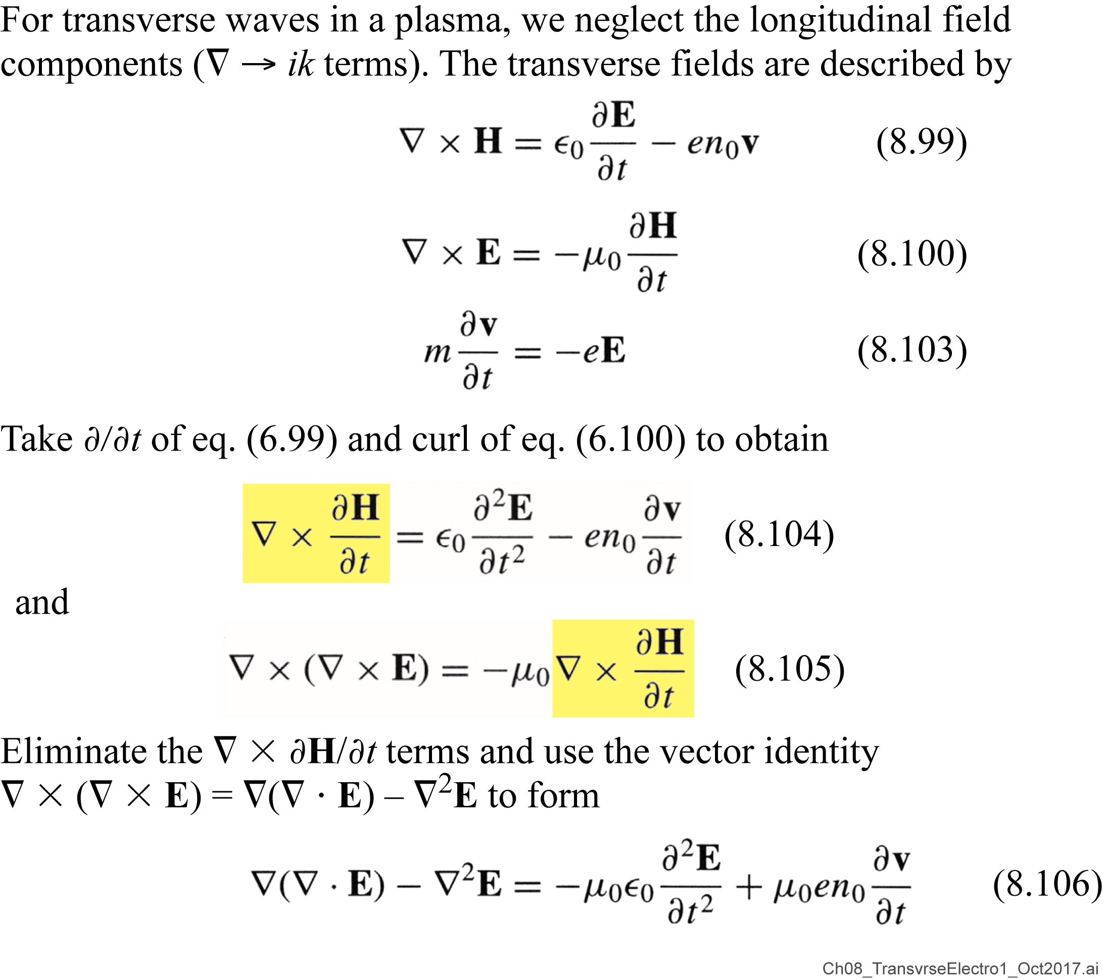
Transverse electromagnetic waves in a plasma
J = -en₀v

Slide 66
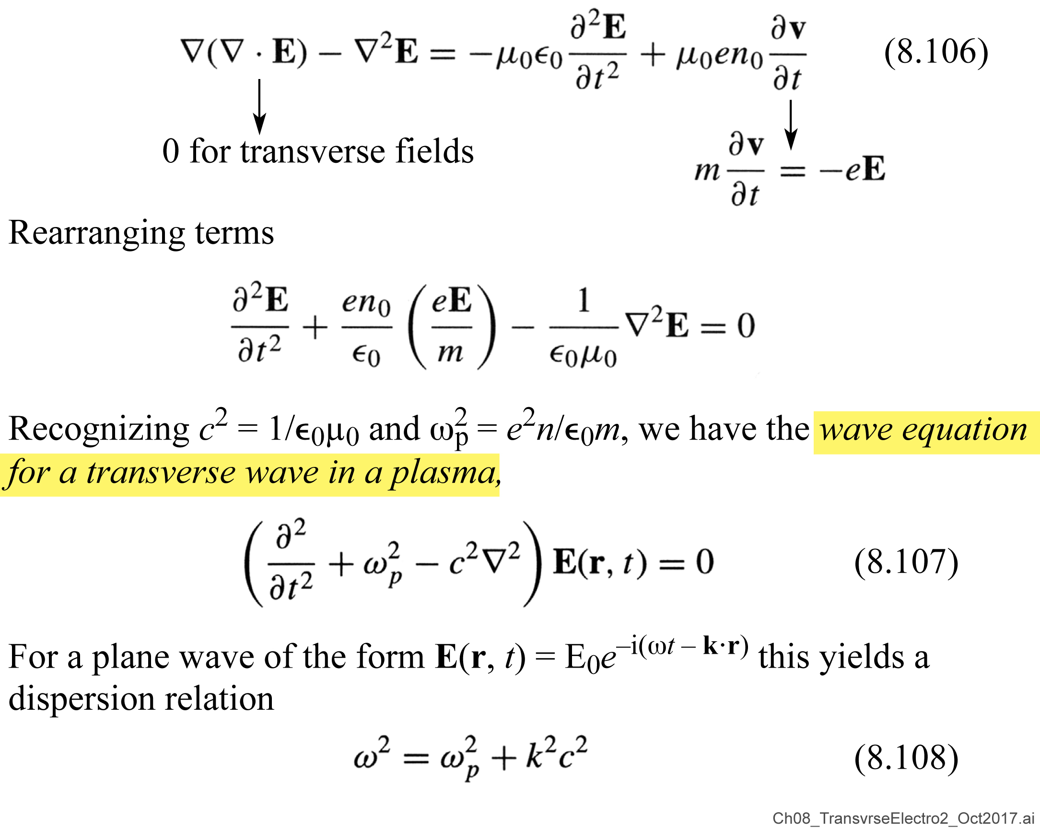
Transverse electromagnetic waves in a plasma (continued)

Slide 67
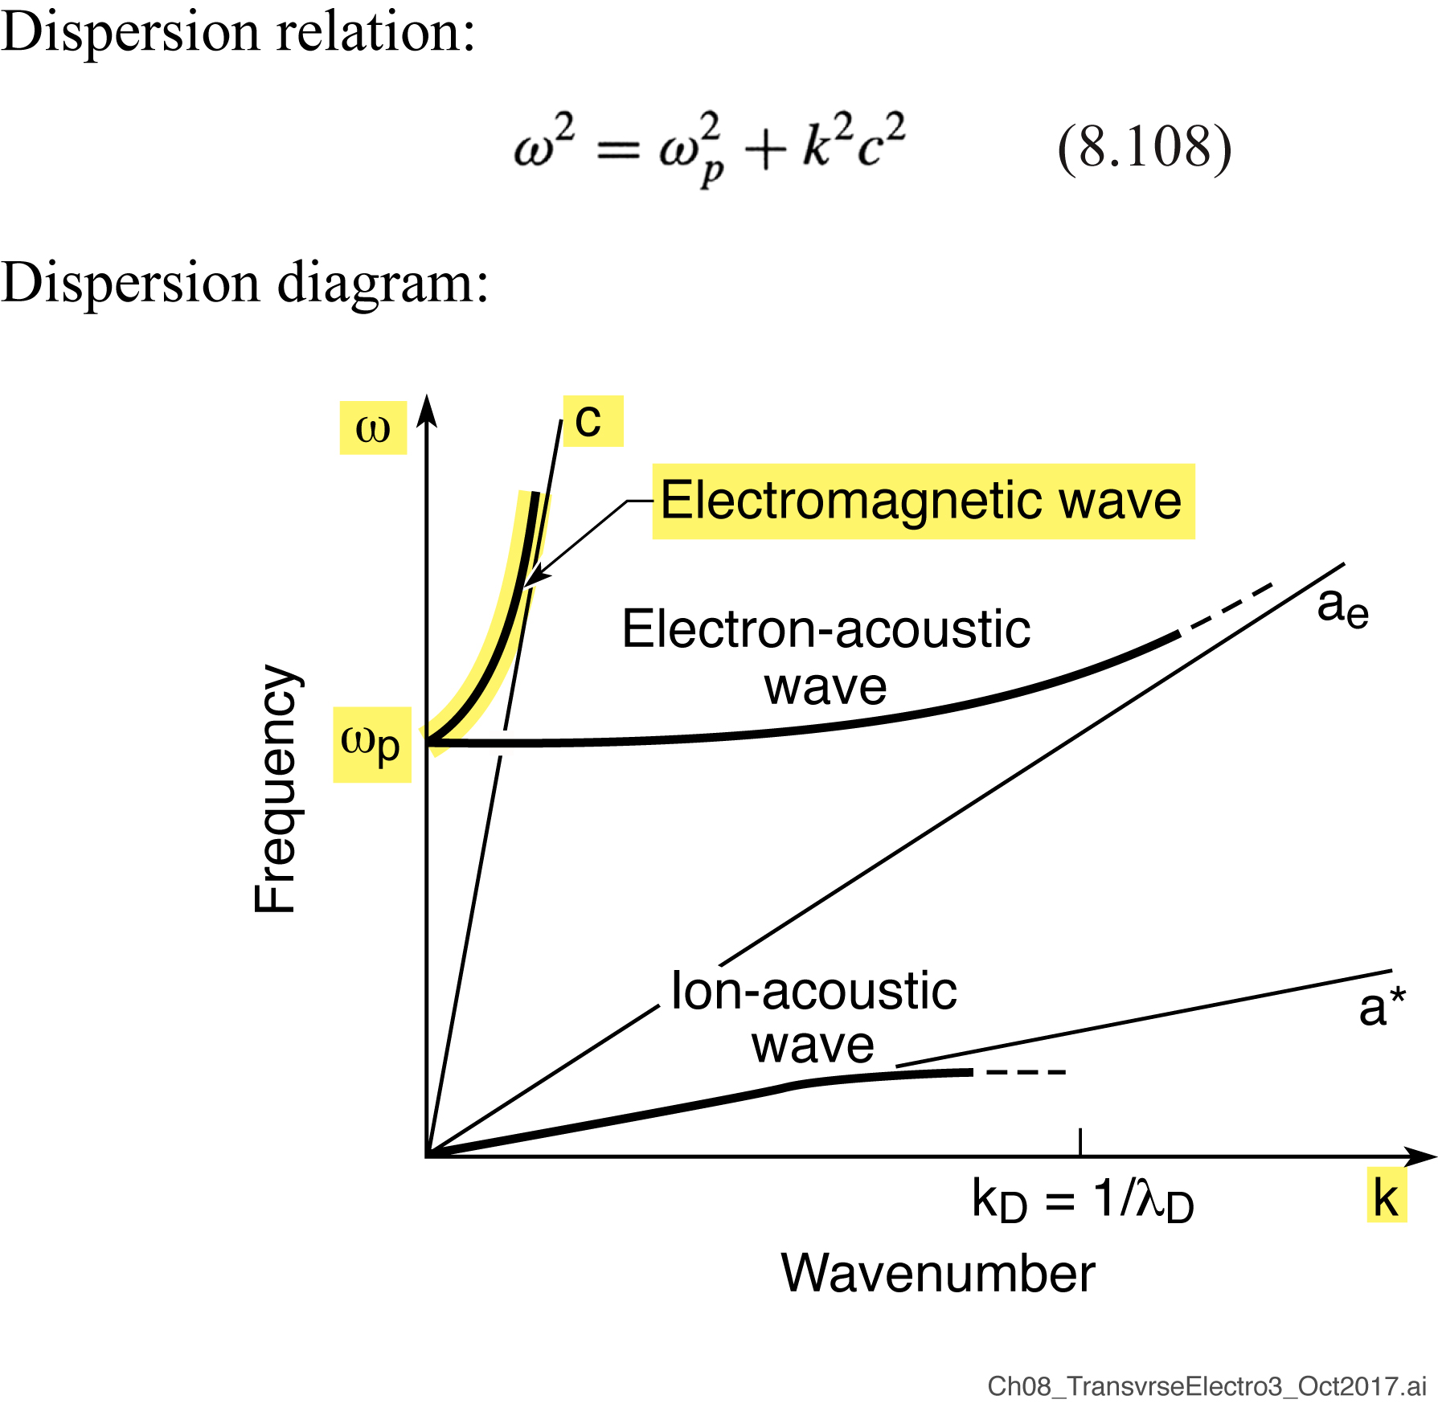
Dispersion diagram for transverse electromagnetic waves in a plasma

Slide 68
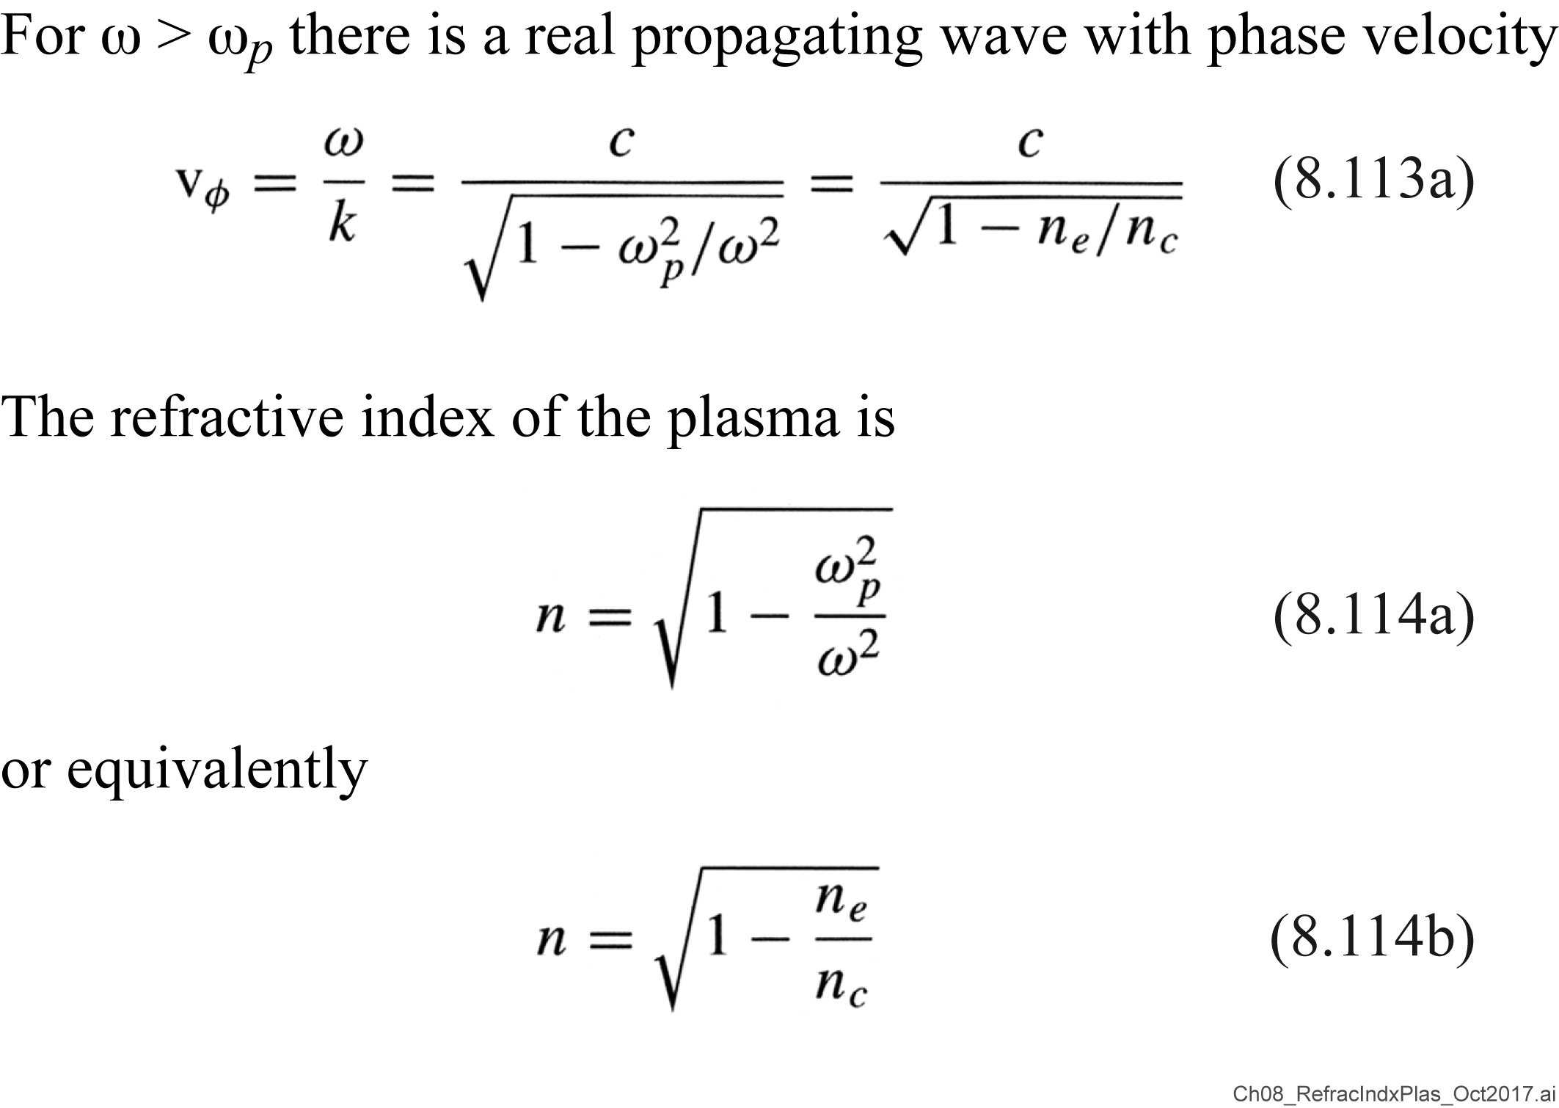

Refractive index of an electromagnetic wave in a plasma
$n = 1 – \frac{n_{e}}{2n_{c}}$
for n_{e}/n_{c} «1, where n_{c} = 1.11 x 10²¹e/cm³ / λ²[µm]

