Slide 1
The Early Liberalization Years
1980–2003

Slide 2
What are liberal reforms?
Beliefs of early modern and especially 19th Century ‘classical’ liberalism that economic growth will be most rapid with the existence of unfettered markets unimpeded by government regulation.
The free movement of the price mechanism will create conditions for the most efficient allocation of goods, services, and capital.
In India 1991 is considered the year of liberalization
This chapter will argue that liberalization began in 1980.
The benefits of liberal reforms on growth, industry, and exports were experienced after 2003 – which is considered the next regime.

Slide 3
The 1980s: India at a crossroad
The Indian economy goes through a significant policy and macro-economic transition in 1980.
What is the impact of reforms – growth in the 1980s and 1990s are not different.
Industry did not grow significantly in 1991?
Why is 1991 considered the year of liberalization?
What explains the take-off after 2003?

Slide 4
Partial reforms introduced in 1980
Political stratification: Indira wins election standing for a re-united Congress party.
Rise of regional and identity politics: AkaliDal, DMK, Telegu Desam, Shiv Sena, Janata Dal, RJD and so on.
1982–82: India forced to take borrowing from IMF and other commercial borrowings.
Indira initiates growth-oriented and market-friendly policies.

Slide 5
Signals to private capital
Liberal reforms under Indira – lower income tax, opening industries for private capital, simplification of license process.
1985: Rajiv becomes PM, Manmohan made head of PC, V.P. Singh is FM.
Rajiv Gandhi and young technocrats become face of policy change – Manmohan (RBI governor), L.K. Jha, Montek Ahluwalia, Rakesh Mohan, Sam Pitroda).
1985 Budget makes significant changes: reduce income corporate and wealth tax, cut import duties on capital goods, tax holiday for export-based industries, eliminates license for 25 industries, attract private capital in telecommunication, IT, and automobile.

Slide 6
Pro-business vs Pro-market reforms
Pro-market supports new entrants while pro-business supports established producers.
Pro-market policies are based on the idea of state intervening to ensure the efficient functioning of markets to allocate resources.
Pro-business – South Korea, Japan – states supports certain producers and provides complementary policies which include price distortions, market intervention, and labor repression.
Kohli (2006) labels reforms in India in 1980s as pro-business directed towards large industries in certain sectors.

Slide 7
Uncertainty from 1989 stops reform process
Rajiv Gandhi faces Bofor Scam.
1989 election won by BJP + Janata Dal coalition wins 200 seats in Lok Sabha.
3 coalition government in two years – blunts progress of liberal reforms.
Global shock in 1990 – USSR dissolved, Gulf War and Iraq invasion, rise in oil price and fall in remittance.
Current A/c plummets and India’s credit rating downgraded.
Debt and fiscal deficit already unsustainable, economic and political uncertainty place India in a precarious position.

Slide 8
Chandrashekhar government dissolved in March 1991.
April 1991 – RBI start process of IMF loan.
Rajiv Gandhi assassination and new Congress government under Narasimha Rao.
Two devaluations in July – Rupee loses value by 20 percent, liquidity tightened and CRR raised to prevent inflation.
IMF pledge USD 220 million as emergency fund.
RBI gold given as collateral for loan to bank of England and Japan –media hysteria in India.

Slide 9
Why 1991 is associated with liberal reforms?
Political uncertainty pushed Congress to break away from Nehruvian policies.
IMF conditionalities forced liberal reforms in trade and finance and fiscal sustainability.
Manomohan Singh was made finance minister in order to boost confidence of industry.
English private media plays key role in disseminating information about reforms.
Vernacular media does not report avoiding a backlash from agricultural sector and rural classes.

Slide 10
19 July – Budget presented and New Industrial policy introduced
  Abolish licensing in all but 18 industries
  Privatize 8 public sector monopolies
  Liberalize foreign investment – FI promotion board
  Remove import license
  Remove MRTP
  NRIs can have 100 percent equity in private enterprise
  Initiate a road map for further reforms
  Actual reform process was slow

Slide 11
Narasimhan Committee ( 14 August 1991) – Financial reforms
  Recommend more competition between public and private bank
  Better integration between capital and money market
  More autonomy to RBI
Chelliah Committee (29 August 1991) – Tax reforms
Rangarajan Committee ( 22 January 1993)
  Privatization of Banks – ICICI, HDFC, UTI
  Modify FERA
    Allow more avenues for foreign investment
    Allow NRI to invest
    Liberalisation of current a/c transactions

Slide 12
Reforms through the 1990s
Trade policy reform
  Some de-licensing measures
  Depreciation of the rupee
Financial reforms: changed the context within which banks functioned
  Private banks allowed to raise funds from capital markets
  CRR and SLR were reduced
  Easier rules for NRI deposits

Slide 13
Impact of reforms on Indian economy
Period (Base Year 2004–05) | Private Final Consumption Expenditure | Government Final Consumption Expenditure | Gross Fixed Capital Formation | Exports of Goods and Services | Imports of Goods and Services | GDP at Market Prices
1980–2003 | 4.7 | 5.7 | 6.6 | 9.2 | 10 | 5.62
Period (Base Year 2004–05) | Agriculture | Industry | Services (Including Construction)
1980–2003 | 3.5 | 5.95 | 6.81

Slide 14
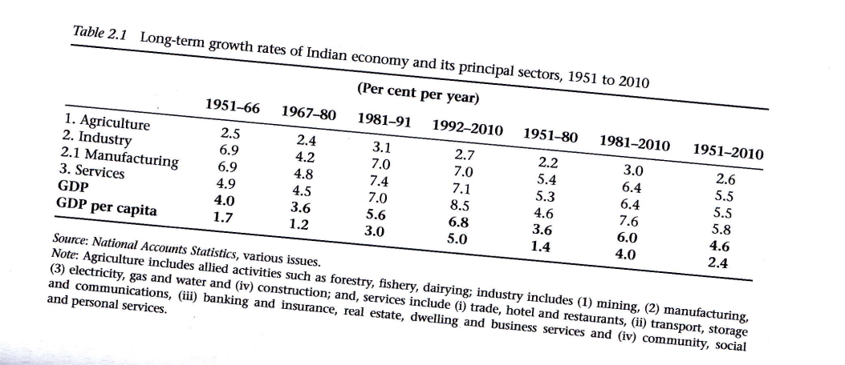

Slide 15
Partial reforms in 1980s led to GDP growth through growth in the manufacturing sector.
Reforms in 1991 did not translate into GDP or manufacturing growth in the 1990s.
There was uncertainty about the reforms process due to political instability and financial crisis in East Asia. Indian businesses did not have confidence in the process.
Lack of political capacity to build infrastructure and bureaucratic apparatus for industries to benefit from reforms.

Slide 16
The impact of reforms on the agricultural sector
The agricultural sector grew at 2.92percent as opposed to 2.21 percent in the previous regime.
Fall in growth rate of wheat from 5.21percent to 3.33percent.
Non-food grain production went up from 2.4 percent to 3.43 percent.
Increase in purchase of modern inputs and private investment in mechanization and pumps.
Green Revolution did not translate into higher productivity as government did not invest in agricultural infrastructure.
Benefits of agricultural sector faced by large farmers in prosperous regions.

Slide 17
De-stabilizing factors in the 1990s
Urban inequality went up. Vakulabharanam (2010) has demonstrated that inequality between rural and urban classes, and urban skilled workers/professionals/managers and non-skilled workers went up. These were the beneficiaries of reforms.
Agricultural sector did not benefit from reforms.
India’s fiscal deficit started going up after initial decrease.
Balance of Payment deteriorated.
Political uncertainty continued through the period.
Reforms did not have major impact on the economy in 1990.

Slide 18
Components of capital a/c 1980–91

Slide 20
Components of current expenditure

Slide 21
Sector Wise: Absolute cap form 1980–90

