Slide 1
IMPORTANT – PLEASE NOTE:
These resources are provided free of charge by Cambridge University Press with permission of the authors of the corresponding work, but are subject to copyright. You are permitted to view, print and download these resources for your own personal use or for educational purposes, provided any copyright lines on the resources are not removed or altered in any way. Any other use, including but not limited to distribution of the resources in modified form, or via electronic or other media, is strictly prohibited unless you have prior permission from the authors of the corresponding work and the owners of the images displayed herein, and provided you give appropriate acknowledgement of the source.

Slide 2
NOTE TO USERS:
The simplified information included in this presentation is intended to compliment the accompanying CUP book on Glaciovolcanism by Smellie & Edwards. Please refer to the book for further details and information on references cited, etc

Slide 3
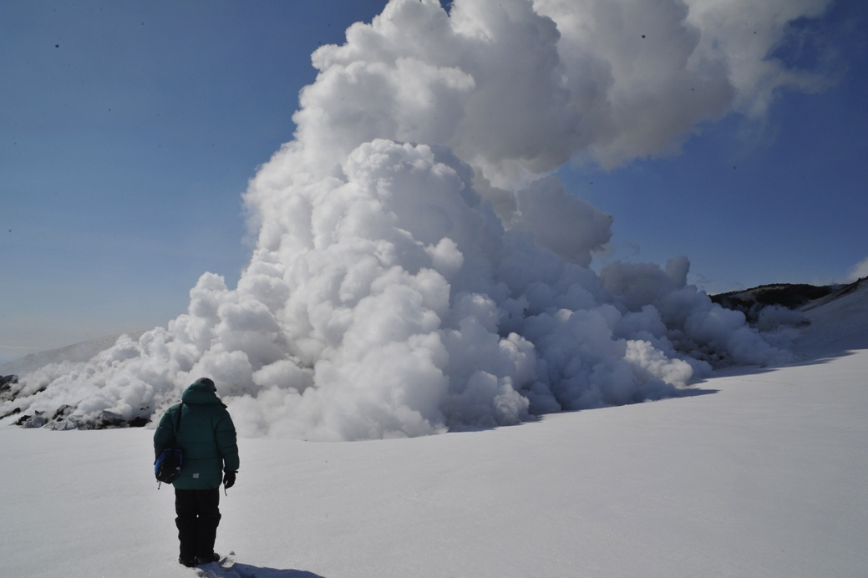
Chemistry & physics of glaciovolcanism on Earth
Image: Ben Edwards

Slide 4
TALK OUTLINE -
Part 1: Chemistry of glaciovolcanic eruptions
1. Overview of Compositional Space
2. Bulk Composition Properties
3. Volatile Solubilities and Measurements
Part 2: Physics of terrestrial glaciovolcanic eruptions
1. Static Pressure analysis and dyke intrusion

Slide 5
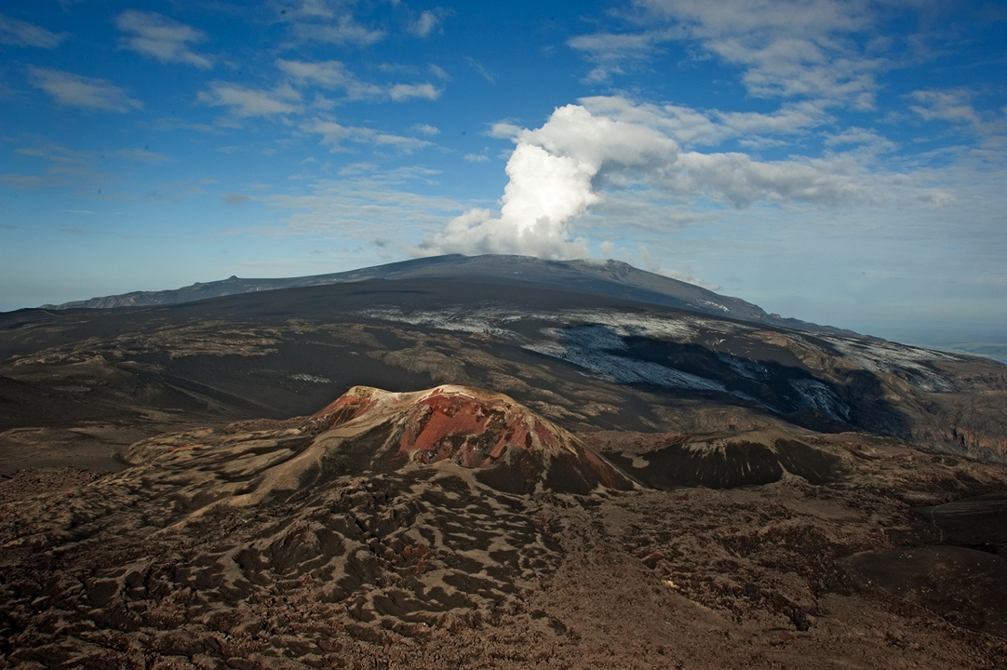
Part 1: Chemistry of glaciovolcanic eruptions
Trachytic tephra, 2010 Eyjafjallajokull
Basaltic lavas, 2010 Fimmvorduhals
Image: Ben Edwards

Slide 6
Compositional space for glaciovolcanism
Glaciovolcanic deposits have a wide range of known compositions.
Only ultramafic compositions have not yet been described.
TAS diagram: LeMaitre et al., 1986
Notes:
Black dots are compositions used in Chapter 5 to calculate physical properties shown in subsequent diagrams.

Slide 7
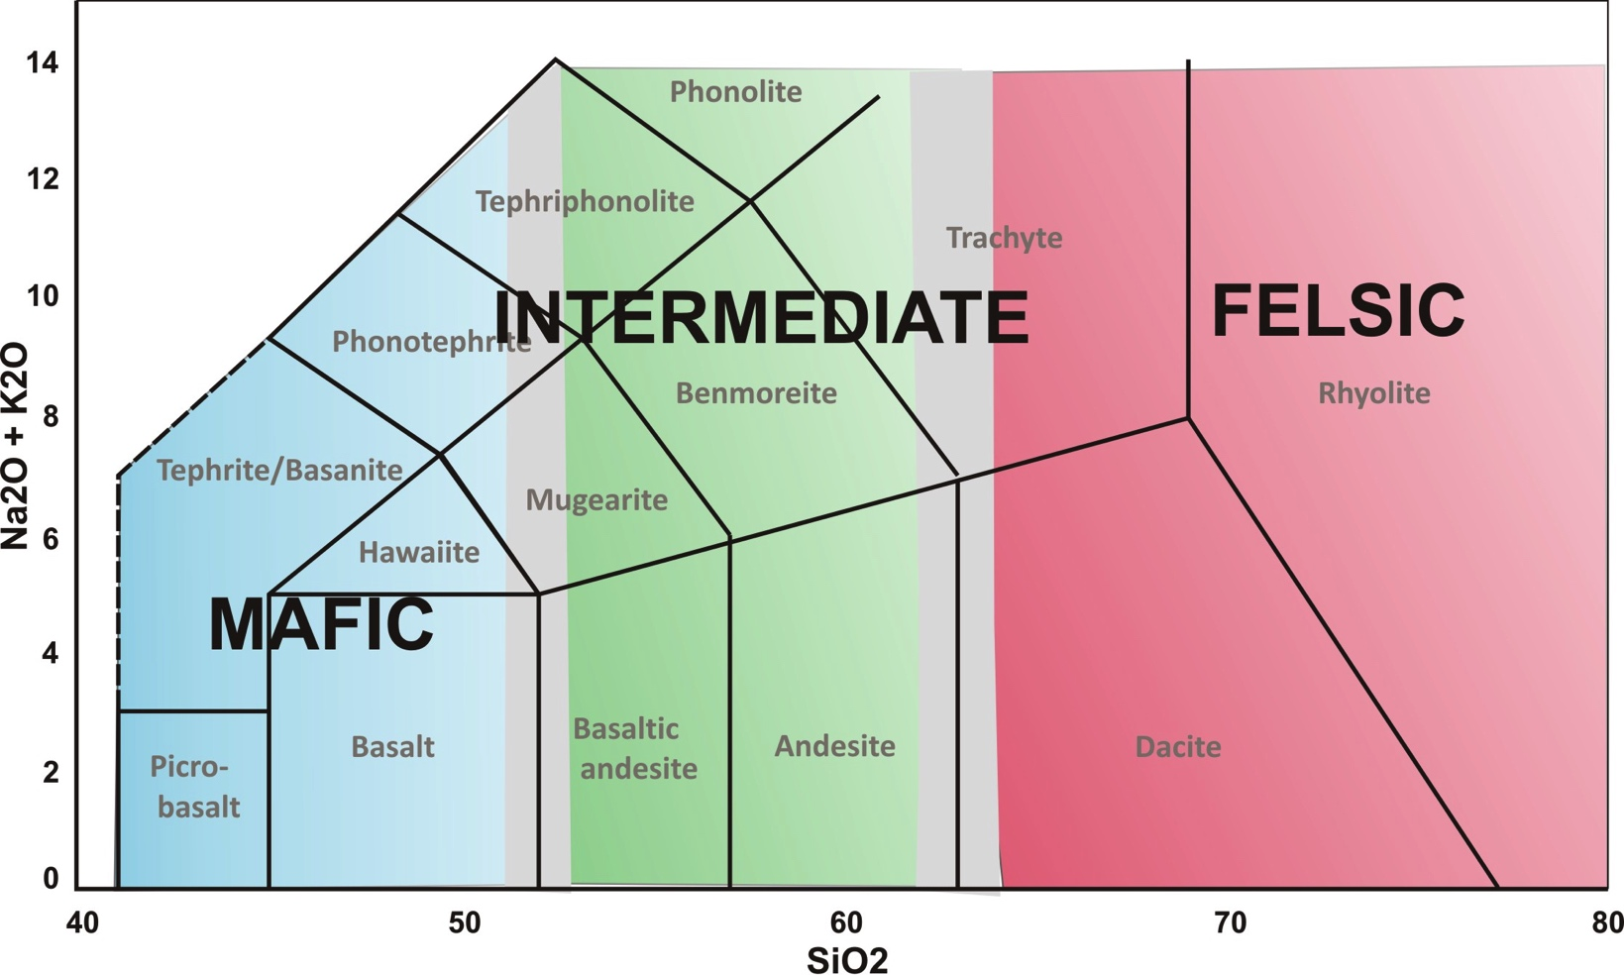
General compositional terminology
Compositional terminology used for glaciovolcanic magmas
Some physical properties (e.g. viscosity) vary gradationally across boundaries
TAS diagram: LeMaitre et al., 1986

Slide 8
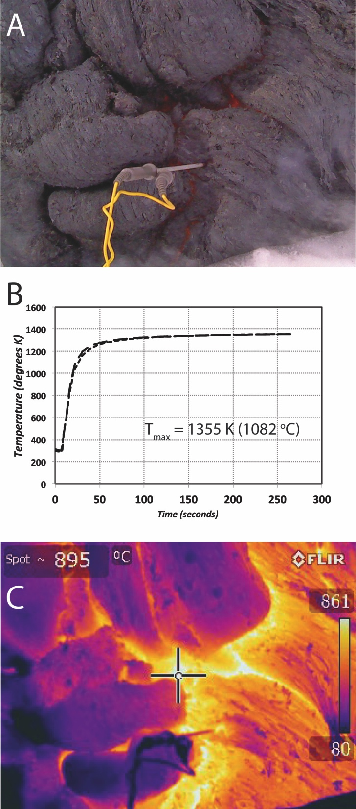
Bulk geochemistry properties:
(1) Eruption temperatures
Basaltic lava flow, Tolbachik 2013
Temperatures of silicate melts are mainly a function of composition. Although they can be estimated using bulk composition or mineral geothermometers, direct measurements in the field are also required.
Images: Ben Edwards

Slide 9
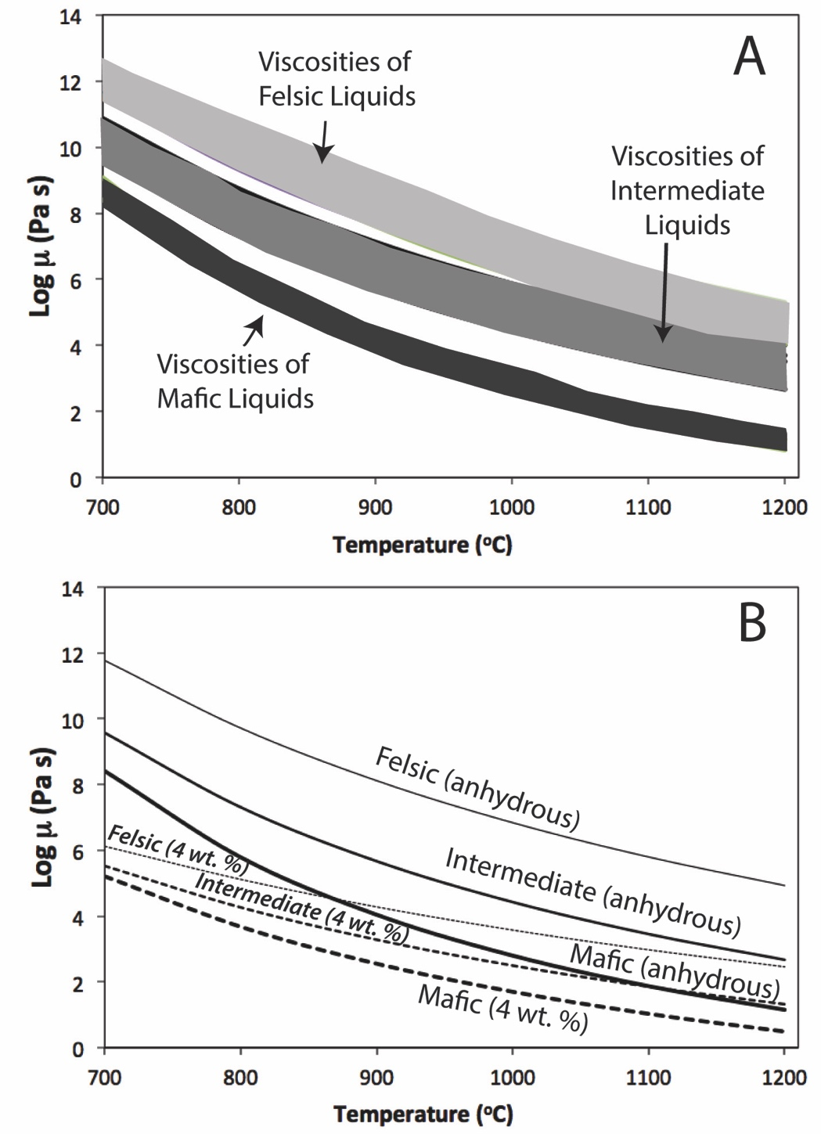
Bulk geochemistry properties:
(2) Anhydrous and hydrous viscosities
Viscosity is an important measure of a liquid’s ability to respond to stress; for silicate melts it is largely controlled by three important parameters: 1. melt composition (A); 2. temperature (A&B); and 3. dissolved water (B). Dissolved water has the most significant effect on changes to viscosity.

Slide 10
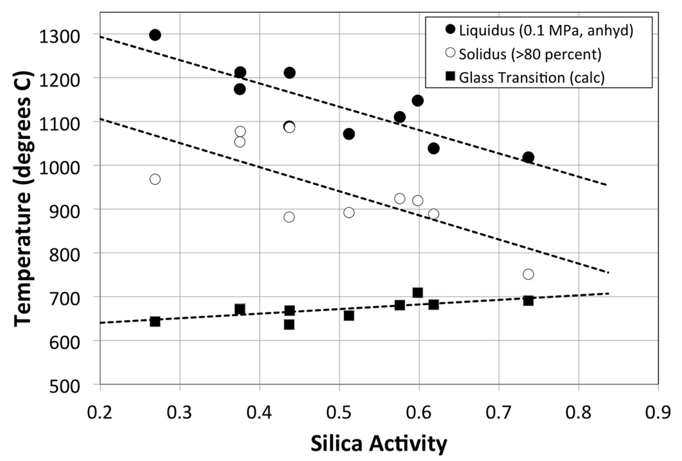
Bulk geochemistry properties:
(3) Liquidus and glass transition temperatures
Estimated glass transition temperatures (Tg) vary less as a function of composition than do liquidus temperatures; thus is it much more difficult to produce crystal-free glass from mafic compositions (i.e. at lower values of silica activity).

Slide 11
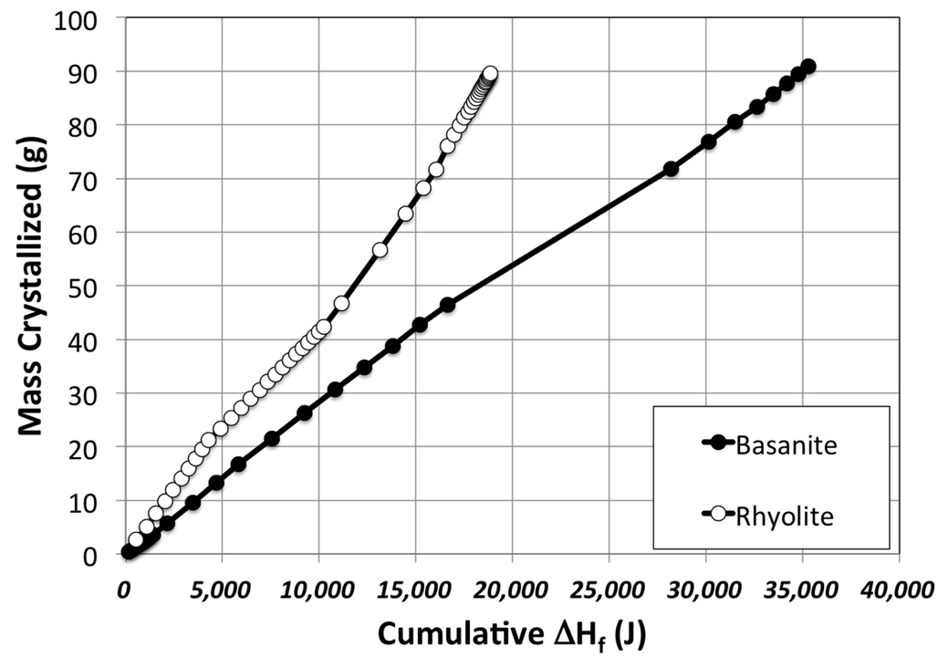
Bulk geochemistry properties:
(4) Cumulative enthalpy production
The potential to melt ice during a glaciovolcanic eruption is controlled by many factors including magma composition. More mafic compositions (e.g. basanite) can release significantly more energy than felsic compositions.

Slide 12
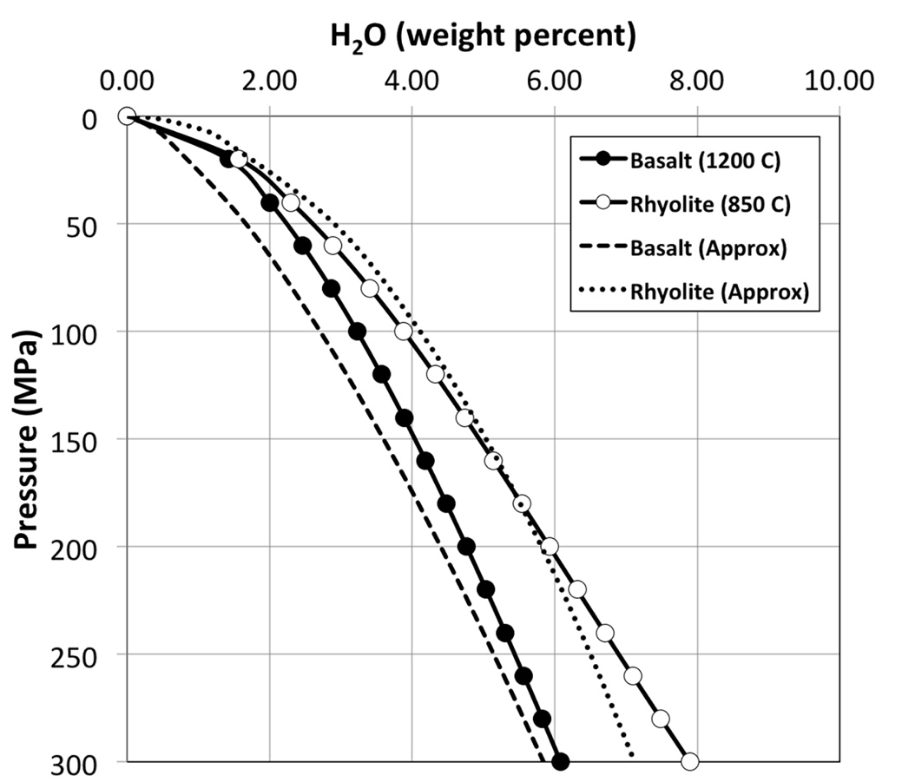
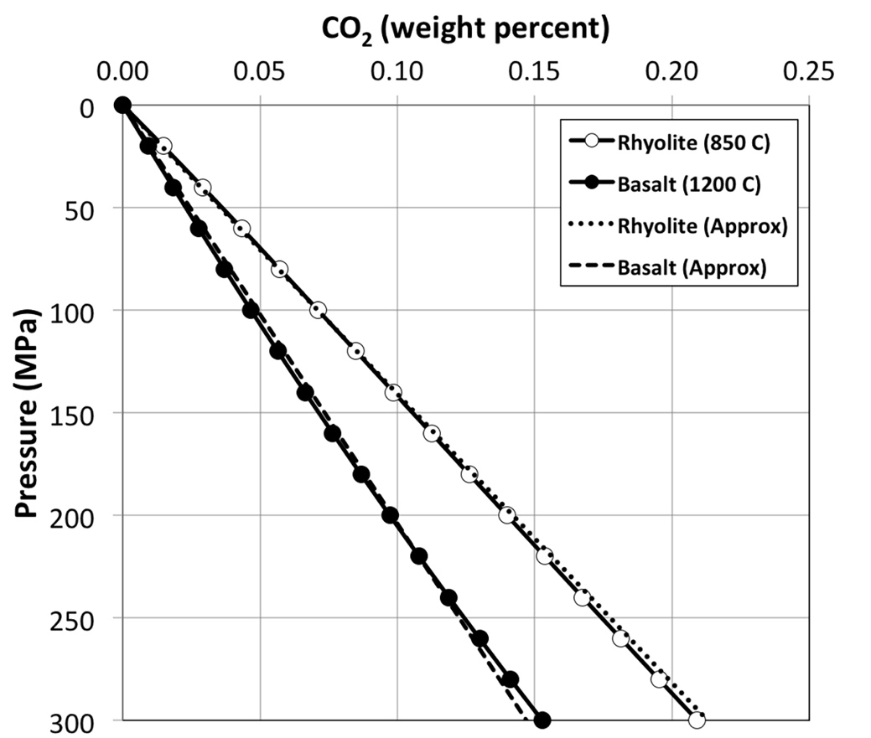
Solubilities of water and carbon dioxide
Simple approximations for estimating the solubilities of water and carbon dioxide in basaltic and rhyolitic silicate melts as a function of pressure. Carbon dioxide is much less soluble, although both phases have relatively low solubilities in the upper crust.

Slide 13
Solubilities of water and carbon dioxide at low pressure
Red boxes demarcate the range of solubilities relevant to low pressure conditions most likely to be controlled by ice overlying a volcanic conduit.

Slide 14
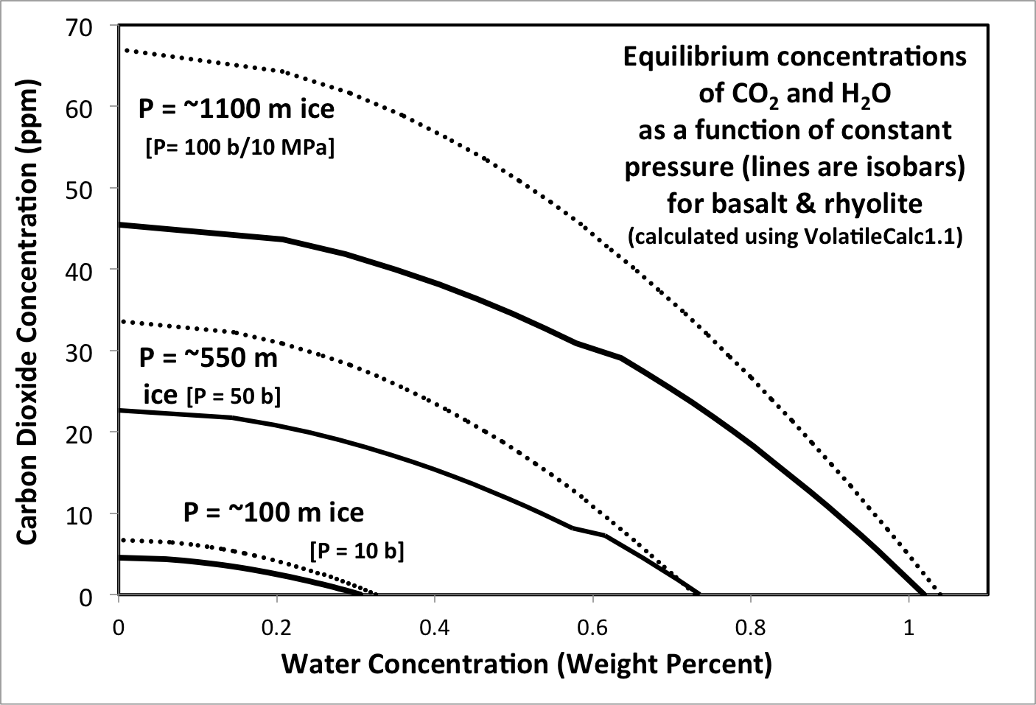
Solubilities of water and carbon dioxide at low pressure
When measurements of both water and carbon dioxide are available, algorithms like VolatileCalc (Newman and Lowenstern, 2002) can be used to determine if the concentrations were in equilibrium at pressures where the magma volatile concentrations were quenched.
Typical approximate detection limit for FTIR

Slide 15
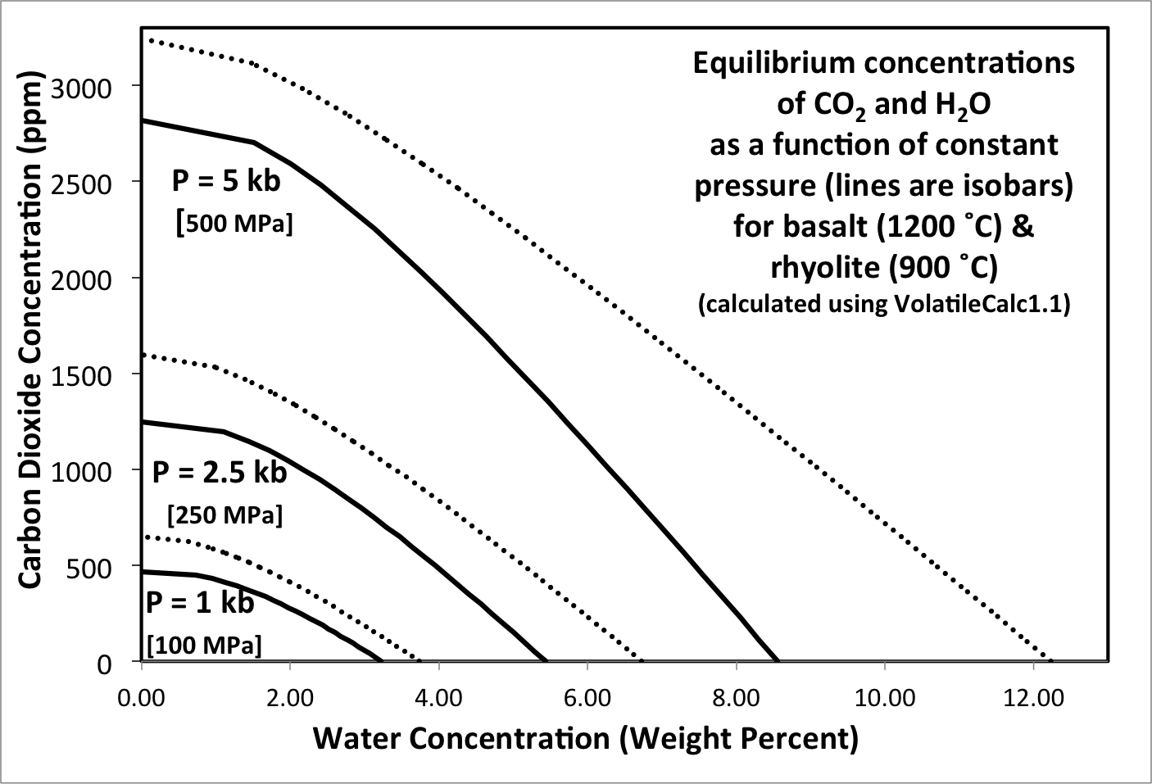
Solubilities of water and carbon dioxide at medium pressure
At crustal pressures (100-500 MPa), algorithms (e.g. VolatileCalc) show that the solubilities of water and carbon dioxide are distinctly higher in rhyolitic (dotted line) than in basaltic (solid line) magmas.

Slide 16
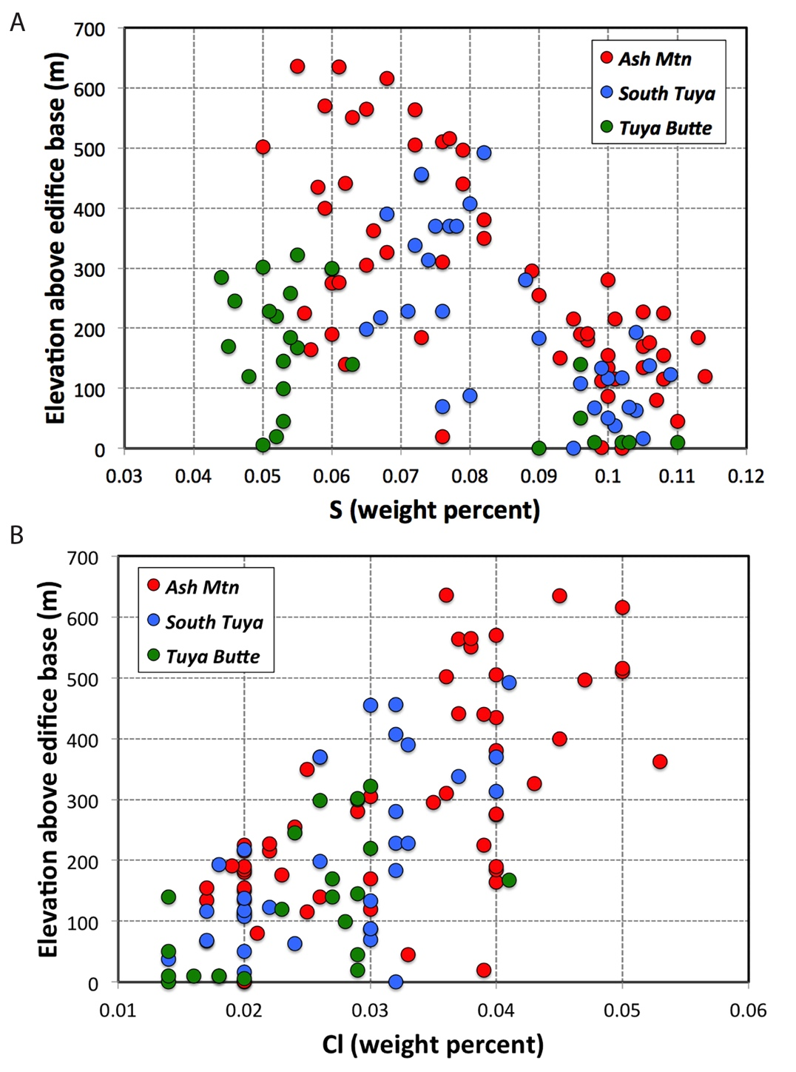
Other volatiles: concentrations of sulphur and chlorine
Few studies have looked at concentrations of volatile species besides CO₂ and H₂O in samples of glass, but Moore et al (1995) used concentrations of S and Cl to investigate possible changes in degassing as a function of elevation of the sample above the edifice base. While S generally decreases with elevation, as expected, Cl appears to increase.

Slide 17
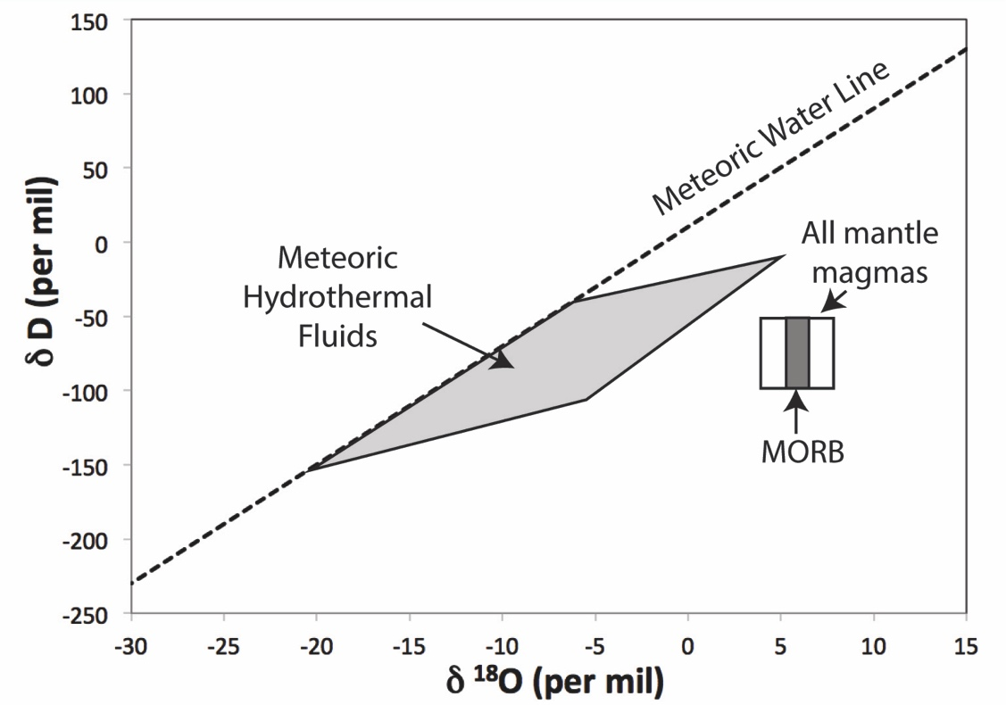
Stable Isotopes of deuterium and oxygen
Some studies have used stable isotopes (deuterium and oxygen;) to identify magmas contaminated by palagonitized glaciovolcanic tephra (e.g. Bindeman et al, 2004). Stable isotope studies are currently underutilized in glaciovolcanic studies.
Effect of assimilation of altered crust

Slide 18
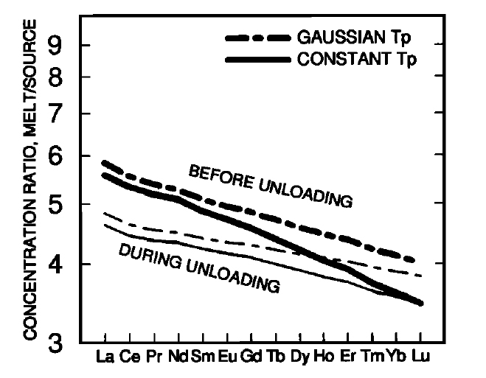
Using trace elements to identify affects of glacier unloading
Jull and Mackenzie (1996) were amongst the first to propose that glacial unloading could produce identifiable changes in source region melting, such as decreases in REE concentrations. Several other studies (e.g. Hardarson and Fitton, 1991; Maclennan et al 2002) have also found evidence for changes in magma compositions potentially related to deglaciation.

Slide 19
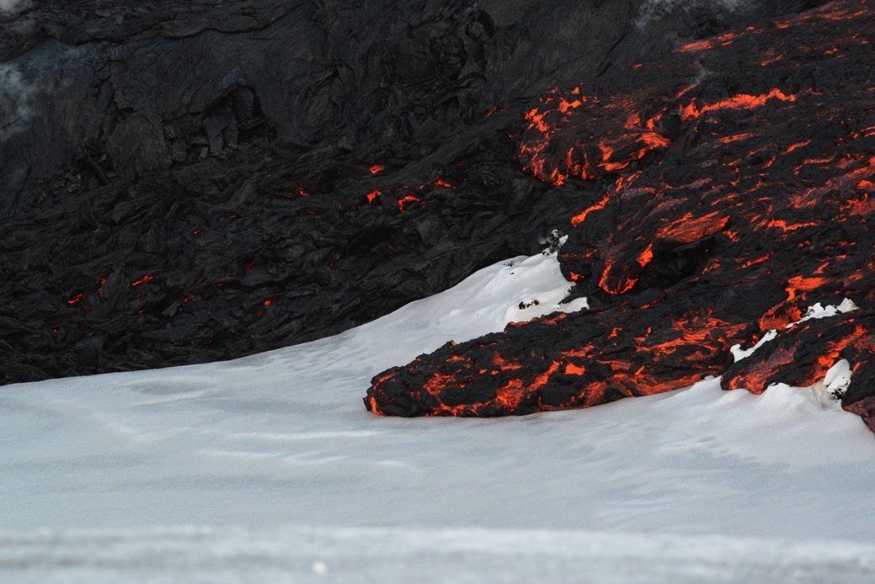
Part 2: Physics of glaciovolcanic eruptions
Image: Ben Edwards

Slide 20
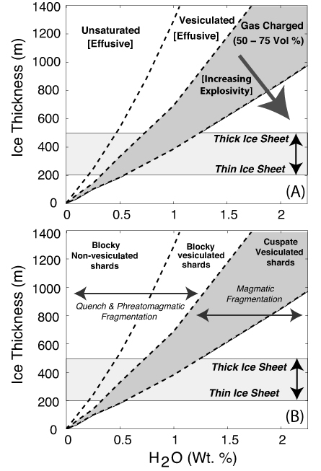
Relationship between ice thickness, magma water content, vesicularity and explosivity
Ice thickness at the eruption site exerts a fundamental control on the explosivity of the eruption and the vesicularity of the erupted products (e.g. Edwards et al., 2015)

Slide 21
Thickness of Ejyafjallajökull ice
in caldera
If primary H₂O in magma is 0.5 wt %, at least 200 m of ice is required to suppress magmatic fragmentation, and possibly 300 m
While fragmentation of magma can occur at a range of gas-fraction volumes, a minimum of 50 vol % is probably required (e.g. Edwards et al., 2015). The Eyjafjallajokull ice cap was too thin to inhibit magmatic fragmentation in 2010.
Frag at 50 vol % gas
Frag at 75 vol % gas

Slide 22
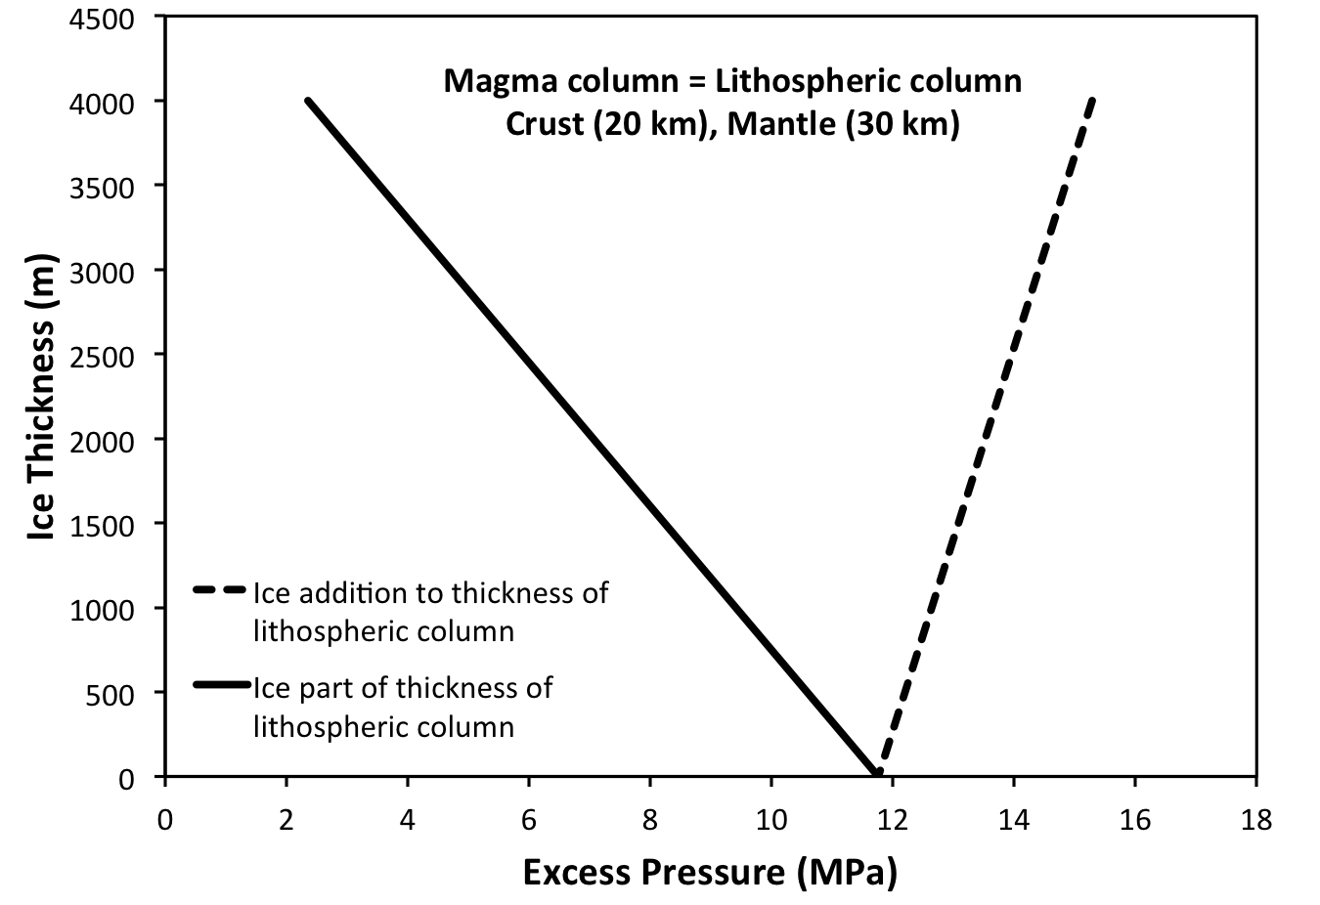
Relationship between ice thickness and excess magma pressure
A general analysis of static pressure changes caused by addition of an ice sheet onto a column of lithosphere illustrates the differences in excess pressure felt by a magma column depending on whether or not the magma column extends to the top of the ice or the base of the ice.

Slide 23
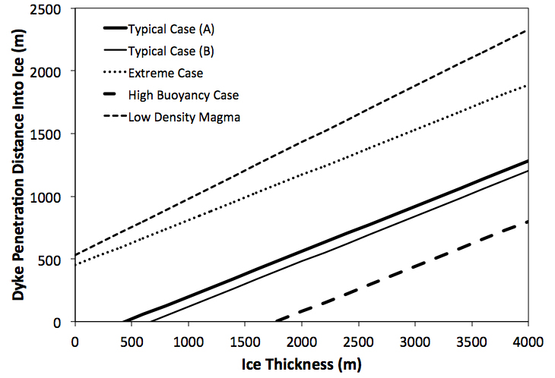
Relationship between ice thickness and distance of dyke propagation
The potential for a dyke to penetrate overlying ice depends on the buoyancy of the magma in the crust and the thickness of the overlying ice (e.g. Wilson et al., 2013). Theoretical estimates show that low density magmas may be able to erupt supraglacially (e.g. on top of overlying ice).

Slide 24
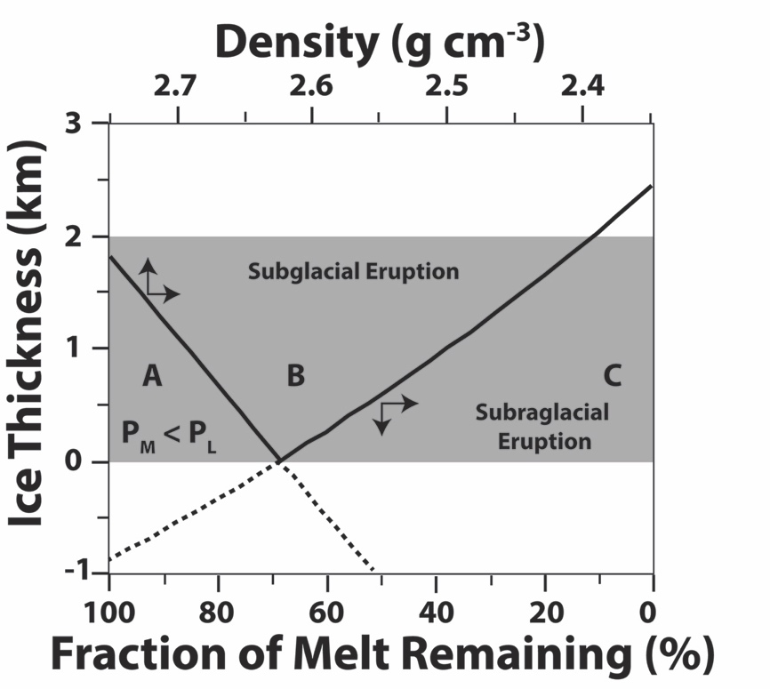
Relationship between ice thickness and excess magma pressure
Processes occurring in magma storage areas (e.g. assimilation-fractional crystallization) can significantly affect the potential eruptibility of a magma at the base of overlying ice (area B) or even on top of overlying ice (area C).
Original figure from Edwards et al. 2002.
Supraglacial

Slide 25
SUMMARY
Understanding how the bulk chemical composition of a magma affects changes to physical properties (e.g. viscosity, volatile solubility, enthalpy) can improve interpretations of glaciovolcanic deposits and understanding processes such as heat transfer during glaciovolcanic eruptions.
Isotopic and trace element studies are useful tools for identifying broader-
scale impacts of deglaciation on volcanism.
The thickness of ice at the eruption site coupled with volatile contents can control explosivity, fragmentation and vesicularity during glaciovolcanic eruptions.
Variations in ice loading can have a significant impact on determining whether glaciovolcanic eruptions will occur beneath, within or on the surface of overlying ice.

