Slide 1
Wavelength Modulation Spectroscopy with DFB Lasers
Principles and Techniques

Slide 2
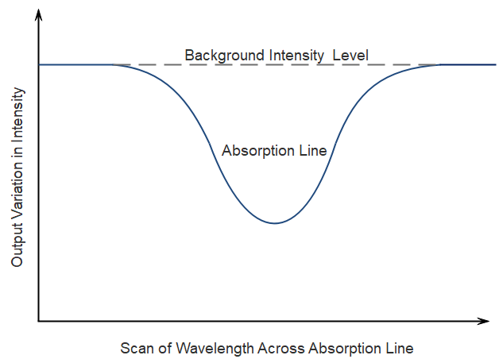
Direct Absorption Spectroscopy (DAS)
Signal normalised to background level P_{in}

Slide 3
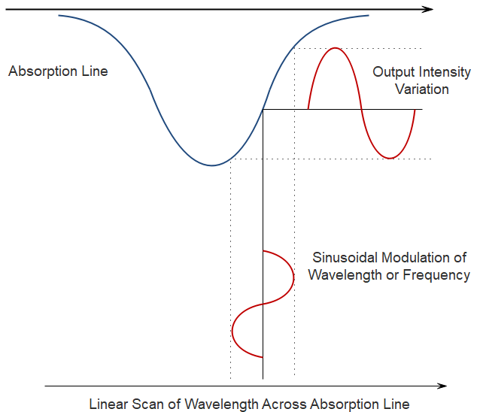
Wavelength Modulation Spectroscopy
Contains fundamental and harmonics of the modulation frequency
from laser diode current modulation:

Slide 4
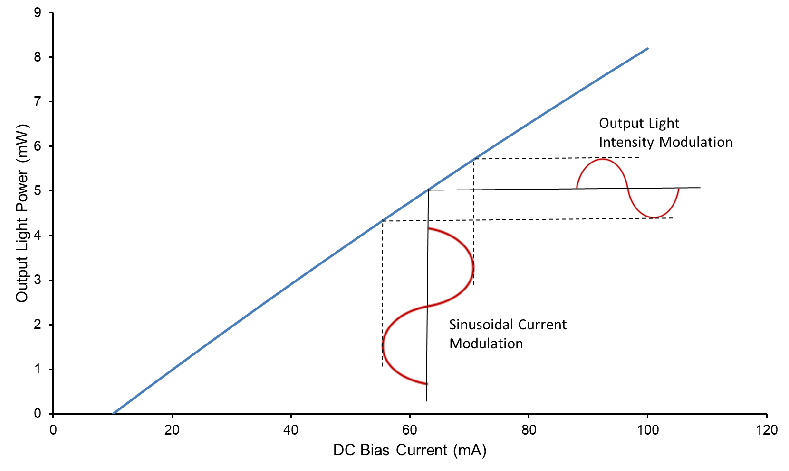
Light vs Intensity Curve of Laser Diode Current & Intensity Modulation
Slightly non-linear curve
i_{m}
I_{b}

Slide 5
Fundamental Relationships for WMS
Beer-Lambert Law for small absorbance
Dimensionless line-shape function
Intensity modulation
Frequency modulation
Harmonics of frequency modulation
Frequency modulation index

Slide 6
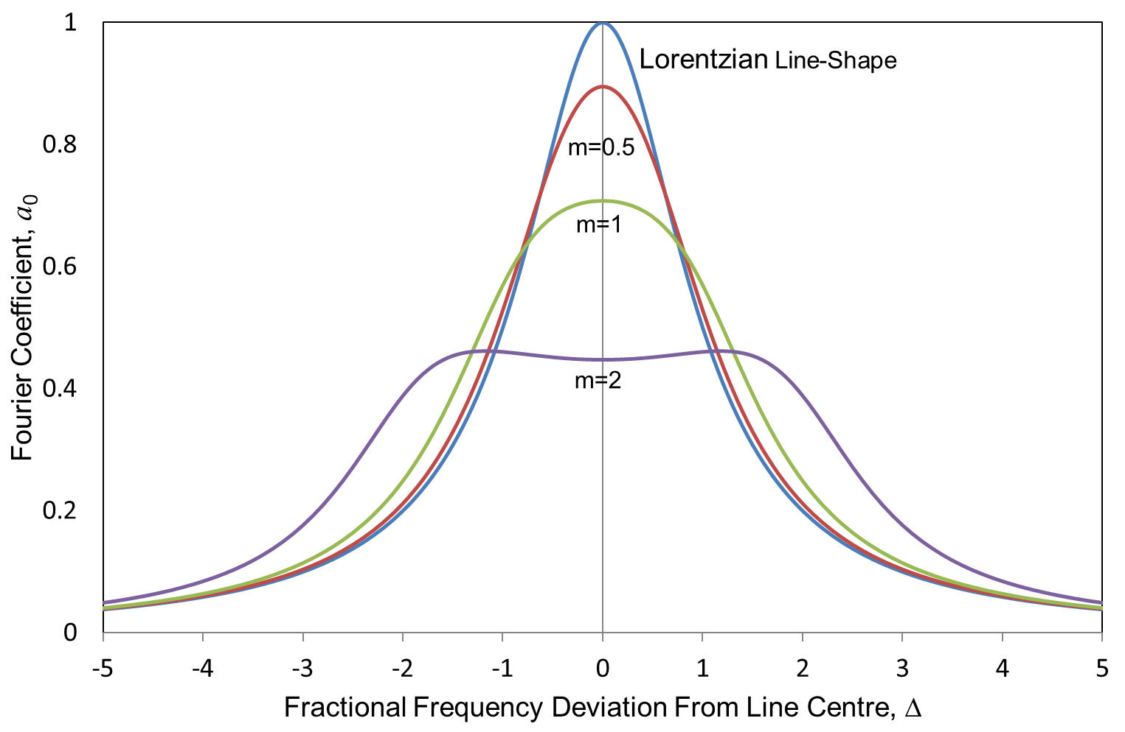
Fourier Coefficient a₀ (Effect of the Modulation Index)

Slide 7
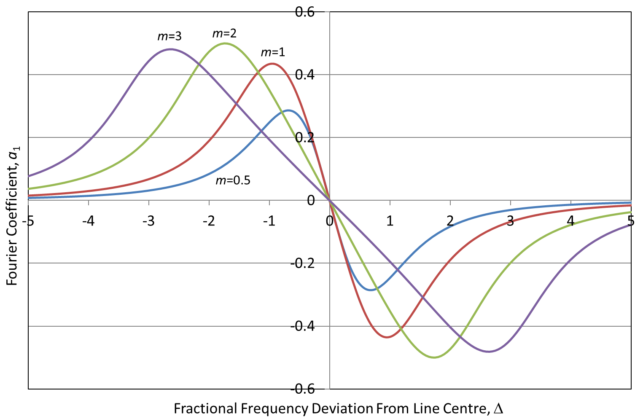
Fourier Coefficient a₁ (Effect of the Modulation Index)

Slide 8
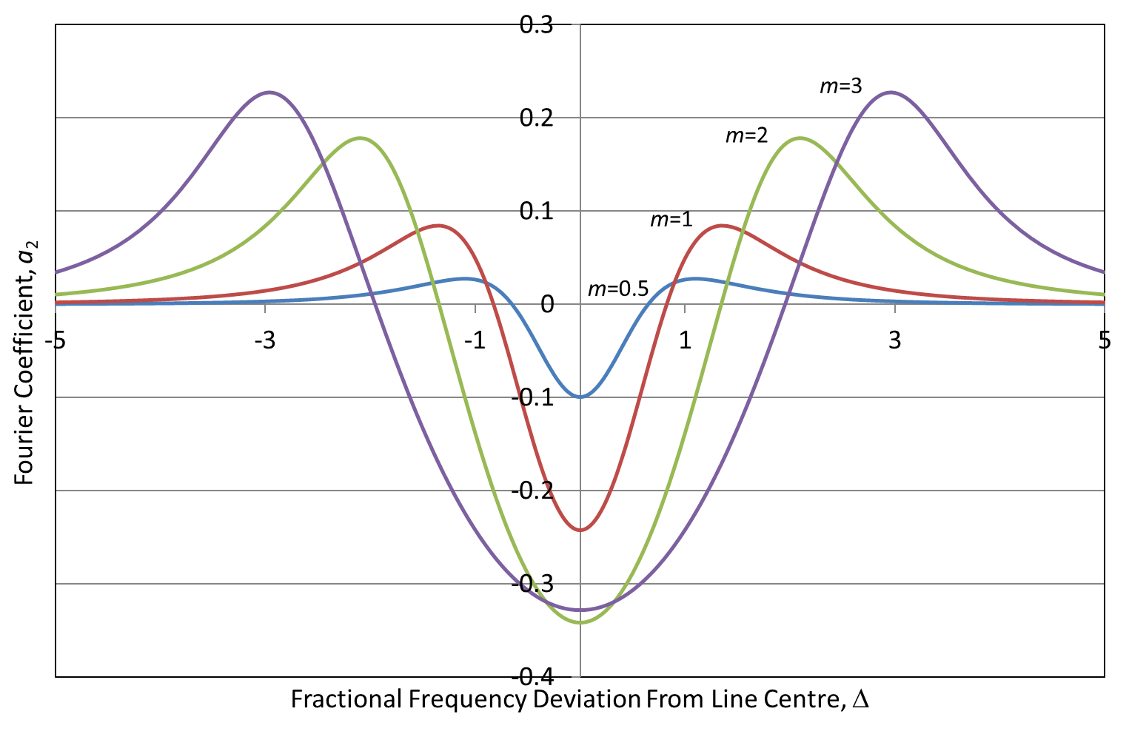
Fourier Coefficient a₂ (Effect of the Modulation Index)

Slide 9
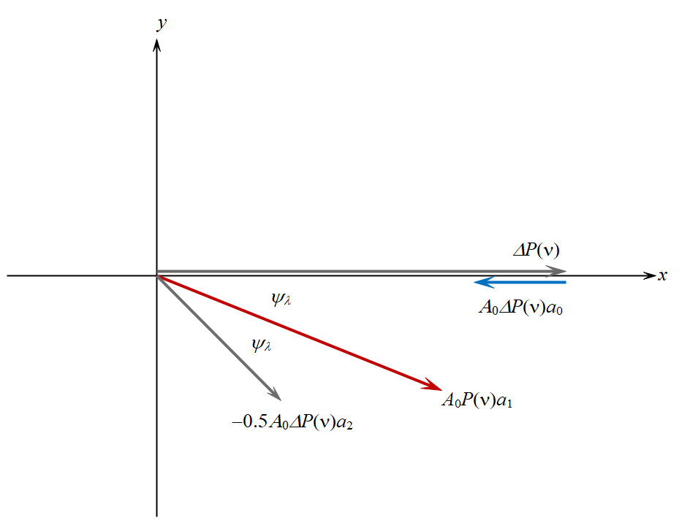
Components of the 1st Harmonic

Slide 10
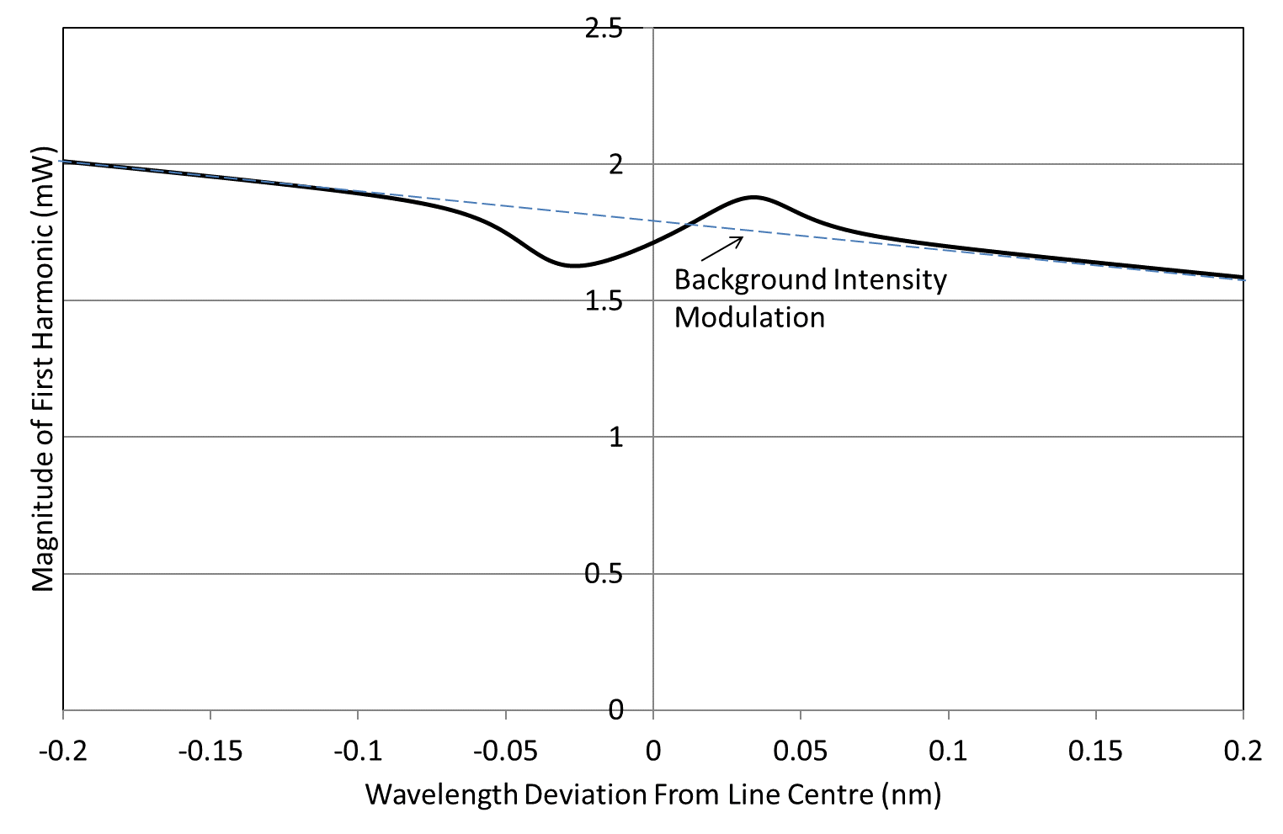
Magnitude of the 1st Harmonic

Slide 11
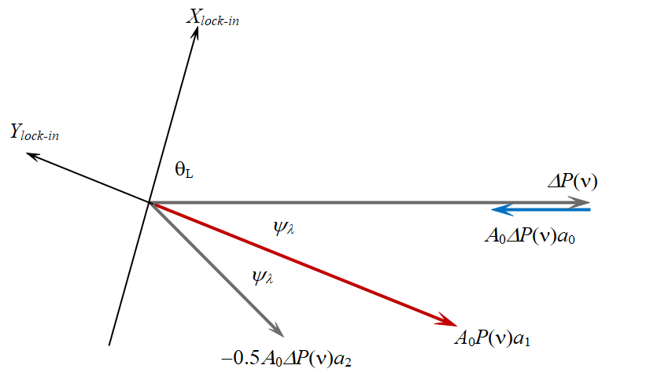
Adjustment of Lock-in Phase (nulling the a₁ component on the X-axis)
Uses intensity modulation for line-shape recovery with signal normalised to background (compare DAS).

Slide 12
Measurements from both Lock-In Axes (for the recovery of the line-shape)
Same as last expression but larger signal due to the absence of the cosine term:
Problem (1): For low modulation index, this term approximates the line-shape function but deviates from it at high modulation index. Hence need for correction factors.
Problem (2): Small signal on large background level.

Slide 13
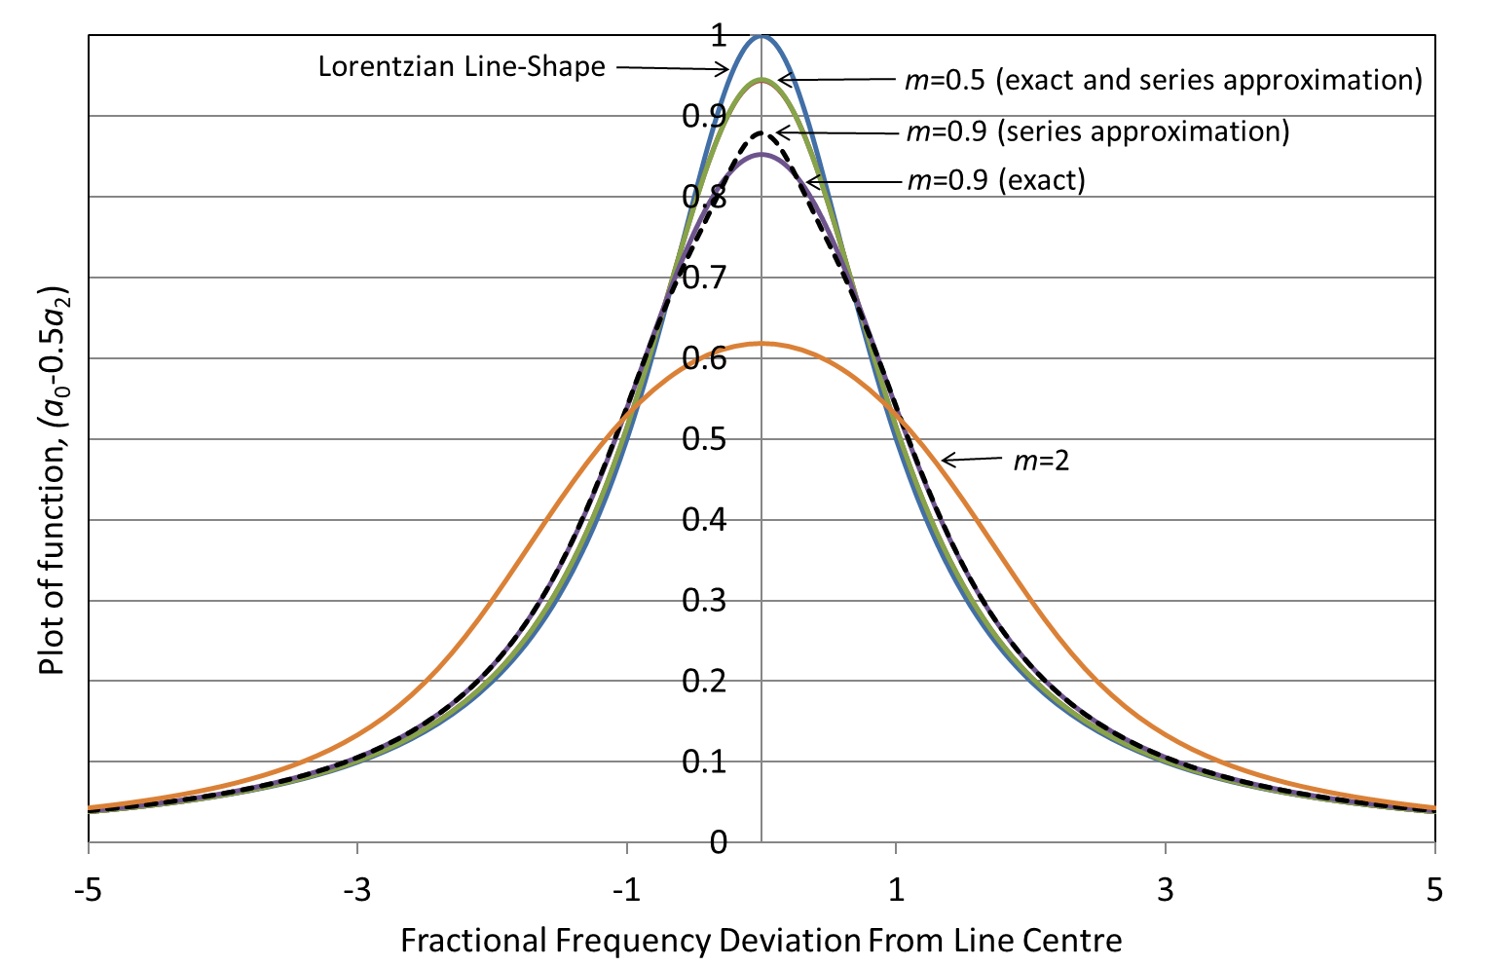
Deviation of Measured Lineshape from Lorentzian with Increasing Modulation Index

Slide 14
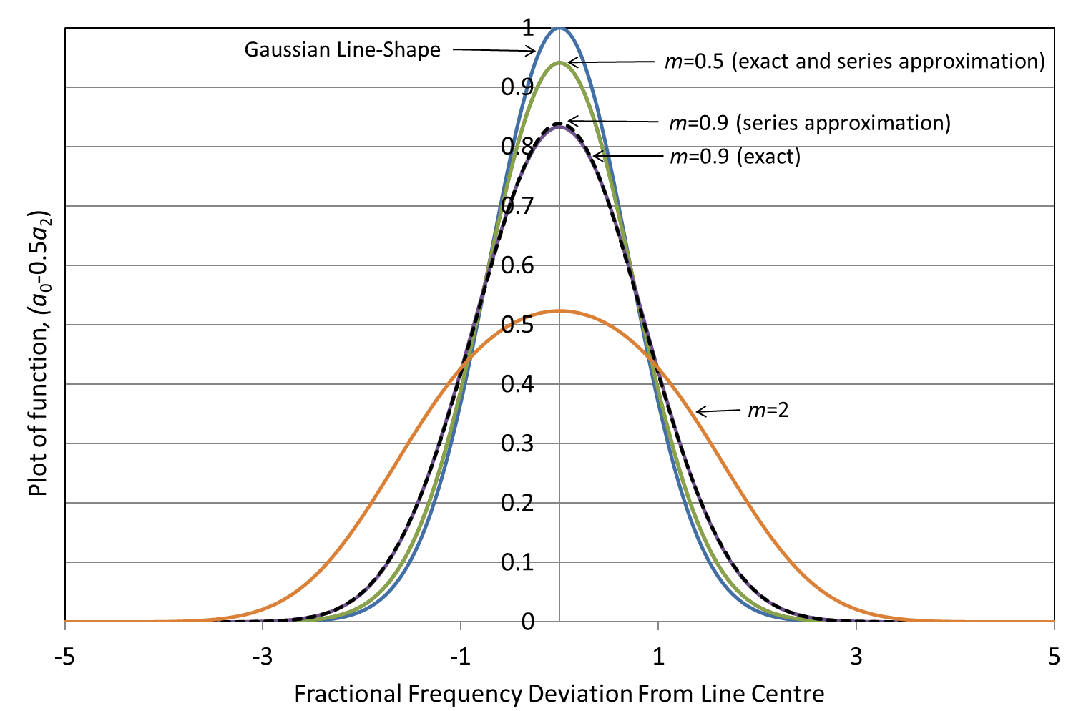
Deviation of Measured Lineshape from Gaussian with Increasing Modulation Index

Slide 15
Optical Delay Line to Null the Background Intensity Modulation

Slide 16
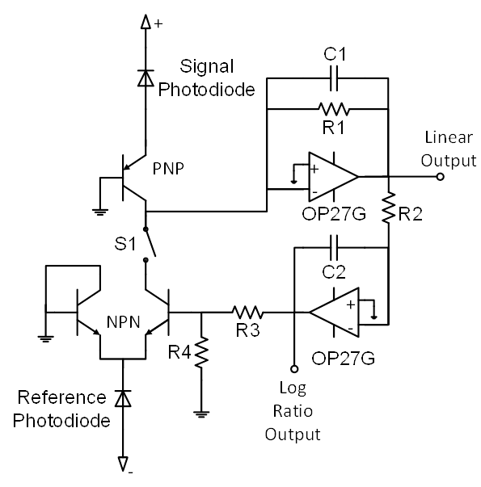
Hobbs Dual Beam Auto-Balancing Receiver Circuit for Nulling Background

Slide 17
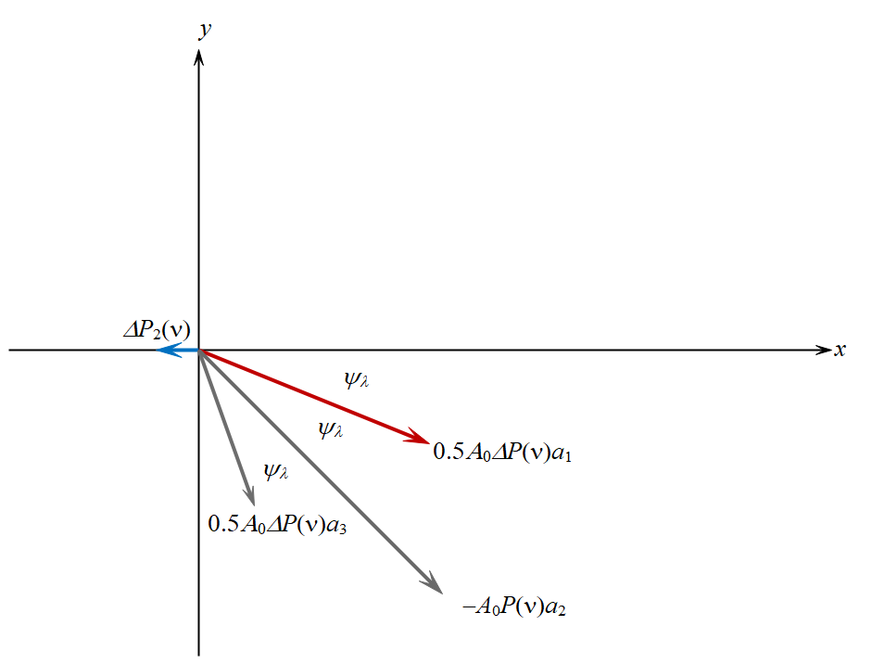
Components of the 2nd Harmonic

Slide 18
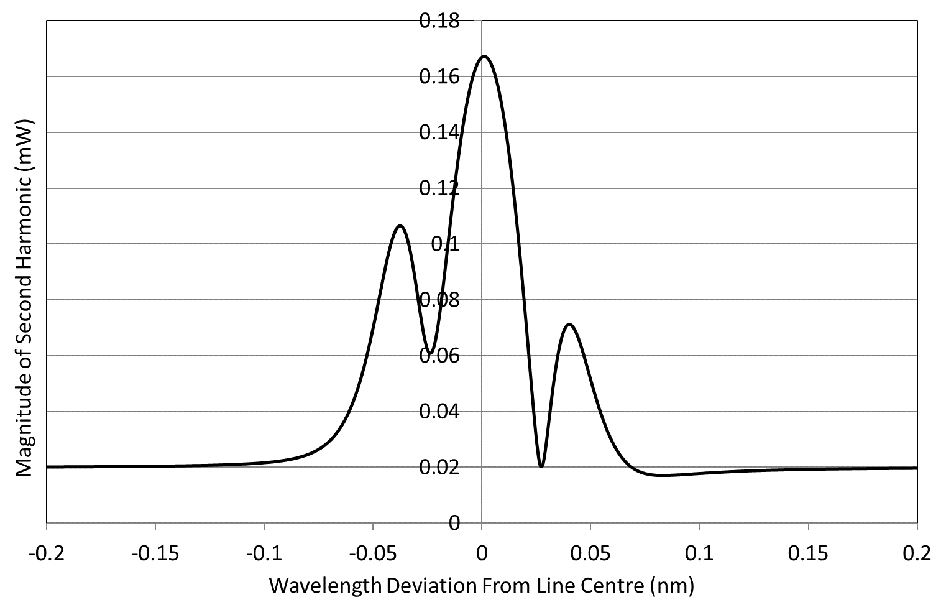
Magnitude of the 2nd Harmonic

Slide 19
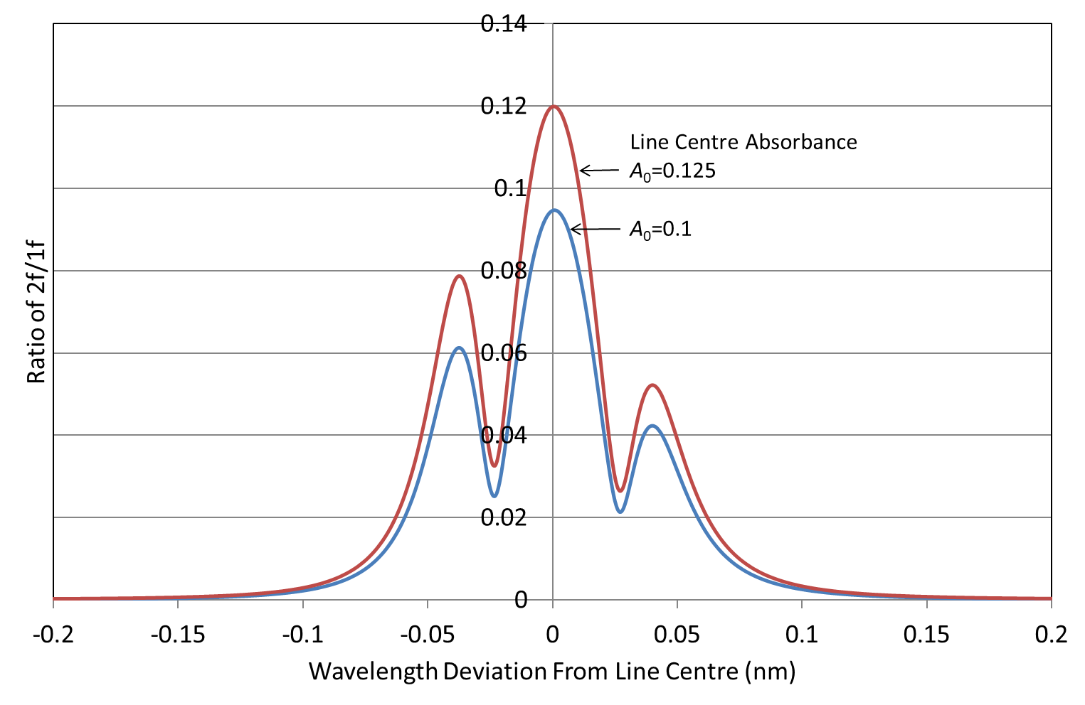
Use of the 2f/1f Ratio for Line-Shape Recovery (effect of absorbance)

Slide 20
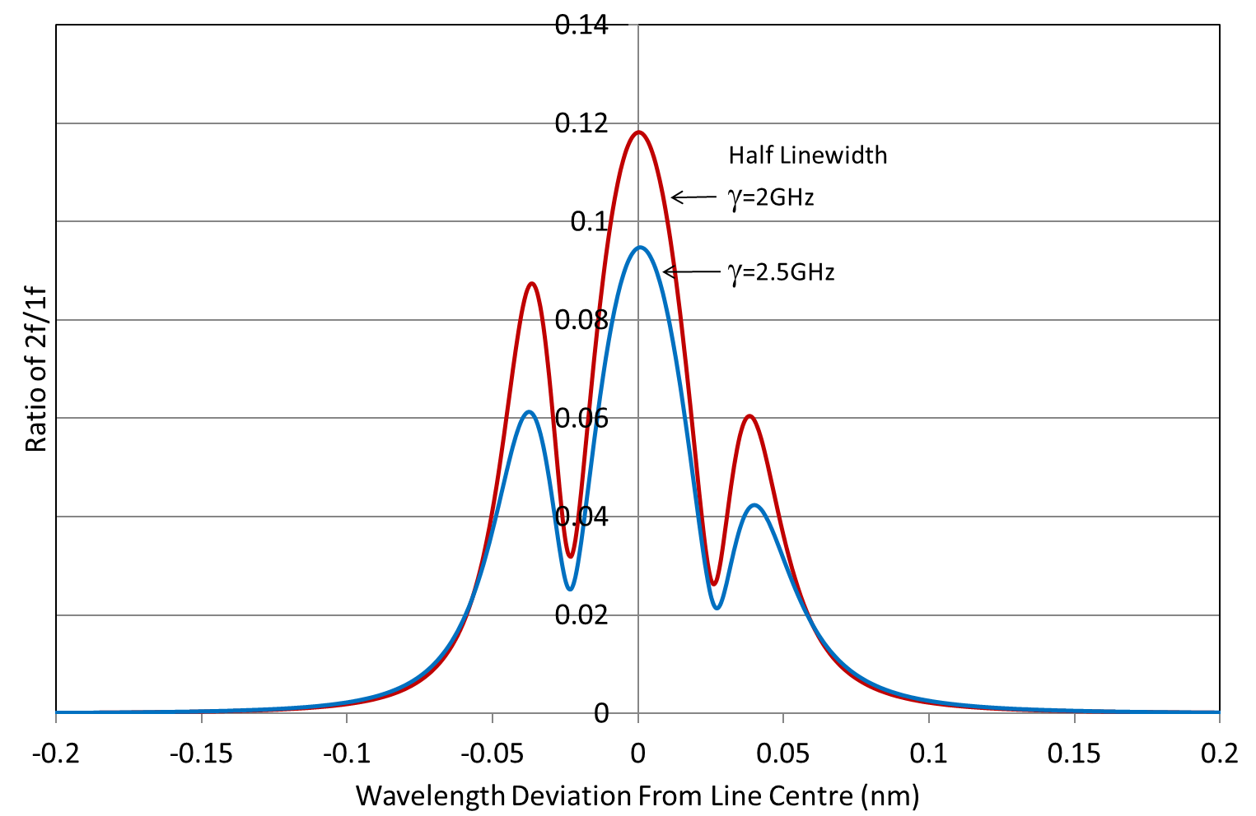
Use of the 2f/1f Ratio for Line-Shape Recovery (effect of linewidth)

Slide 21
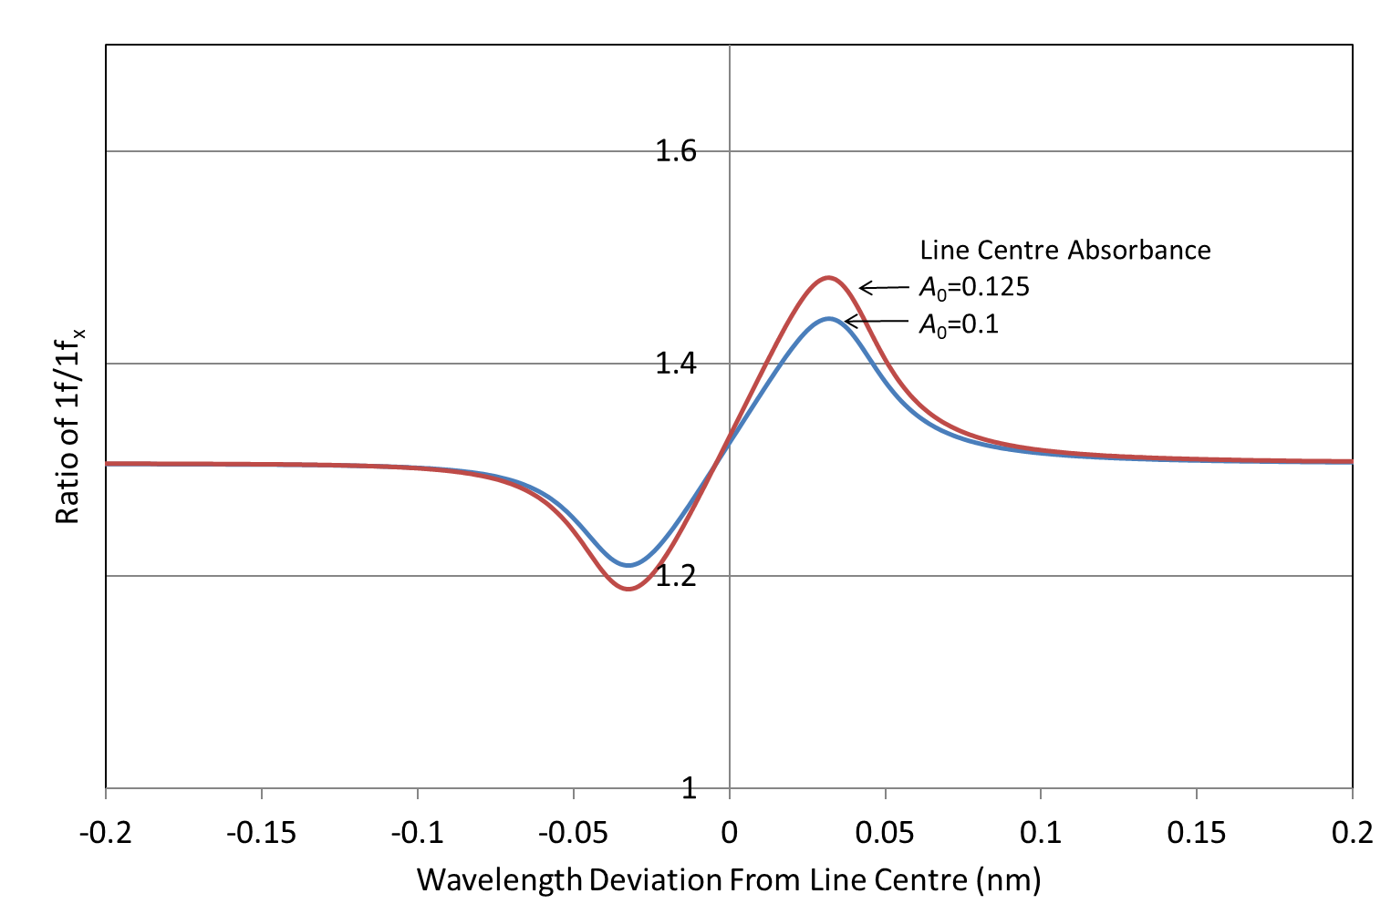
Use of the first harmonic 1f/1f_{x} ratio (effect of absorbance)

Slide 22
Summary & Conclusions
The theoretical harmonic signals that arise with WMS have been derived from first principles.
The first harmonic signal may be used for the recovery of absorption line-shapes but it has a high background level and correction factors (along with background nulling) are necessary for high sensitivity.
Line-shape recovery can be accurately performed through measurement and simulation of the 2f/1f ratio (with good S/N ratio) provided the laser parameters are well-defined.

