Slide 1
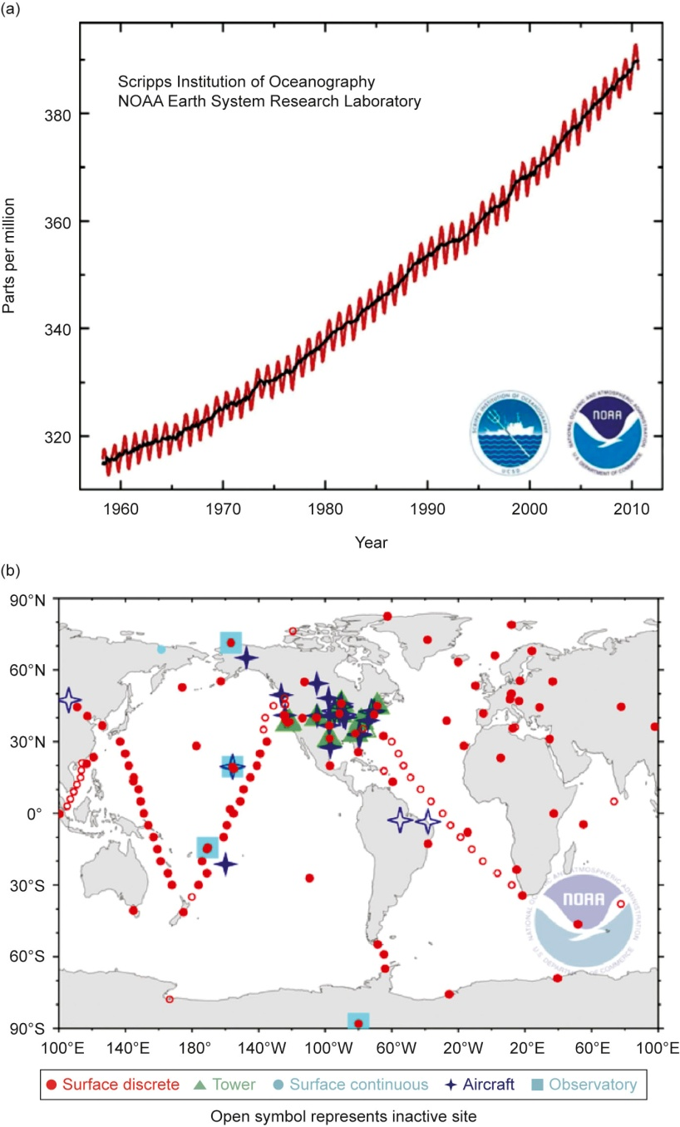
Fig 01_01

Slide 2
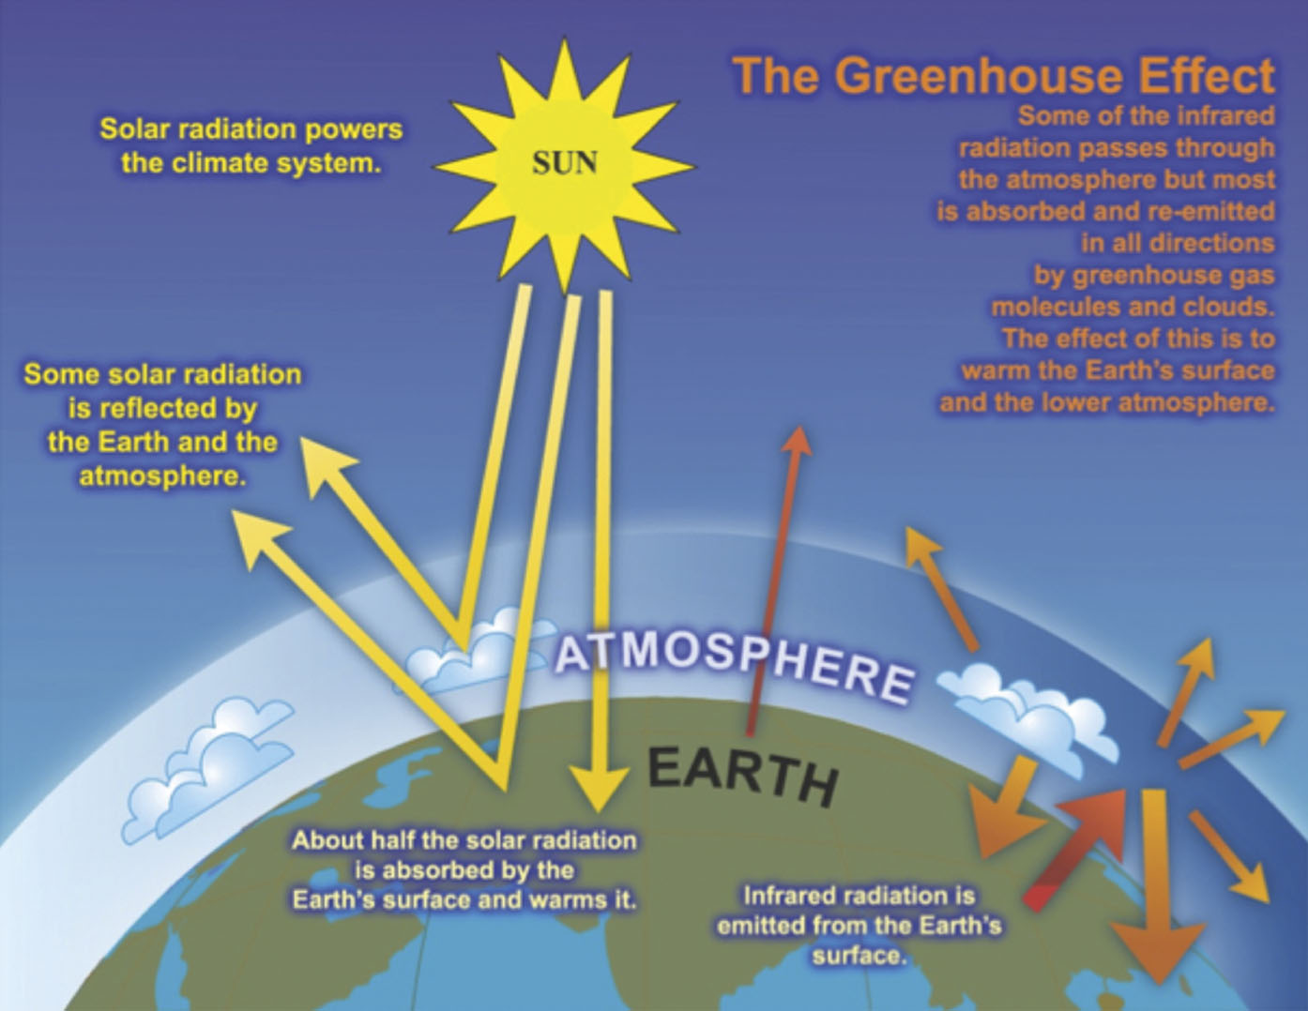
Fig 01_02

Slide 3
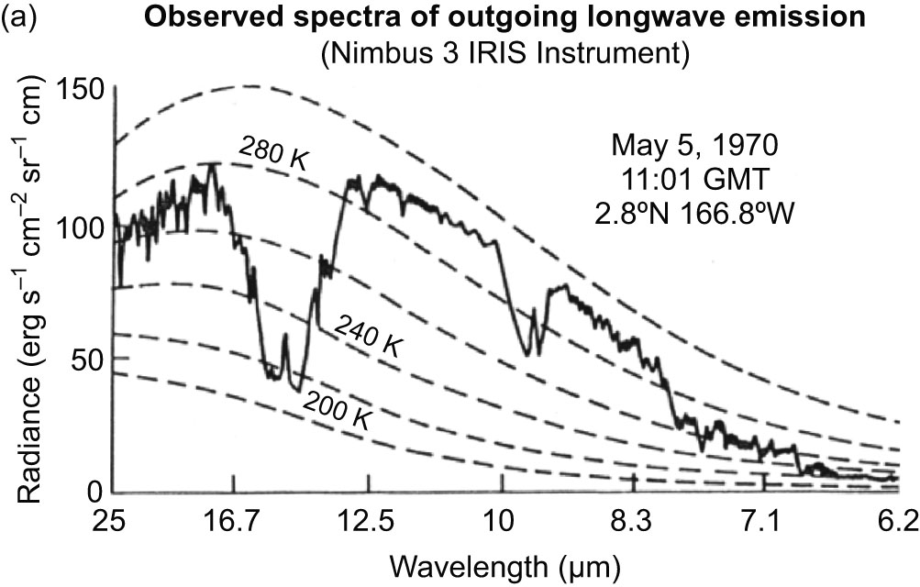
Fig 01_3a

Slide 4
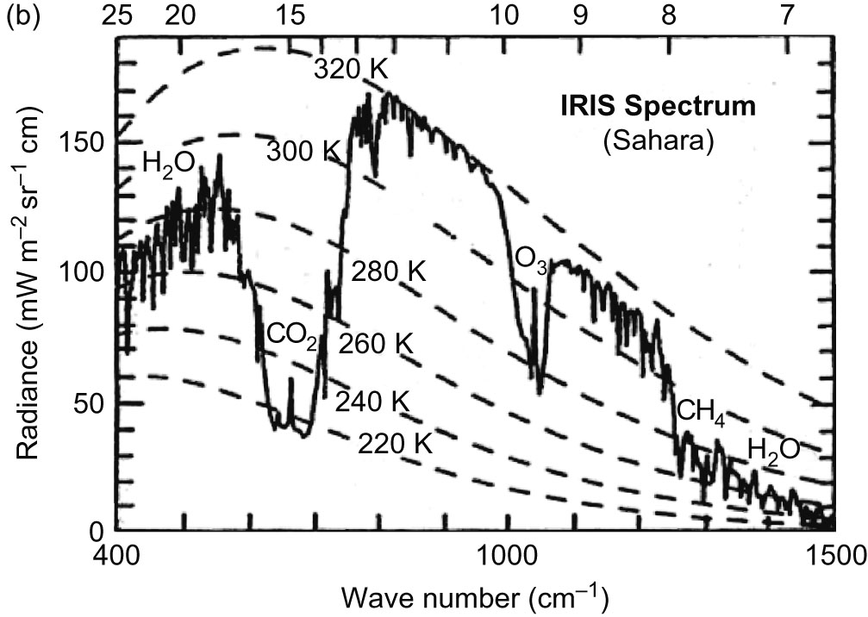
Fig 01_3b

Slide 5
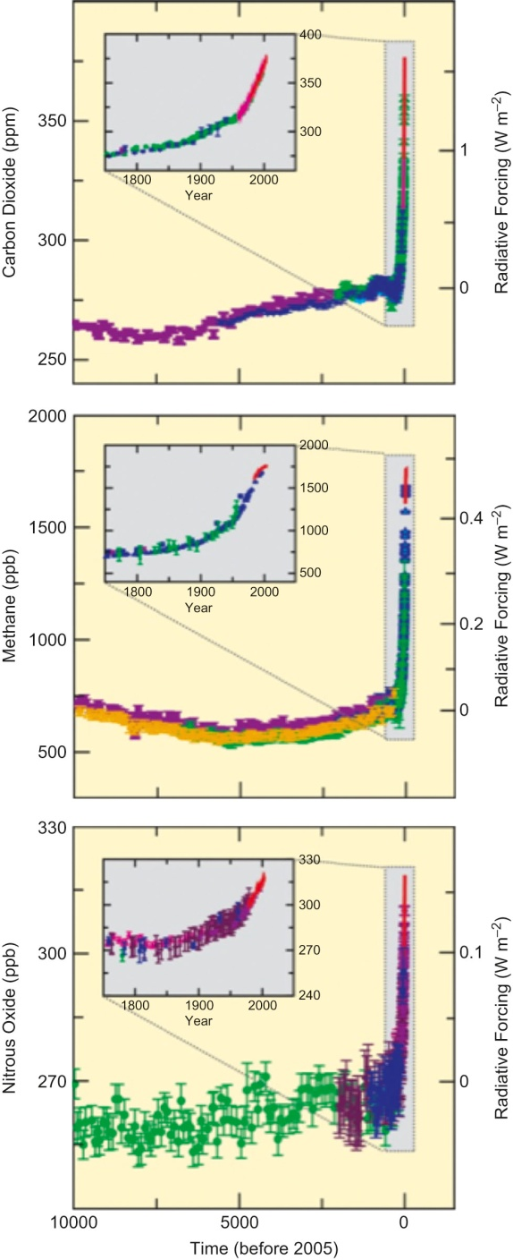
Fig 01_04

Slide 6
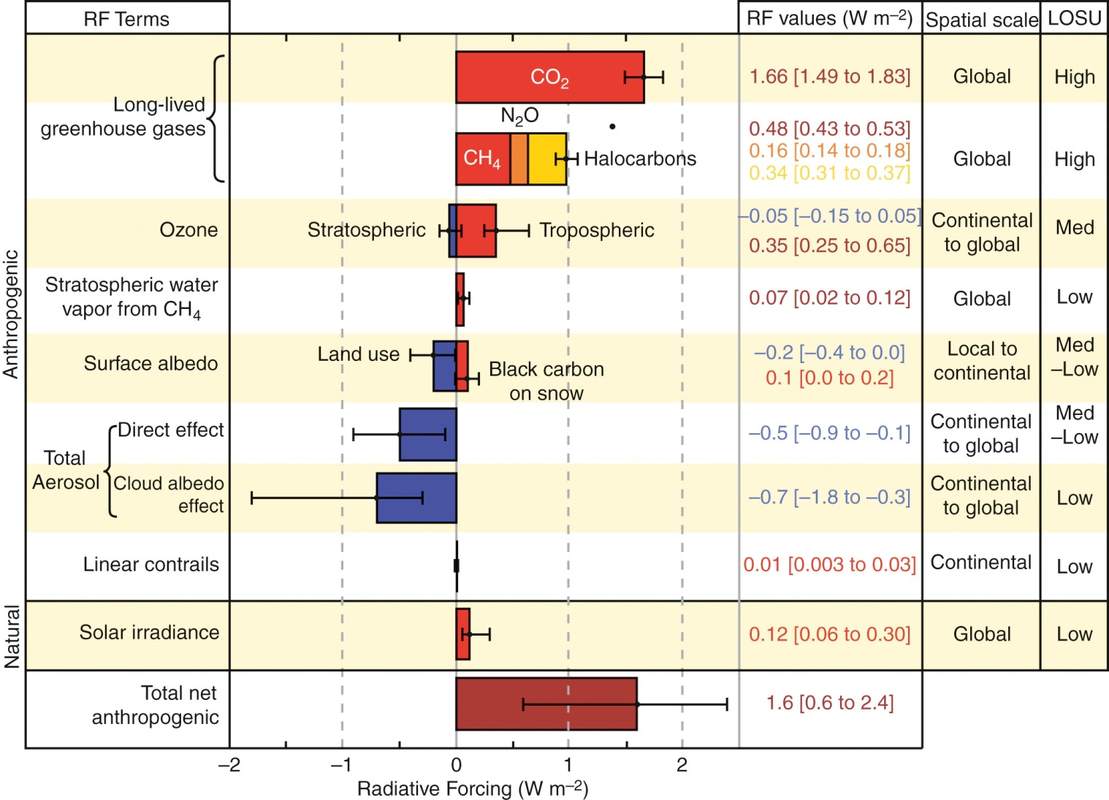
Fig 01_05

Slide 7
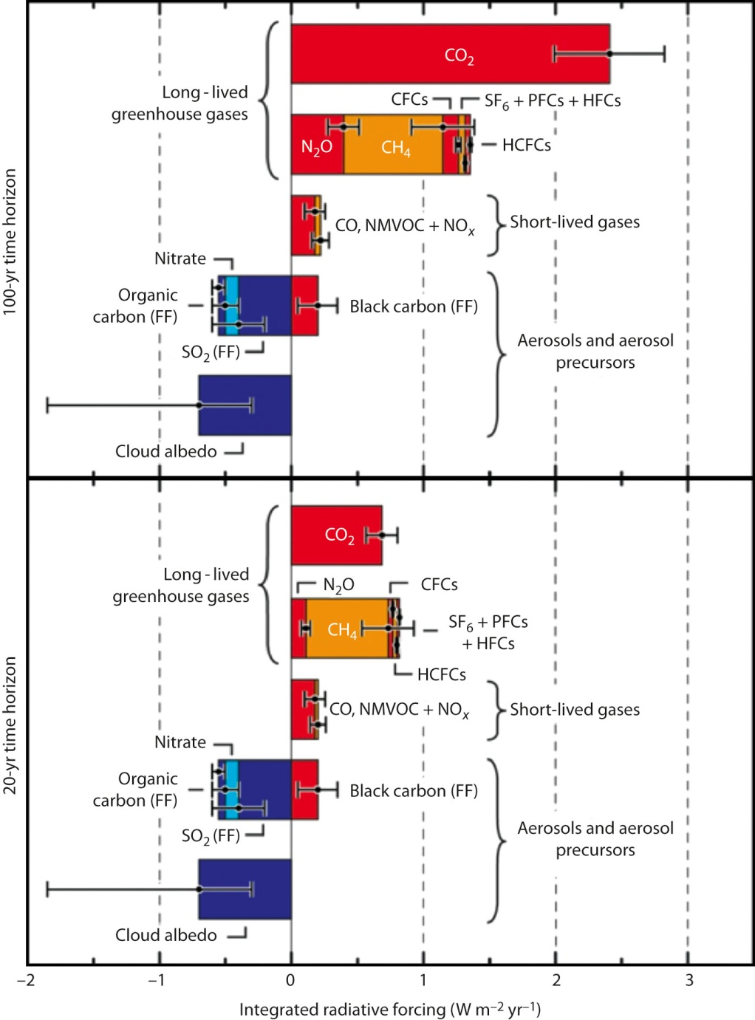
Fig 01_06
© IPCC AR4 WG1

Slide 8
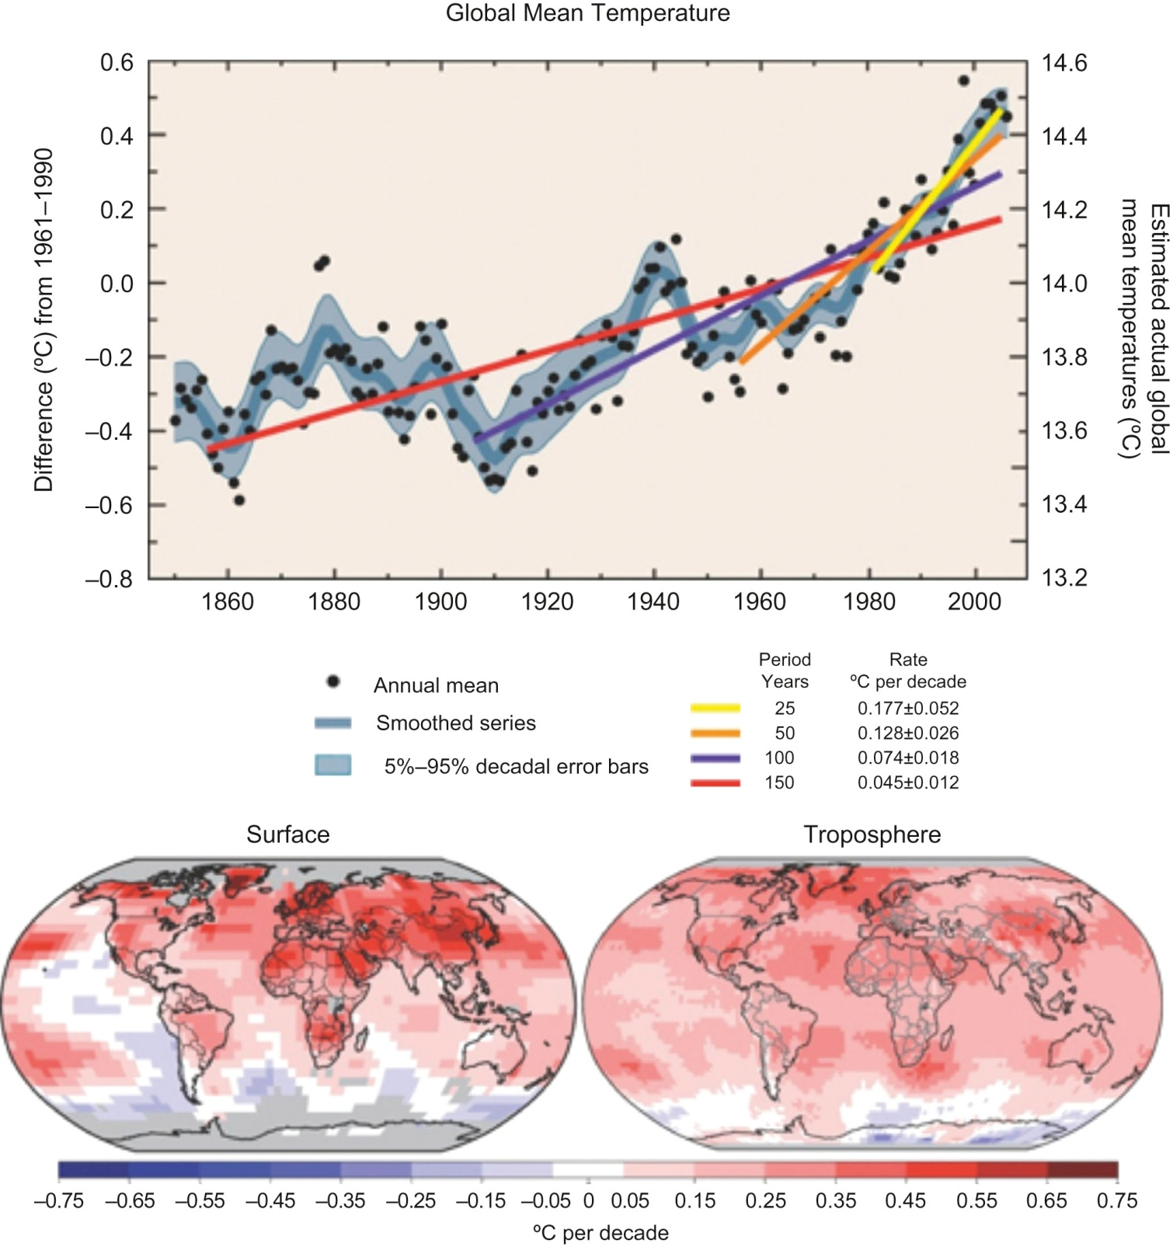
Fig 01_07
© IPCC AR4 WG1

Slide 9
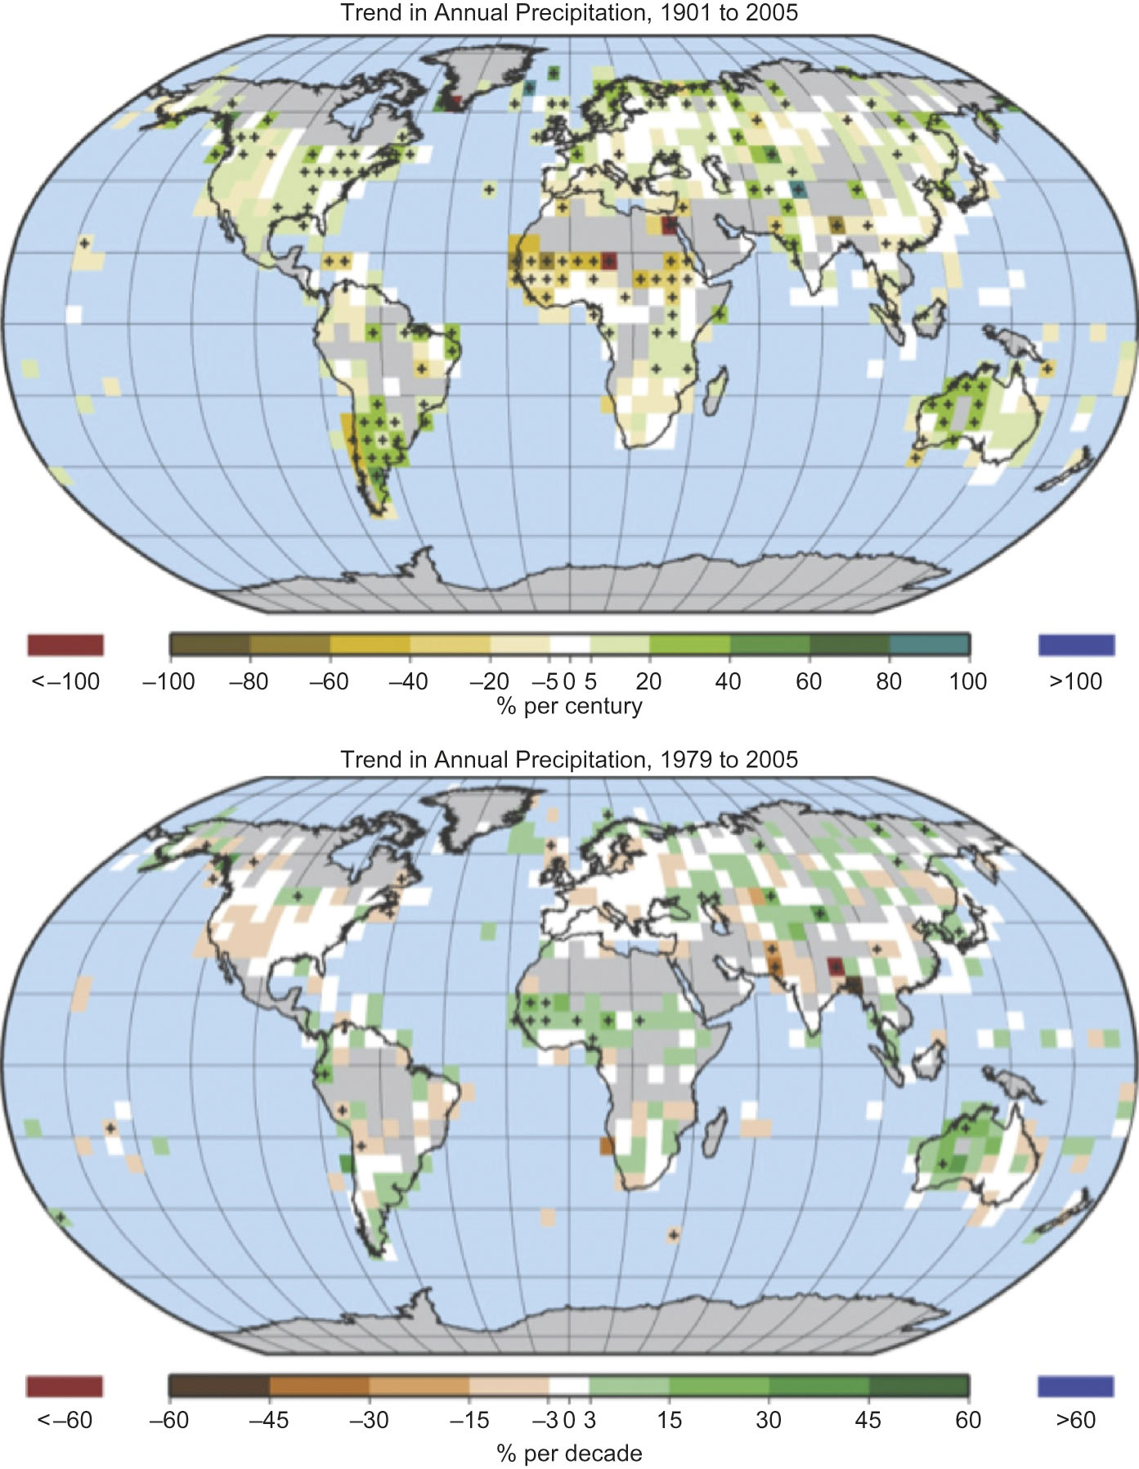
Fig 01_08
© IPCC AR4 WG1

Slide 10
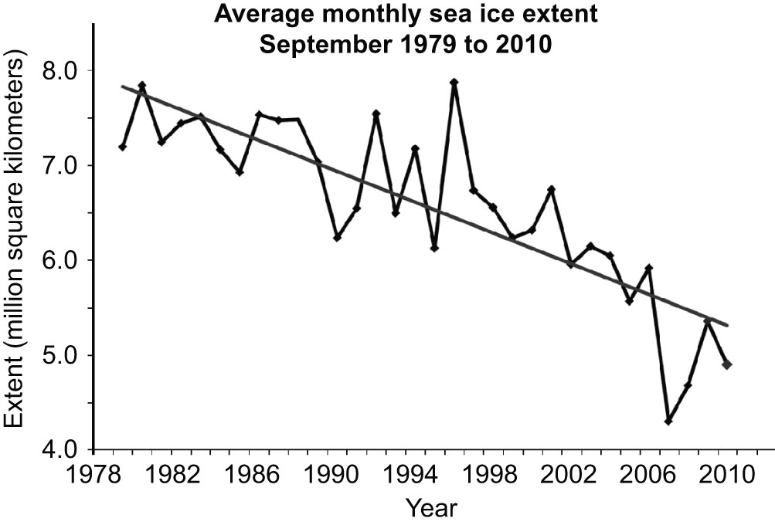
Fig 01_09

Slide 11
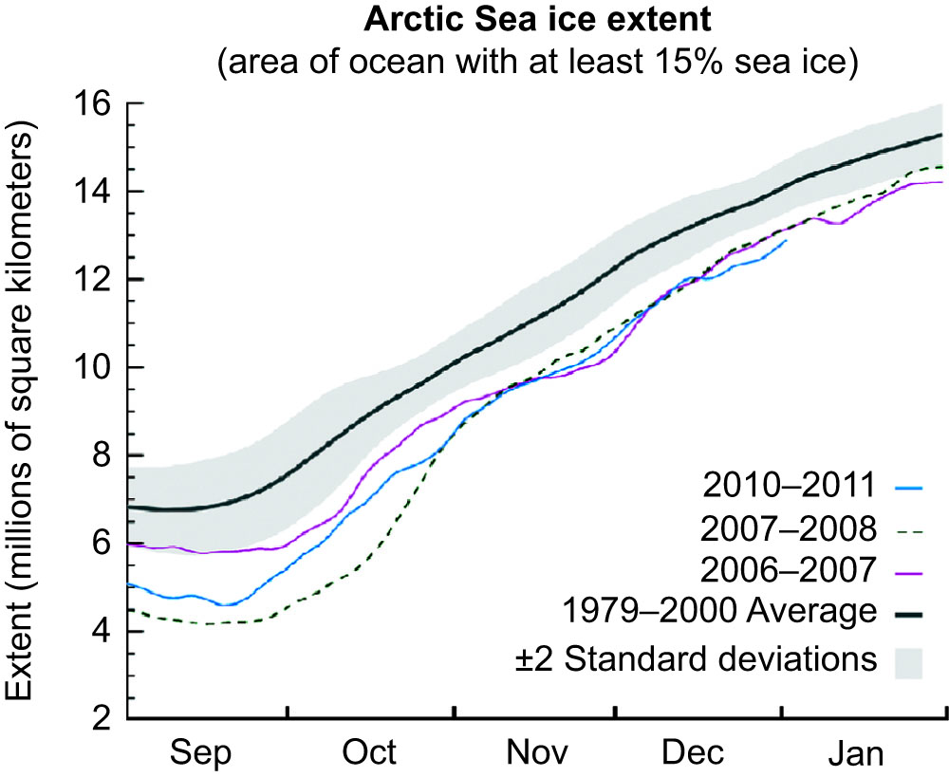
Fig 01_10

Slide 12
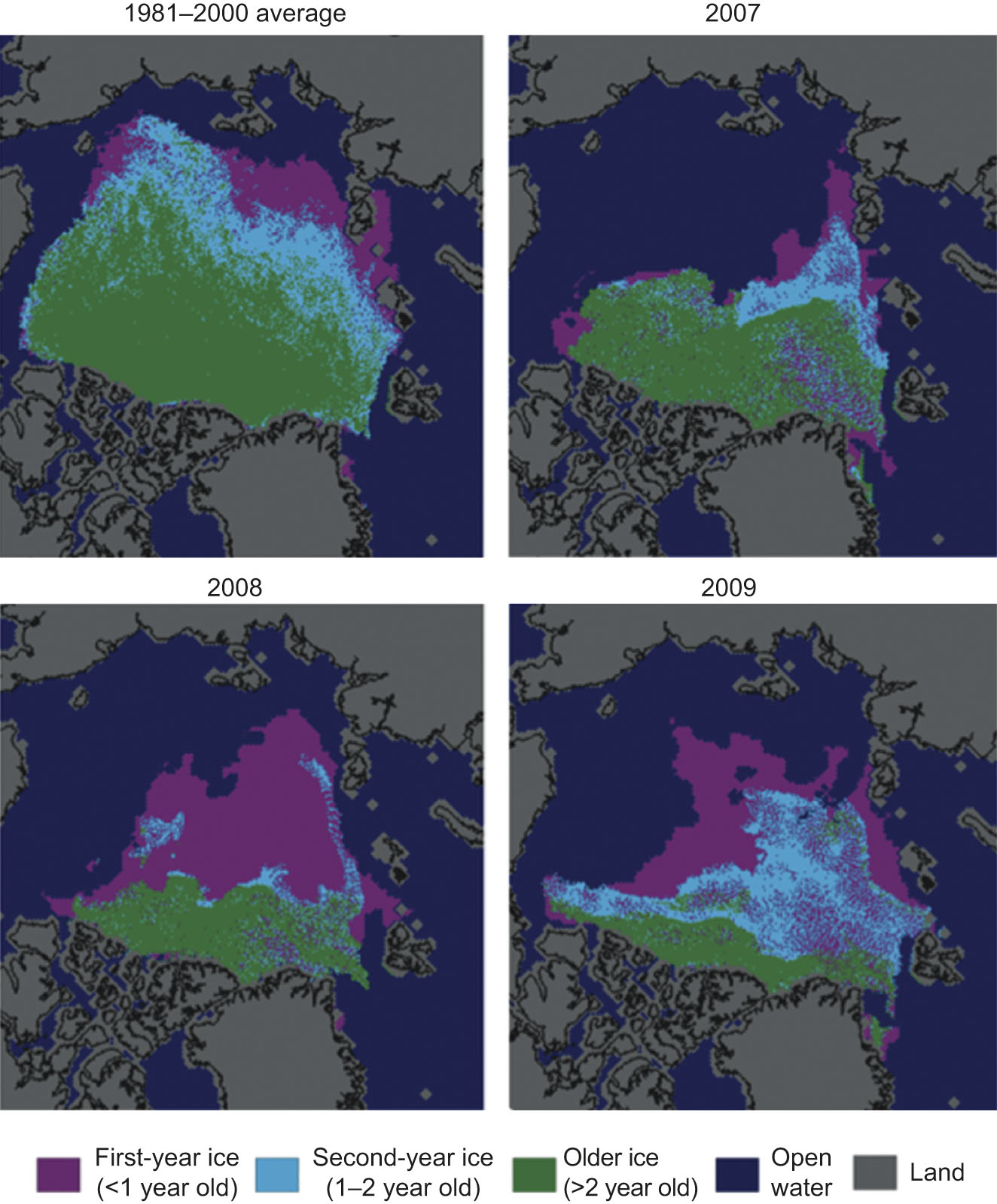
Fig 01_11
© National Snow and Ice Data Centre
courtesy C. Fowler and J. Maslanik, University of Colorado at Boulder

Slide 13
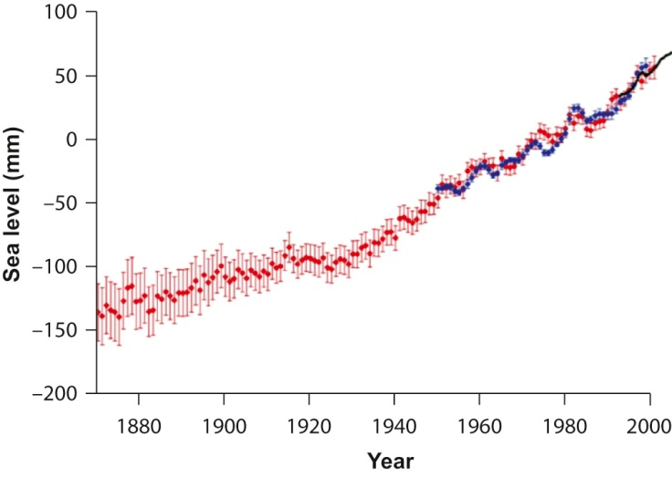
Fig 01_12

Slide 14
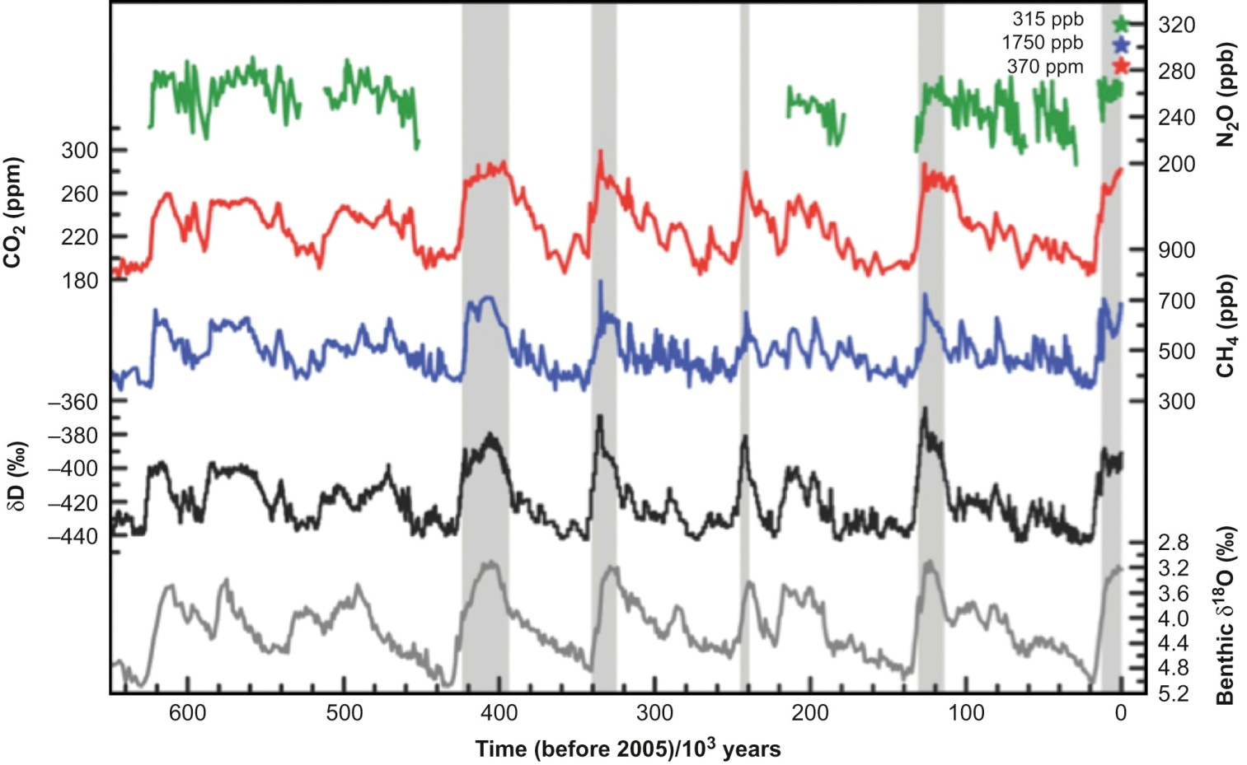
Fig 01_13
© IPCC AR4 WG1

Slide 15
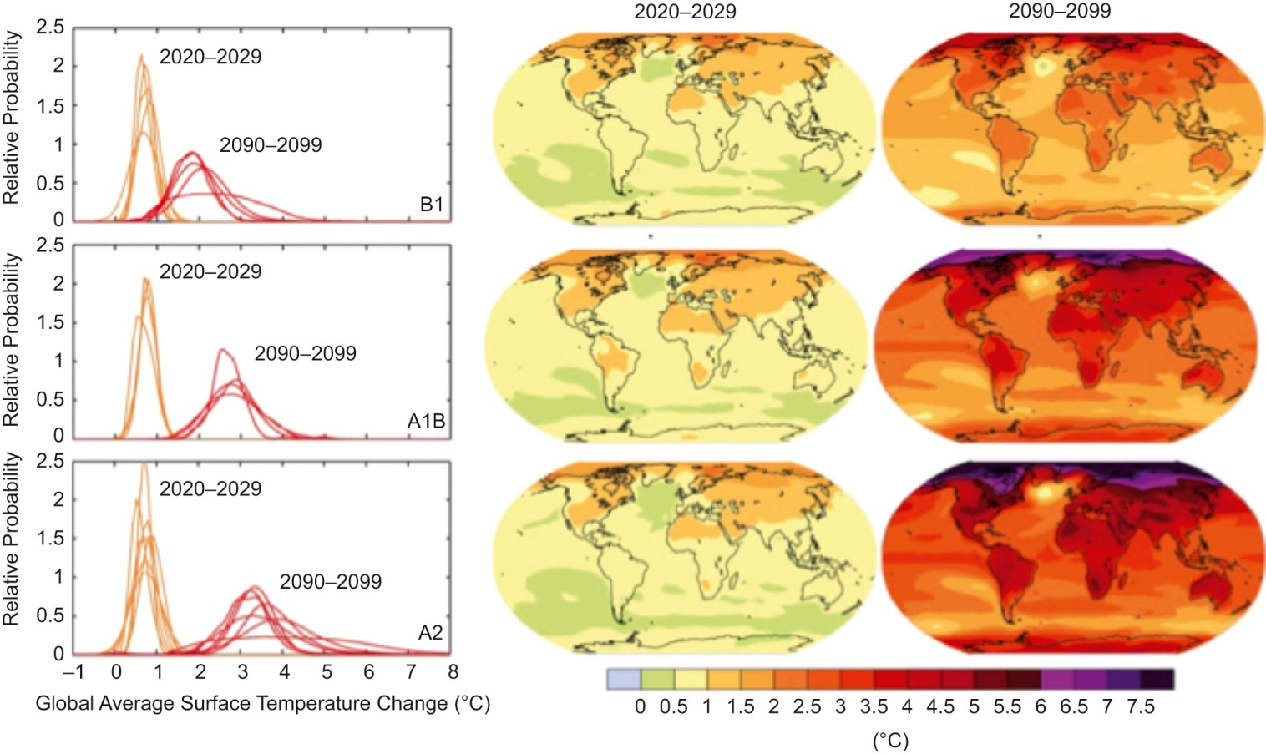
Fig 01_14
© IPCC AR4 WG1

Slide 16
Fig 01_15
© IPCC AR4 WG1

Slide 17
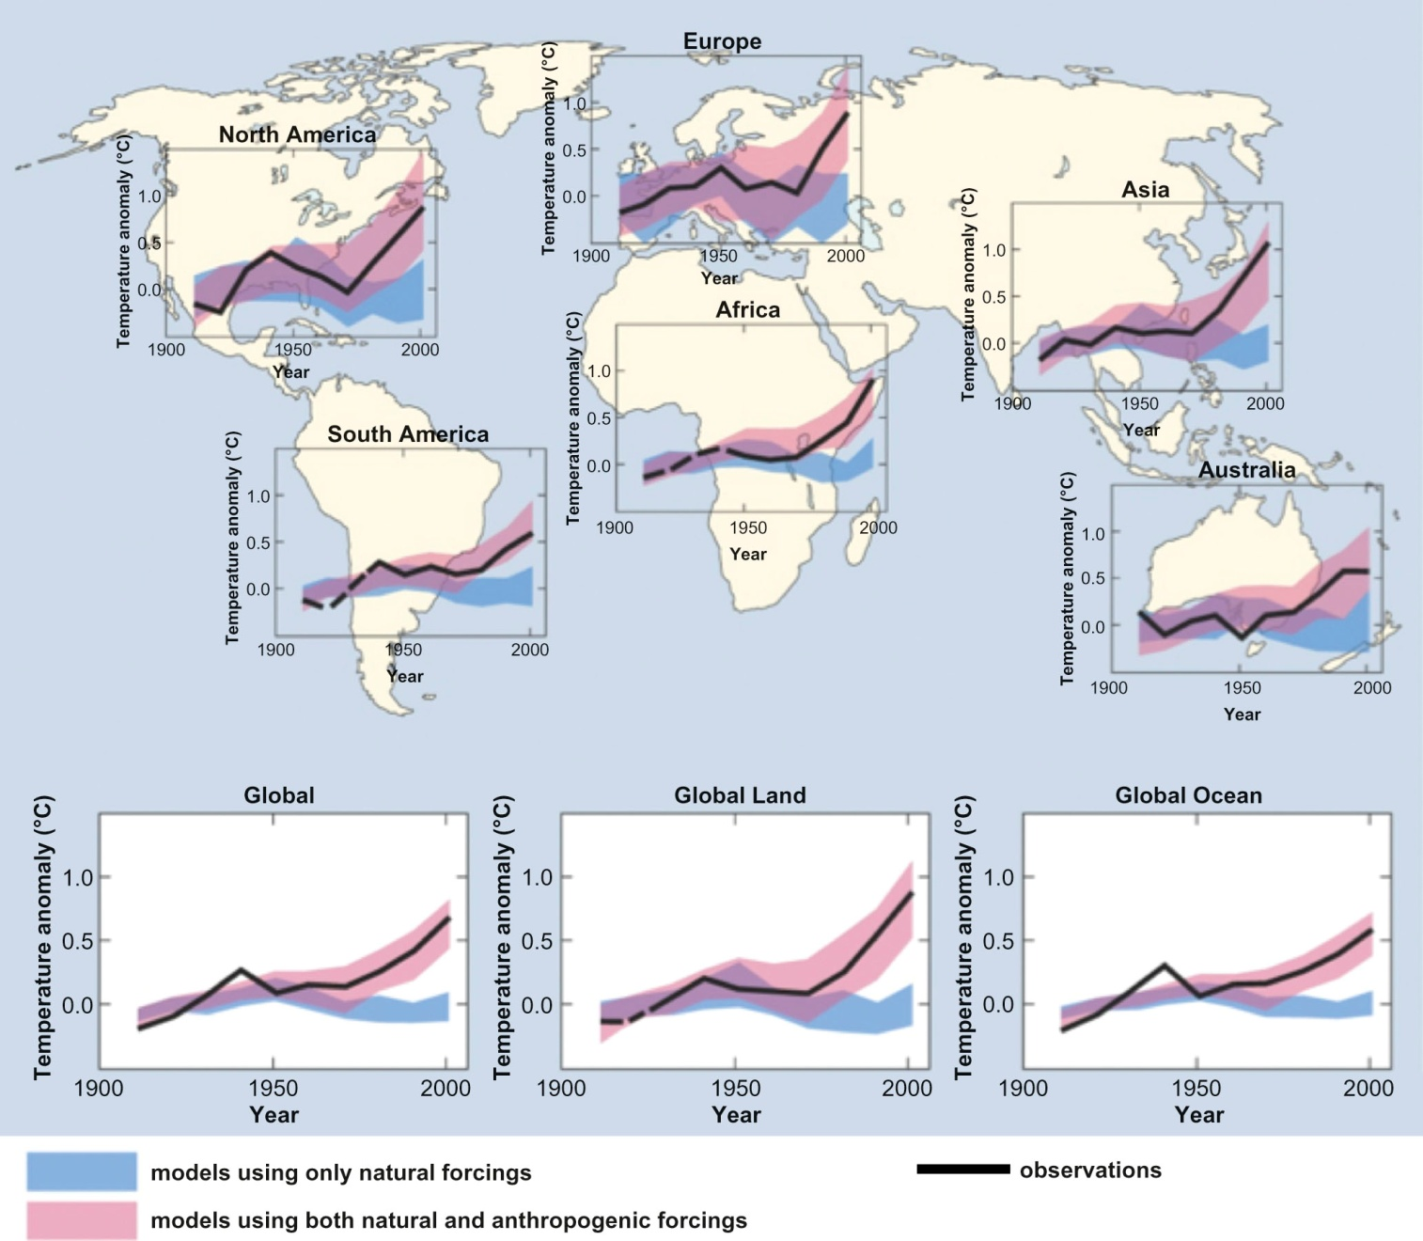
Fig 01_16
© IPCC AR4 WG1

Slide 18
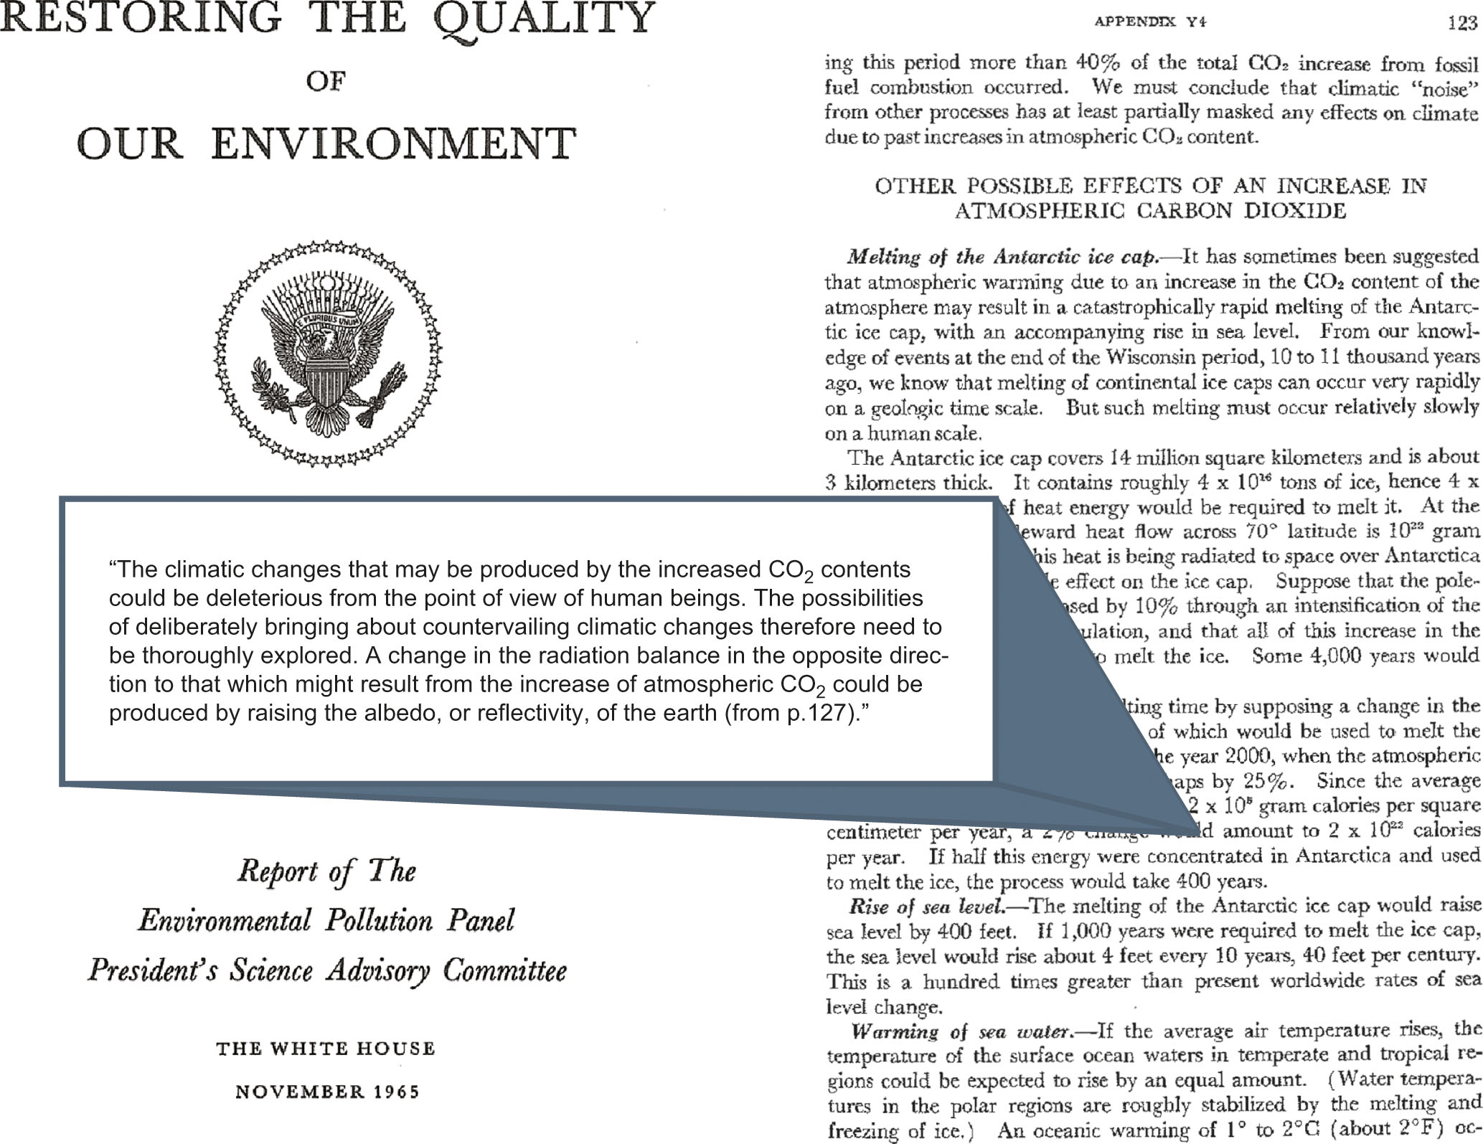
Fig 01_17

